Slide 1
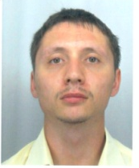
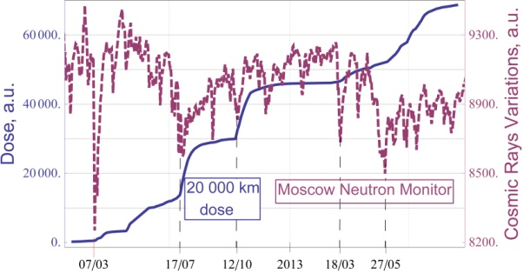
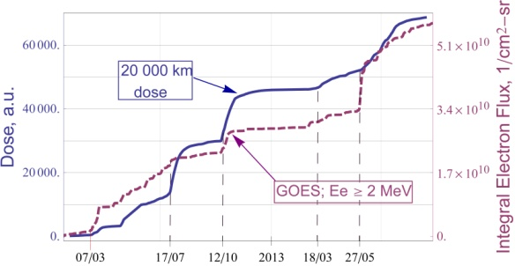
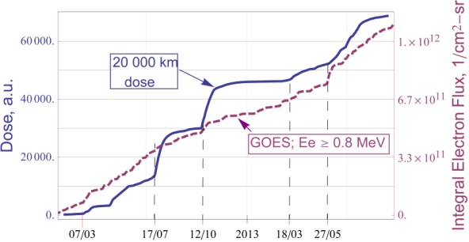
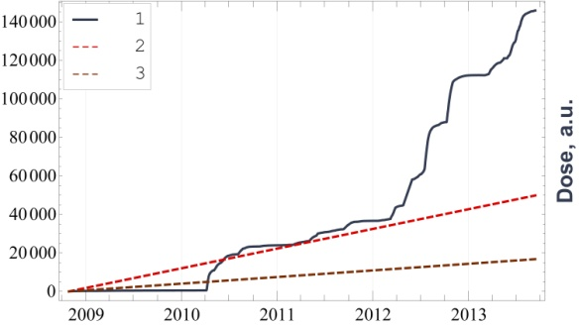
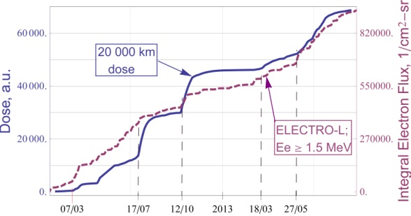
The recent anomalities of space weather characteristics fixed by the Russian Federal Space Agency monitoring system
g.a.protopopov@mail.ru
V. Anashin¹, G. Protopopov¹, I. Elushov¹ S. Balashov², S. Gaidash³, S. Tasenko⁴, P. Shatov⁴
¹Institute of Space Device Engineering (Moscow, Russia); npk1@niikp.org; ²Information Satellite System Reshetnev Company, (Zheleznogorsk, Russia); ³Pushkov institute of terrestrial magnetism, ionosphere and radio wave propagation (IZMIRAN) (Troitsk, Russia); ⁴ Fiodorov Institute of applied geophysics (Moscow, Russia)
ANOMALITIES FIXED BY THE MONITORING SYSTEM
ANALYSIS OF ABNORMAL INCREASE FIXED BY THE MONITORING SYSTEM FOR OTHER SPACE CHARACTERISTICS
The Russian Federal Space Agency space radiation exposure on electronic components Monitoring System elements operates successfully.
38 TID sensors operate on board of 19 spacecrafts in circular MEO (Middle Earth Orbit) ~20000 km with inclination of ~65º.
Fig.1. Flight data for one TID sensor in MEO and cosmic rays variations ground-level measurements (Moscow Neutron Monitor) from January 2012 to September 2013.
Date | Dose Rate Increase (TID sensor measurements) | Geomagnetic Storms (Kp Index) | Solar X-Ray Flares | Solar Radiation Storms (Ep>10 MeV, 1/(сm²-day-sr))
7.03.2012 | ~50 times | Severe (Kp=8) | 2 X | Extreme (6.1 ∙10⁶)
17.07.2012 | 9 times | Strong (Kp=7) | 1 M | None
12.10.2012 | 9 times | Severe | None | None
18.03.2013 | ~8 times | Strong | None | None
27.05.2013 | 5 times | Strong | None | Extreme (5.2 ∙10⁵)
Dates of accumulated dose abnormal increasing in MEO correlates with ground-level cosmic rays decreasing dates.
Fig.2. Flight data for one TID sensor in MEO and electron integral fluence (E ≥ 2 MeV) in GEO from January 2012 to September 2013.
Correlation coefficient from January 2012 to September 2013 is: 0.953.
Dates of accumulated dose abnormal increasing in MEO correlates with sudden electron with Е ≥ 2 MeV increasing dates.
COMPARISON OF
EXPERIMENTAL AND CALCULATED ACCUMULATED DOSE VALUES
Fig.3. Flight data for one TID sensor in MEO and electron integral fluence (E ≥ 0.8 MeV) from January 2012 to September 2013.
Correlation coefficient from January 2012 to September 2013 is: 0.976.
Fig.4. Flight data for one TID sensor in MEO and ELECTRO (GEO) electron integral flux with E ≥ 1.5 MeV from January 2012 to September 2013.
Correlation coefficient from January 2012 to September 2013 is: 0.98.
Fig.5. Comparison of experimental (1) and calculated accumulated dose values: 2 - AE8, Nymmik model, half-plane shielding, 3 – DSG calculation [1] considering shielding chemical properties.
Dates of accumulated dose abnormal increasing in MEO correlates with the dates of sudden electron increasing with Е≥1.5 MeV.
There are long (more than a year) curved lines, where experimental and calculated dose rate values vary significantly.
Since electrons contribute primarily to the accumulated dose value in MEO the main reason for these differences is AE8 model imperfections. There are plans to compare experimental and calculated data by using AE9 model.
Sensitive volume shielding of TID sensor stops electrons with energy up to 1-1.2 MeV, according to DSG calculations [1], based on GEANT4.
High-energy electron impact contributes mainly to the accumulated dose value (E≥0.8-1.5 MeV) and its abnormal increasing (E≥1.5 MeV) in MEO.
Abrupt dose rate increasing can be explained by the electron fluence increasing in MEO followed by the Van Allen Belts compression during geomagnetic storms.
SUMMARY
The space radiation exposure on electronic components Russian Federal Space Agency Monitoring System elements were developed and operates successfully. Monitoring System provides correct detection of space weather characteristics anomalous dose rate increasing. These increasing can be explained by the electron fluence increasing caused by Van Allen Belts compression. The AE8 space model updating is required.
REFERENCES
[1] V.S. Anashin, V. V. Emeliyanov, I. O. Ishutin, N. V. Kuznetsov, G. A. Protopopov, G. I. Zebrev “The software complex for SEU rate and radiation dose calculation”, The conference on Radiation and its Effects on Components and Systems, Langenfeld, Austria, 20-24 September 2010, RADECS 2010 – Technical Program, PG3

