Slide 1



ESWW10 Session 13
Cosmic Ray Detectors
Establishing a Space Weather Service based upon Neutron Monitors for the ESA SSA Program
H. Mavromichalaki¹, A. Papaioannou^{1,*}, G. Souvatzoglou^{1,2},
J. Dimitroulakos², P. Paschalis¹, M. Gerontidou¹, C. Sarlanis²
¹Nuclear & Particle Physics Section, Physics Department
National & Kapodistrian University of Athens
²ISNET Co, Athens
* also at IAASARS, National Observatory of Athens
ESWW10 Session 13 ,Cosmic Ray Detectors
Antwerp | 22.11.2013

Slide 2
Outline
Neutron Monitors Worldwide Network / Global distribution
Neutron Monitor Database (NMDB) The ESA SSA SWE Segment Goals of the European Neutron Monitor Service Architecture of the service Multi-station NM data Ground Level Enhancement (GLE) Alert Plus
ESWW10 Session 13 ,Cosmic Ray Detectors
Antwerp | 22.11.2013
Notes:
A brief introduction to NMs, their Global distribution and to the establishment of the recent Neutron monitor database (NMDB)
Further to that we will discuss the Motivation of the NM Service, its architecture and the two products that constitute this service: the multi-station data abd the new GLE alert, GLE Alert +

Slide 3
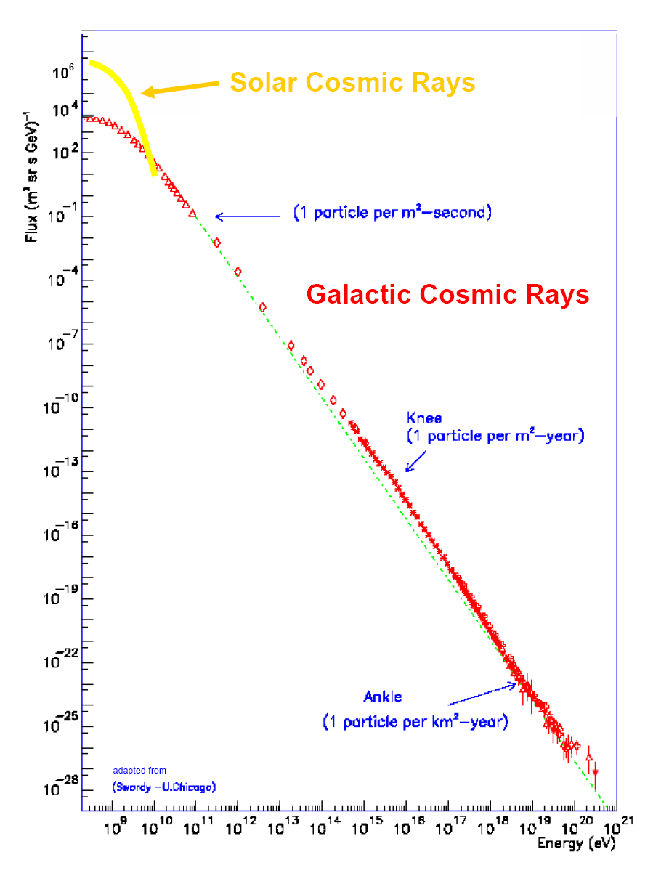
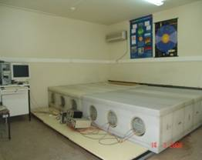
Neutron Monitors
Neutron monitors: 500 MeV – 20 GeV
- cover a small fraction of the CR energy spectrum
But cover an energy region that:
- includes solar modulation of GCRs
- contains sporadic solar cosmic rays
Are the prime instruments for CR research in the low GeV region
Have the longest series of CR measurements in history (since 1956-1957)
Flueckiger, 2009
ESWW10 Session 13 ,Cosmic Ray Detectors
Antwerp | 22.11.2013

Slide 4
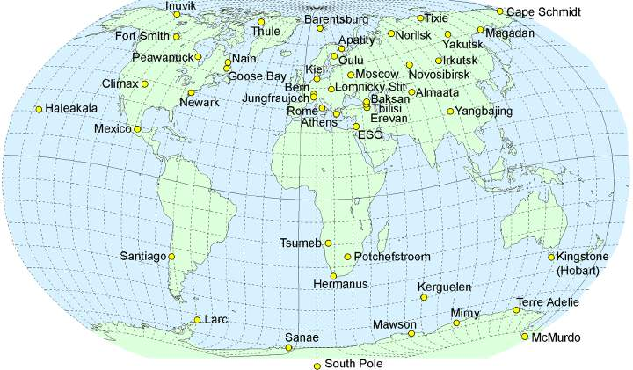
Worldwide distribution of Neutron Monitors
Rigidity Cut-off
Energy Cut-off
The world-wide network of NM detectors is essential for forecasting / now-casting work.
Figures credit: http://nmdb.eu
Storini., 2006
ESWW10 Session 13 ,Cosmic Ray Detectors
Antwerp | 22.11.2013
Notes:
low rigidity cutoff (or low energy cutoff), below which particles coming from the Universe cannot reach the atmosphere above the neutron monitor,
a narrow cone of viewing directions, within which the primary cosmic rays must impinge on the magnetosphere in order to reach the neutron monitor
Because of these specificities, a network of neutron monitor stations located at different geographical positions is necessary to characterise the flux of charged particles arriving at the magnetosphere, both in arrival direction and as a function of rigidity or energy.
The combination of the worldwide network of neutron monitors with the Earth's atmosphere and magnetosphere can be considered as a unique instrument with directional resolution and energy resolution.
This is why neutron monitors have been historically conceived with a standard design.
The use of all stations as a unified multidirectional detector also makes the accuracy substantially higher (< 0.1% for hourly data) than for a single instrument.
The above map shows the distribution of neutron monitors around the world.

Slide 5
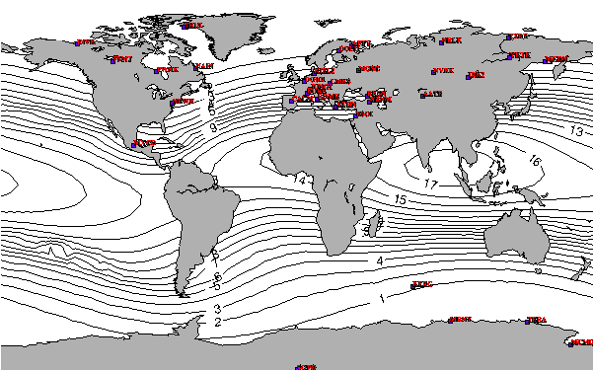
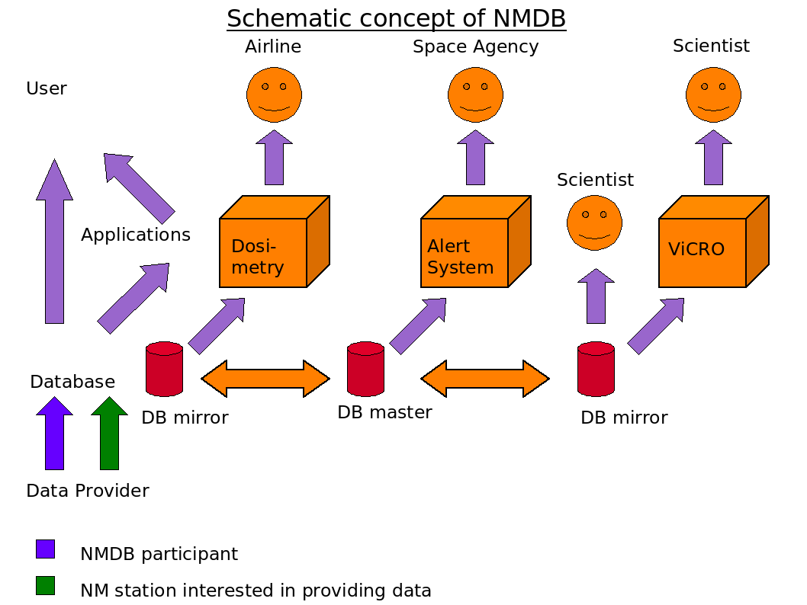

Neutron Monitor Database (NMDB)
Moscow
Kiel
Athens
http://www.nmdb.eu
single easy-to-use point of access for NM data
45 stations
~26 in quasi real-time mode
R. Butikofer, this Session
C.T. Steigies, this Conference
The NMDB map is courtesy of Dr C.T. Steigies
ESWW10 Session 13 ,Cosmic Ray Detectors
Antwerp | 22.11.2013
Notes:
NMDB was initiated in 2008 and currently is the single easy-to-use point of access for NM data. Its basic design shows that apart from the master Server which is operated in Kiel, there are two mirror databases operated at Moscow and Athens.

Slide 6
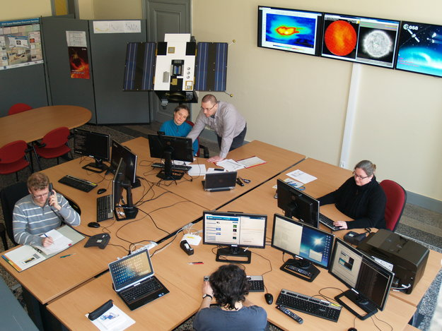
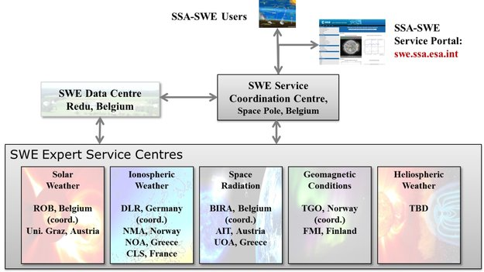
The ESA Space Situational Awareness (SSA)
The SSA Space Weather (SWE) Segment
SSCC - In Operation
Figures credit: http://spaceinimages.esa.int
ESWW10 Session 13 ,Cosmic Ray Detectors
Antwerp | 22.11.2013

Slide 7
The European Neutron Monitor Service
This is a scientific research pilot project during which the Neutron Monitor Service will be established, tested and validated
Products of the ENM Service
Multi-station
NM data
GLE Alert
Provide
data from as many NMs as possible
Provide timely GLE alerts of large SEPs/GLEs
ESWW10 Session 13 ,Cosmic Ray Detectors
Antwerp | 22.11.2013

Slide 8
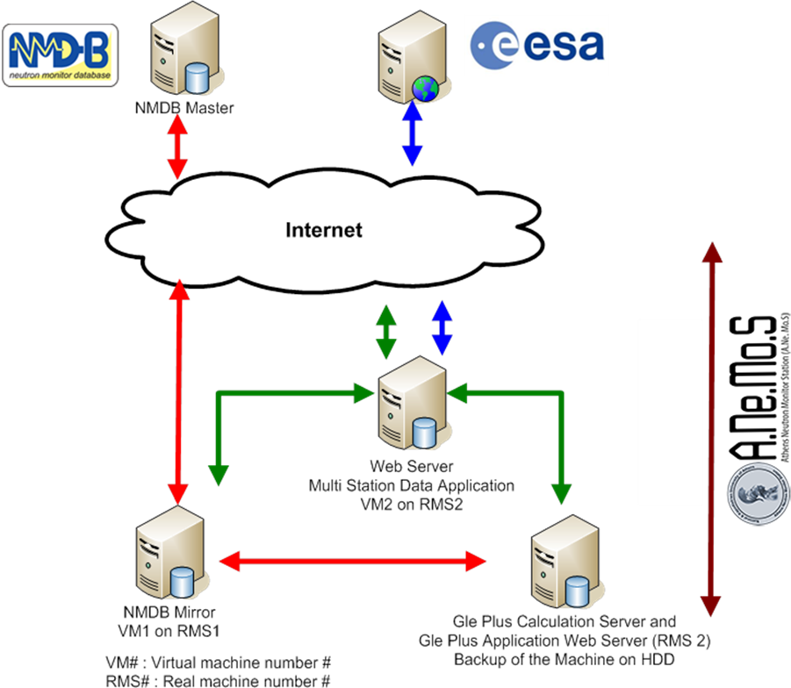
Architecture of the NM Service
Architecture:
Red : Communication with NMDB. Data used for the GLE Alert Process. The GLE Calculation Server receives data from the Athens NMDB Mirror and executes calculations in order to produce the GLE Alert signal
Green: Inter-Athens Station communication. The central point is the Web-Server which communicated both with the NMDB mirror and the GLE Alert Server. It also provides the sharing point to the World Wide Web
Blue: Specific portal for ESA
ESWW10 Session 13 ,Cosmic Ray Detectors
Antwerp | 22.11.2013

Slide 9
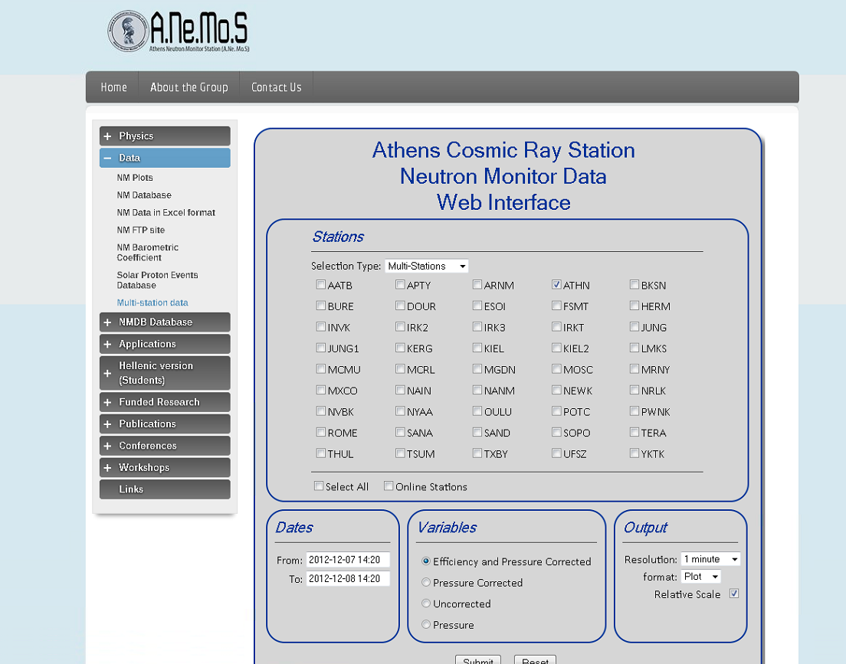
Provision of Multi-station NM data
Multi-variables
Pressure
Corrected
Un-corrected
Multi-stations
One variable (see above) for multi-stations
ESWW10 Session 13 ,Cosmic Ray Detectors
Antwerp | 22.11.2013

Slide 10
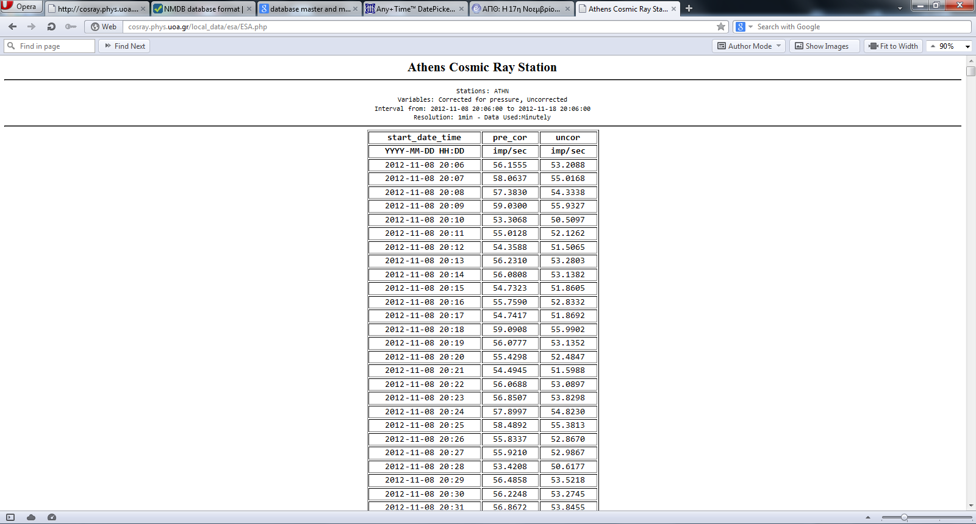
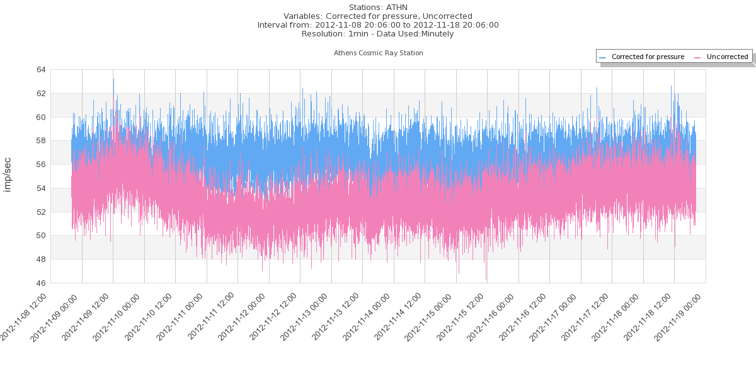
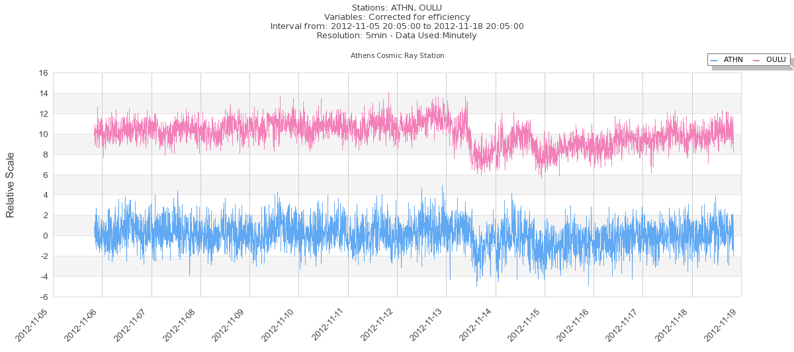
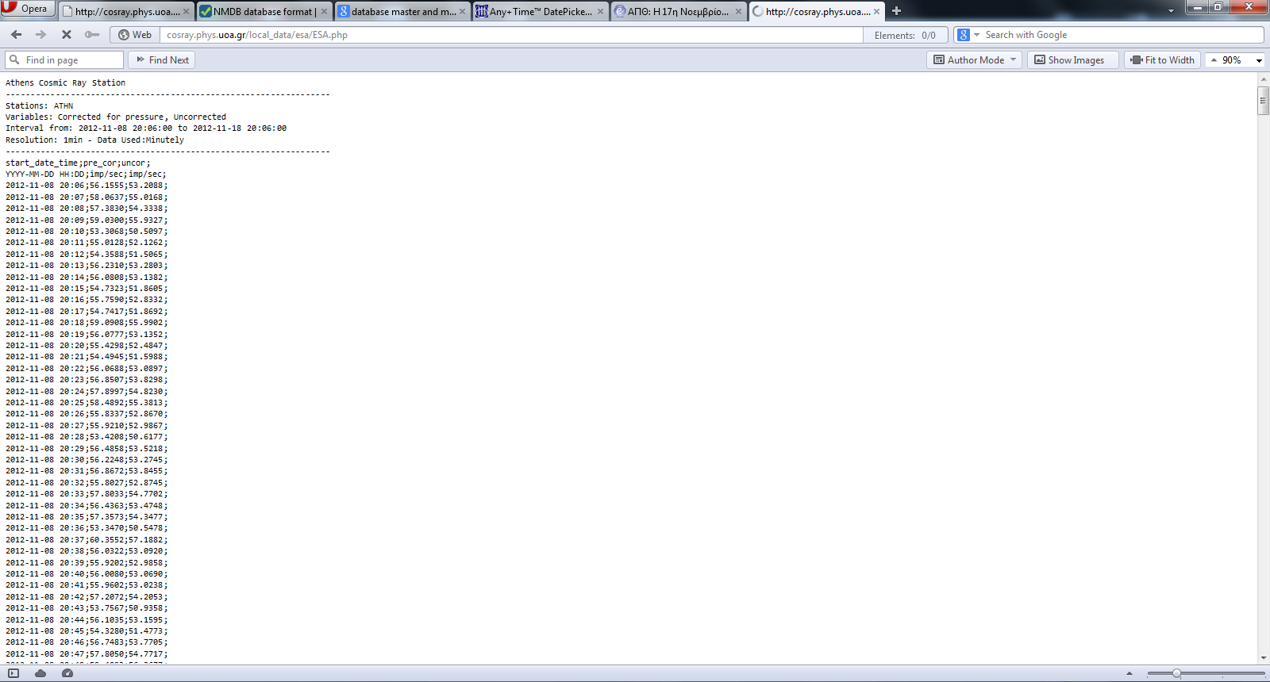
Provision of Multi-station NM data
Selection of the output resolution
Three types of output (Plot – ASCII – File)
ESWW10 Session 13 ,Cosmic Ray Detectors
Antwerp | 22.11.2013

Slide 11
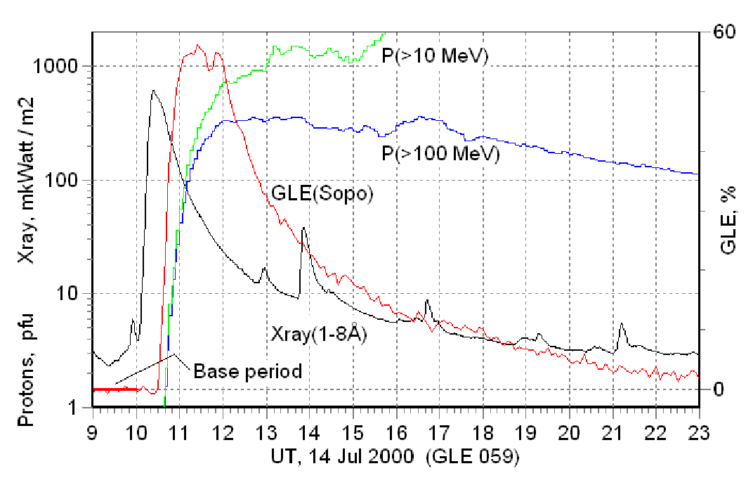
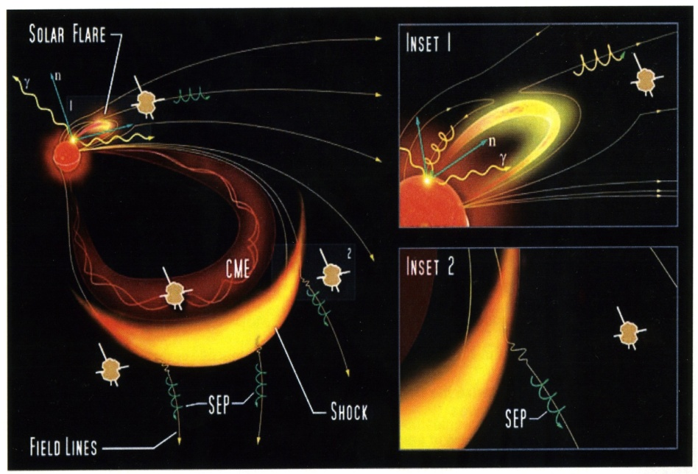
GLE Alert: Physical Concept
Solar Energetic Particles (SEPs) are transient particle enhancements generated by solar activity regularly detected in space and (sometimes) at Earth as Ground Level Enhancements (GLEs)
- Particle energies involved from hundreds of keVs up to a few GeVs
- Two principal sources of energetic particles:
- a flare (inset 1)
- a CME-driven shock (inset 2)
both responsible of the accelerated particles
that propagate along the IMF lines and reach the observer (for GLEs that is Earth )
Figure credit: Anashin et al., 2009
Rodriguez-Gasen et al., 2013
Figure credit: Sentinels mission; Rodriguez-Gasen et al., 2013
ESWW10 Session 13 ,Cosmic Ray Detectors
Antwerp | 22.11.2013

Slide 12
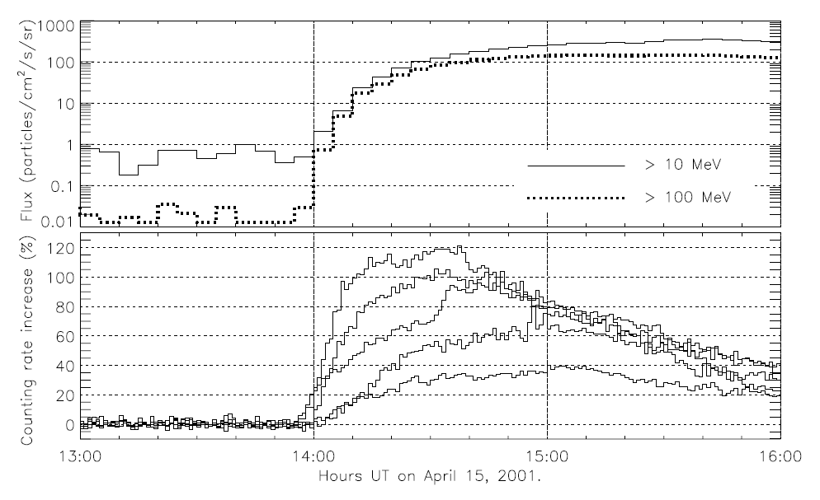
GLE Alert: Physical Concept
Neutron monitors record particles with characteristic energies
Ε > 500MeV
- These particles are very fast and reach the Earth promptly (in several minutes)
GOES
14:26 @ > 10 MeV
14:21 @ > 100 MeV
NMs
13:58
Figure credit: Kuwabara et al., 2006
- The start time of the intensity increase in neutron monitors is much earlier than that of the lower energy proton flux
Kuwabara et al., 2006
Souvatzoglou et al., 2009
Dorman et al., 2003
Anashin et al., 2009
ESWW10 Session 13 ,Cosmic Ray Detectors
Antwerp | 22.11.2013

Slide 13



Implementation of the GLE Alert
Step I: Station Alert
N(t)
Moving threshold of a NM
Alert
Moving average
Warning
Watch
Quiet
Measurements
of a NM
Ts: minutes waiting for the next NM station to enter a ‘Station Alert’
Levels of Station Alert Mode
Tm: baseline period, N preceding minutes, averaging time
Td: Current time - Tm
Quiet for ‘Station Alert’ level 0
Watch for ‘Station Alert’ level 1 and below Jmax-1
Warning for ‘Station Alert’ level Jmax-1
Alert for station alert level Jmax and above
Dorman et al., 2003
Kuwabara et al., 2006
Souvatzglou et al., 2013
ESWW10 Session 13 ,Cosmic Ray Detectors
Antwerp | 22.11.2013
Notes:
The basis of the GLE alert algorithm is in principle similar to the one appearing in
earlier work e.g Dorman et al., Kuwabara et al.
First we focus on each neutron monitor separately and the objective is to issue a Station Alert for this
particular neutron monitor. That means that we seek for a persistent increase in the
counting rate of the station.
A moving threshold of a NM based upon the counting rate of the NM station is introduced.
We define four levels of alert (quiet, watch, warning and alert) based on the subsequent number of counts that exceed the Tht
of this neutron monitor station in succession
Baseline: we have set the end of the baseline in some time earlier than
the current time in order to ensure that all neutron monitor stations have provided their
measurement in time into NMDB and at the same time that the selected baseline does
not include the period when SEPs are present

Slide 14
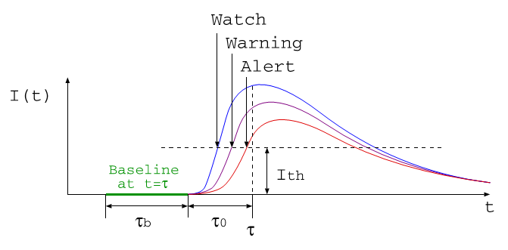
Implementation of the GLE Alert
Step II: General Alert
Levels of General Alert Mode
Quiet for ‘General Alert’ when 0 NM stations at ‘Station Alert’ mode
Watch for ‘General Alert’ when 1 NM stations at ‘Station Alert’ mode
Warning for ‘General Alert’ when 2 NM stations at ‘Station Alert’ mode
Alert for ‘General Alert’ when 3 NM stations at ‘Station Alert’ mode
General Alert: When a certain number of NM stations enter the ‘Station Alert’ Mode independently of each other within a specific time-window
Kuwabara et al., 2006
Souvatzoglou et al., 2013
ESWW10 Session 13 ,Cosmic Ray Detectors
Antwerp | 22.11.2013
Notes:
The second step is the establishment of the General Alert which is subject to the number of neutron monitor stations that enter
the Station Alert mode independently of each other but within a fixed time window of Td= 15min

Slide 15
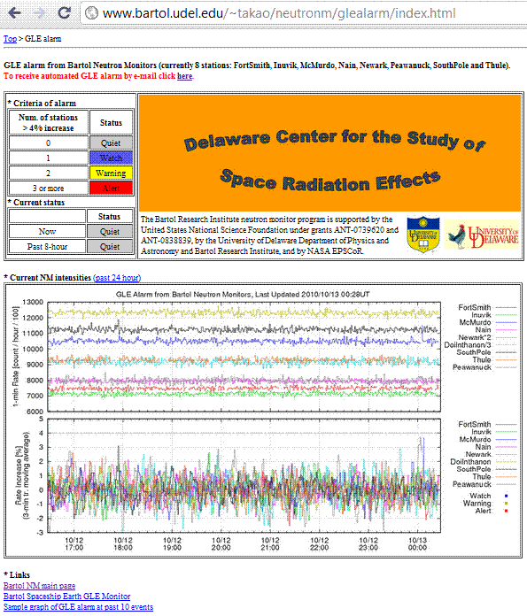
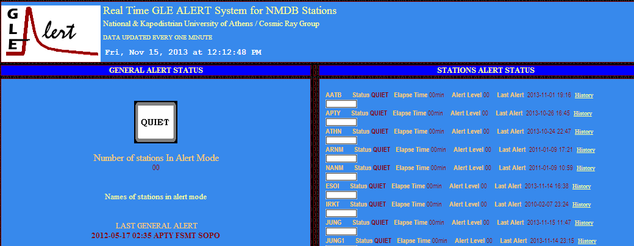
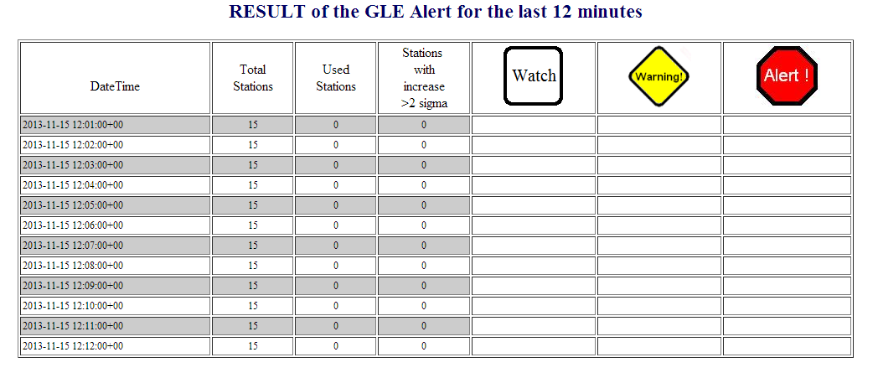
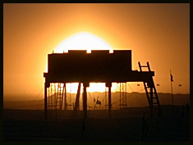

Operating GLE Alert Systems
Spaceship Earth | NMDB
http://www.bartol.udel.edu/~takao/neutronm/glealarm/
http://www.nmdb.eu/?q=node/19
Kuwabara et al., 2006
J. Bieber, this Conference
Anashin et al., 2009
Mavromichalaki et al., 2010
ESWW10 Session 13 ,Cosmic Ray Detectors
Antwerp | 22.11.2013

Slide 16
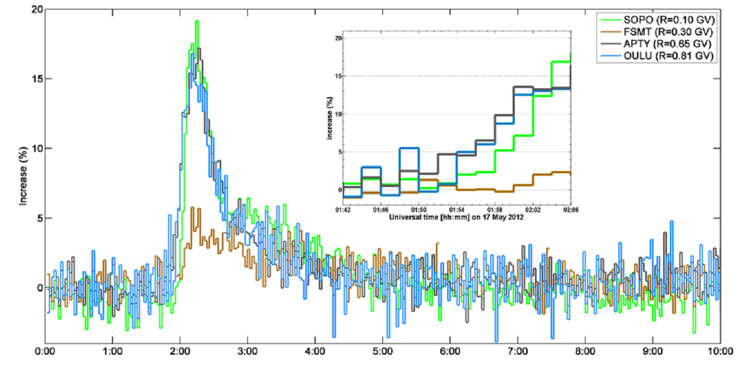
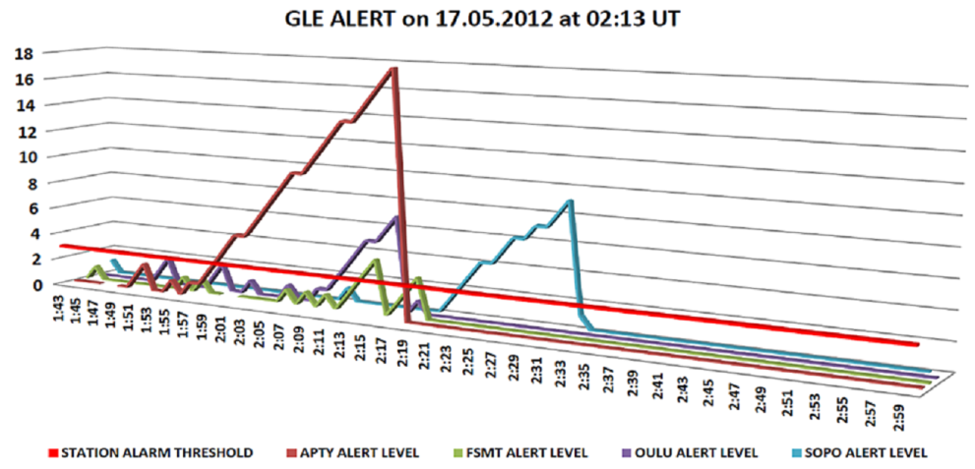
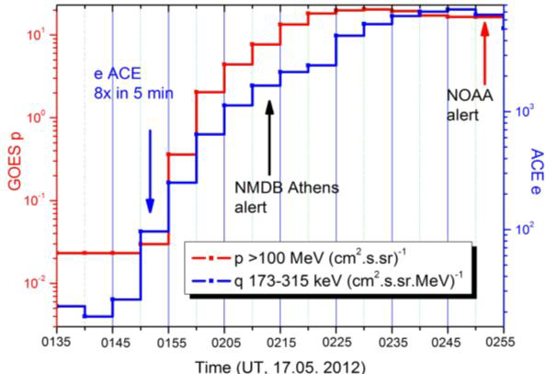
Optimizing the GLE Alert I Towards GLE Alert Plus
Stating the problem: Data flow
Real-time
GLE71
01:55
02:13
Non real-time
- The GLE Alert system is need of real-time NM data updated every 1-min of time.
- If this is NOT fulfilled , delayed Alerts occur
Kudela , 2013
Papaioannou et al., 2013
ESWW10 Session 13 ,Cosmic Ray Detectors
Antwerp | 22.11.2013
Notes:
This is a feature that we could not support in the older version of implementation and it is very helpful in order to be able to explain the differences in the time that a General GLE Alert is produced running historical data from the database and running the real time data

Slide 17
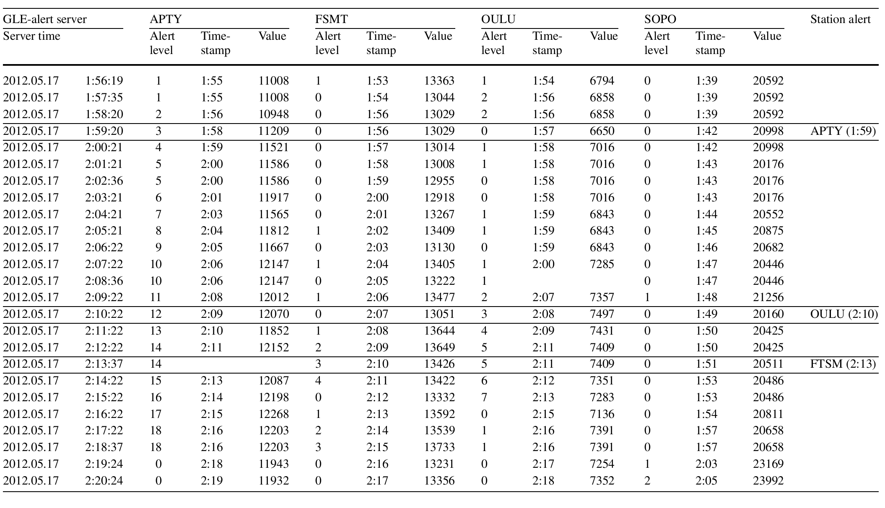
Optimizing the GLE Alert I Towards GLE Alert Plus
Stating the problem: Getting the data in
Problems in time synchronization
4 consecutive minutes - same time stamp
3 consecutive minutes - same timestamp
OULU NM was discarded 3 times in 9 minutes
Delayed
GLE Alert
Papaioannou et al., 2013
Real-time behavior @ GLE71
ESWW10 Session 13 ,Cosmic Ray Detectors
Antwerp | 22.11.2013
Notes:
In the new software, every minute, the algorithm is able to go back in time for a number of N minutes in order to evaluate the delayed data. The number of N minutes is programmable and depends on the uploading behavior of each NM station. In this way we increase the amount of usable data from all stations. The procedure is implemented with such a way that does not affect the effectiveness of the hard real time functionality of the older version of the GLE Alert system.

Slide 18
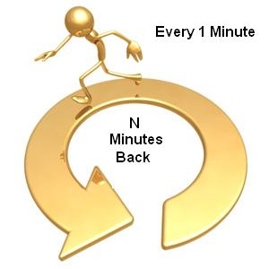
Optimizing the GLE Alert I Towards GLE Alert Plus
The Go-Back N improvement
ALERT SERVER |  | ALERT LEVEL | ALERT PLUS LEVEL | OULU
UT TIME SERVER |  |  |  | TIME STAMP | value
5/17/2012 | 1:57:35 | 2 |  | 1:56 | 6858
5/17/2012 | 1:58:20 | 2 |  | 1:56 | 6858
5/17/2012 | 1:59:20 | 0 | 0 | 1:57 | 6650
5/17/2012 | 2:00:21 | 1 | 1 | 1:58 | 7016
5/17/2012 | 2:01:21 | 1 | 0 | 1:58 | 7016
5/17/2012 | 2:02:36 | 0 | 0 | 1:58 | 7016
5/17/2012 | 2:03:21 | 0 | 0 | 1:58 | 7016
5/17/2012 | 2:04:21 | 1 | 2 | 1:59 | 6843
5/17/2012 | 2:05:21 | 1 | 0 | 1:59 | 6843
5/17/2012 | 2:06:22 | 0 | 0 | 1:59 | 6843
5/17/2012 | 2:07:22 | 1 | 3 | 2:00 | 7285
5/17/2012 | 2:08:36 | 1 | 0
5/17/2012 | 2:09:22 | 2 | (4-9) 10 | 2:07 | 7357
5/17/2012 | 2:10:22 | 3 | 11 | 2:08 | 7497
5/17/2012 | 2:11:22 | 4 | 12 | 2:09 | 7431
5/17/2012 | 2:12:22 | 5 | (13)14 | 2:11 | 7409
5/17/2012 | 2:13:37 | 5 | O | 2:11 | 7409
5/17/2012 | 2:14:22 | 6 | 15 | 2:12 | 7351
5/17/2012 | 2:15:22 | 7 | 16 | 2:13 | 7283
Increase the number of usable NMs
Increase the number of usable data per NM station
ESWW10 Session 13 ,Cosmic Ray Detectors
Antwerp | 22.11.2013

Slide 19
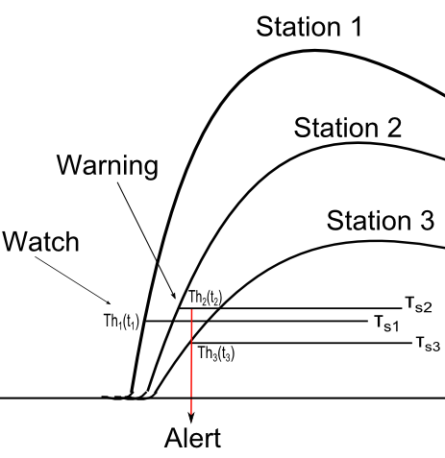
Optimizing the GLE Alert I Towards GLE Alert Plus
Revisiting the GLE Alert Mode
- The standard practice is to have one threshold applied to all NM stations participating to the GLE Alert
- GLE Alert Plus treats each NM station separately and based on its data defines a threshold per NM station
Souvaztoglou et al., 2013
ESWW10 Session 13 ,Cosmic Ray Detectors
Antwerp | 22.11.2013
Notes:
It is noteworthy that each neutron monitor station that contributes to the establishment of the General
Alert follows an independent climax since it exceeded its very own threshold Tht as this
is demonstrated in the upper figure and in the bottom right one
The red line (vector) in the Figure marks the timestamp at which the thee NM stations are all in
Station Alert mode so that the General Alert is produced.

Slide 20
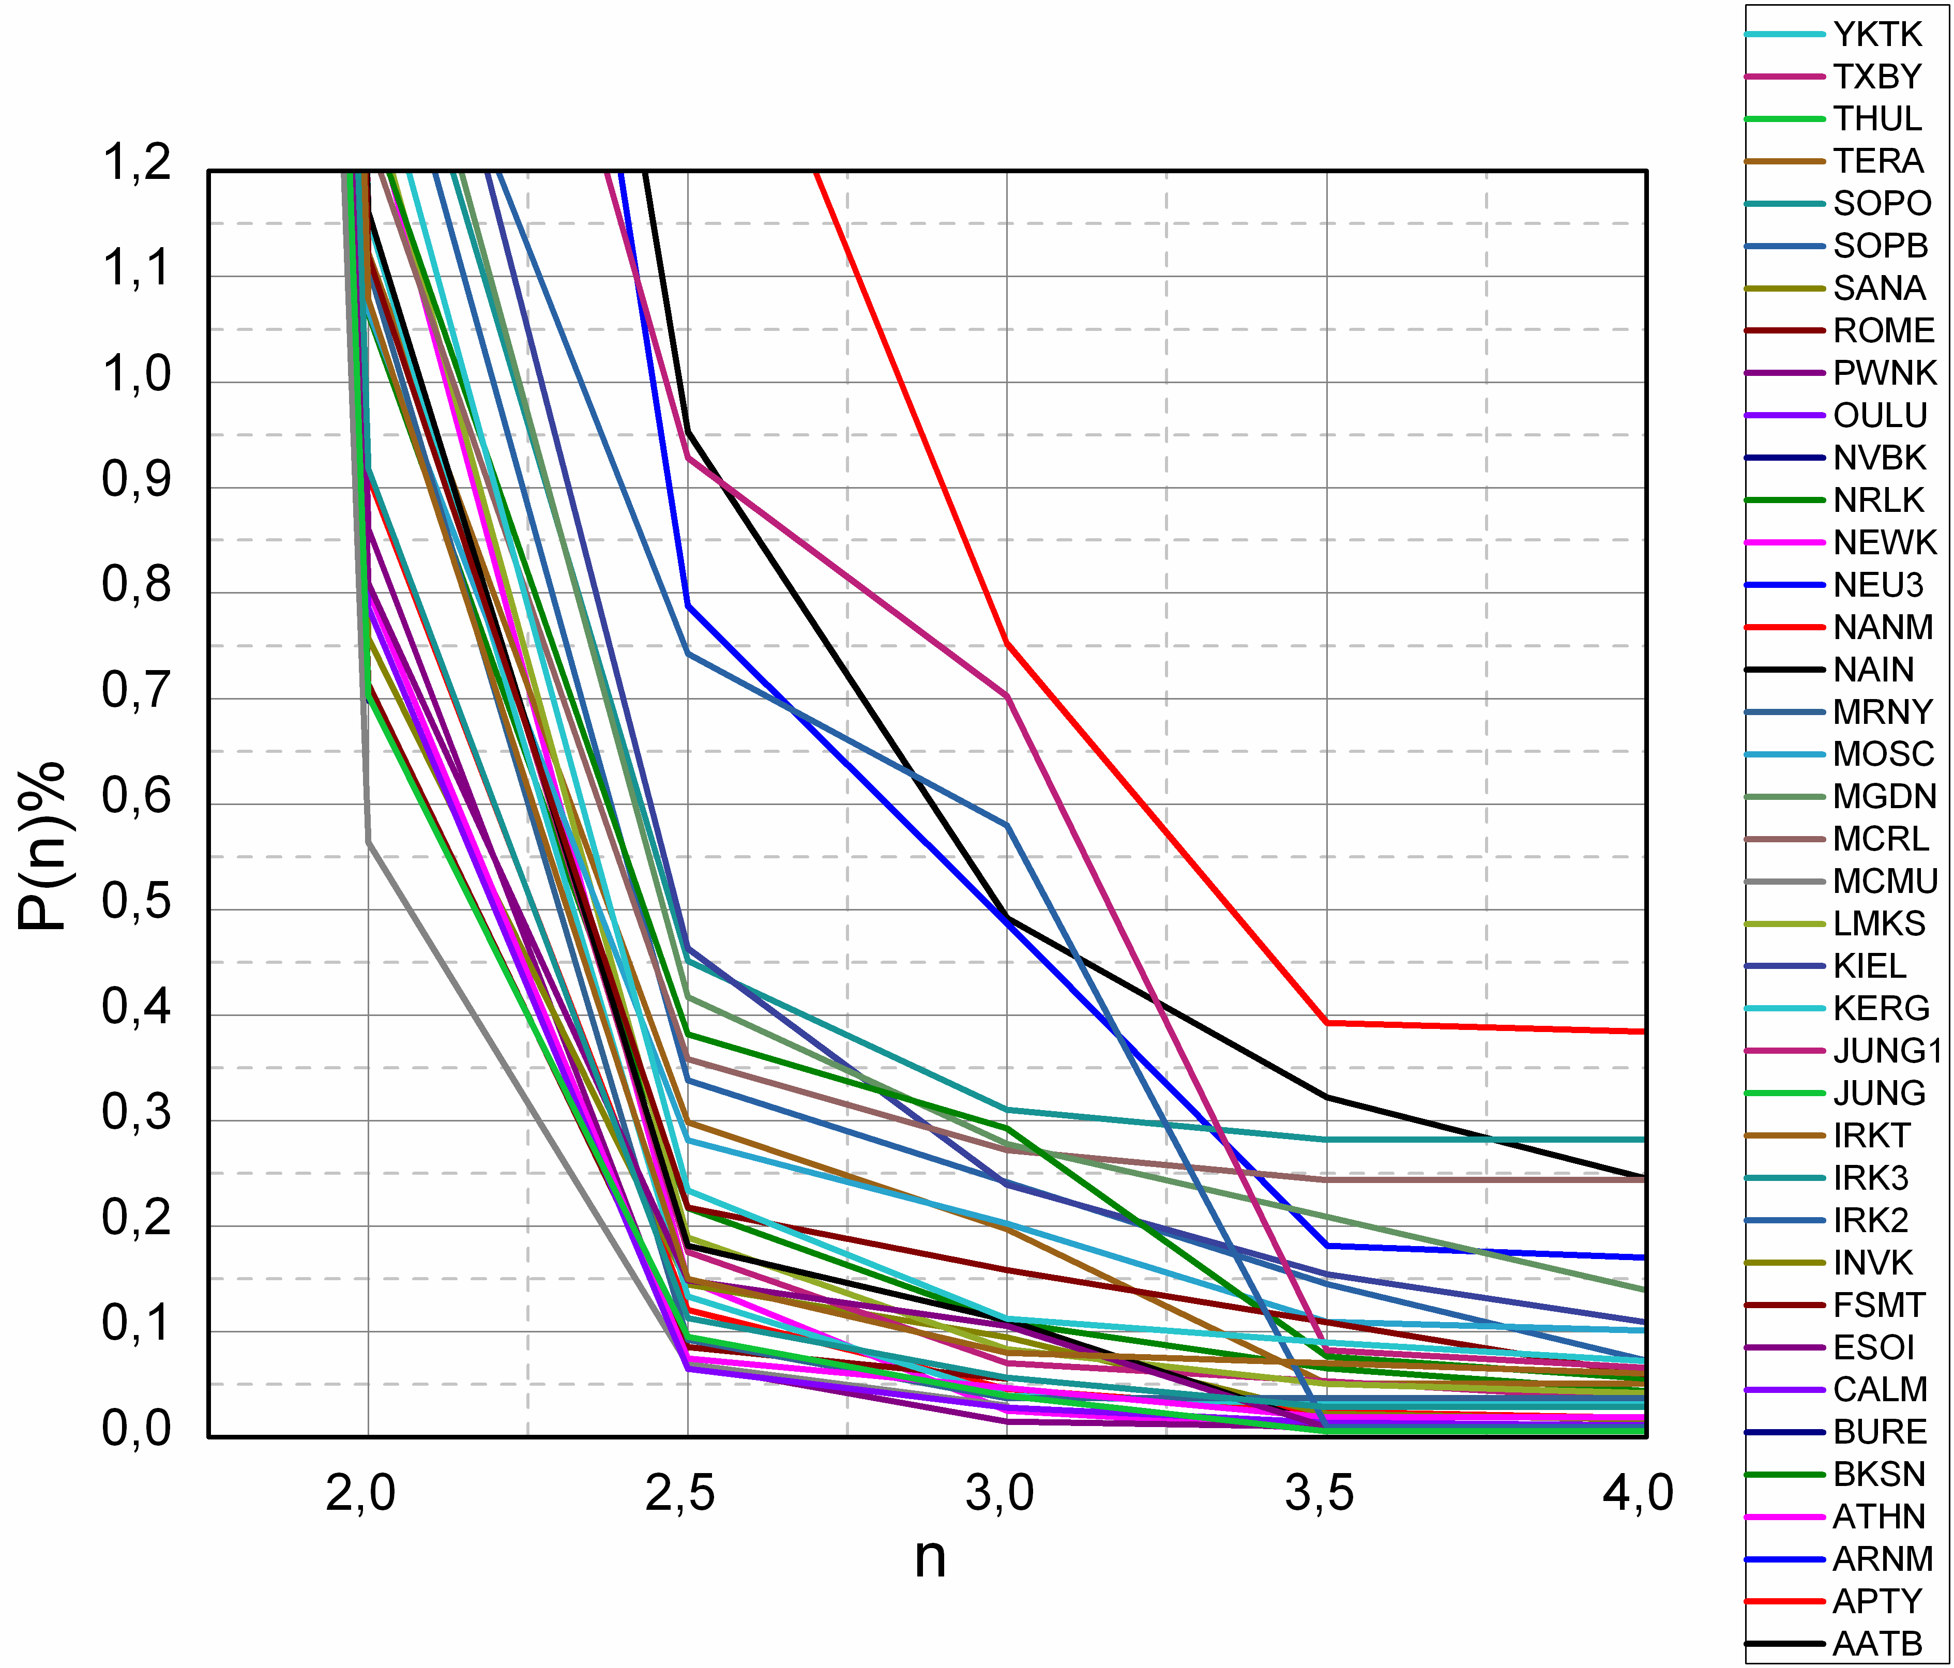
Optimizing the GLE Alert I Towards GLE Alert Plus
Data treatment
P(n)% | Success | Missed | False | True warnings | False warnings
0,75 | 10 | 3 | 0 | 11 | 18
0,78 | 10 | 3 | 0 | 12 | 20
0,80 | 10 | 3 | 0 | 12 | 23
0,81 | 12 | 1 | 0 | 12 | 14
0,82 | 12 | 1 | 0 | 12 | 14
0,83 | 12 | 1 | 0 | 12 | 14
0,84 | 12 | 1 | 0 | 12 | 14
0,85 | 12 | 1 | 0 | 12 | 14
0,87 | 12 | 1 | 0 | 12 | 15
0,90 | 12 | 1 | 0 | 12 | 15
0,95 | 12 | 1 | 0 | 12 | 19
1,00 | 12 | 1 | 0 | 12 | 24
1,50 | 12 | 1 | 3 | 12 | 82
2,00 | 12 | 1 | 5 | 12 | 91
2,50 | 12 | 1 | 5 | 12 | 106
3,00 | 12 | 1 | 5 | 12 | 176
- The larger the n the smaller the P(n)
- What would be the optimal P(n) ?
Souvatzoglou et al., 2013
ESWW10 Session 13 ,Cosmic Ray Detectors
Antwerp | 22.11.2013

Slide 21
Optimizing the GLE Alert I Towards GLE Alert Plus
Data treatment
The green column represents the n used by GLE Alert Plus for each NM station
Souvatzoglou et al., 2013
ESWW10 Session 13 ,Cosmic Ray Detectors
Antwerp | 22.11.2013

Slide 22
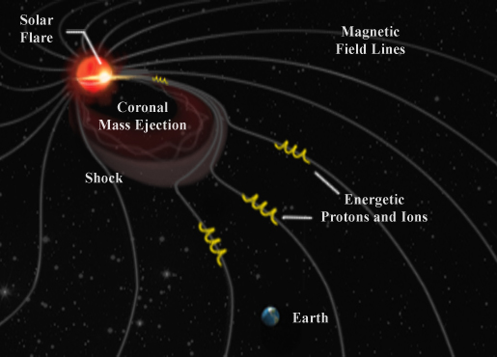
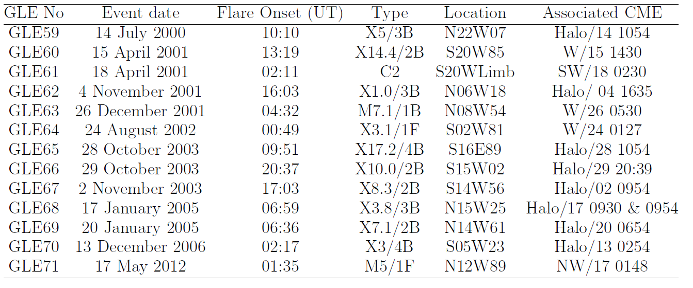
Validation of the GLE Alert Plus
A0. Archived data: Sample used in the analysis
- Our sample consists of 13 GLEs recorded by NMs from 2000 to 2013
- We have implemented a concatenated database of NM data, including all available recordings of NMDB. For the missing records (i.e. measurements not included in NMDB) we have downloaded the data ourselves from the PIs websites.
Souvatzoglou et al., 2013
ESWW10 Session 13 ,Cosmic Ray Detectors
Antwerp | 22.11.2013

Slide 23
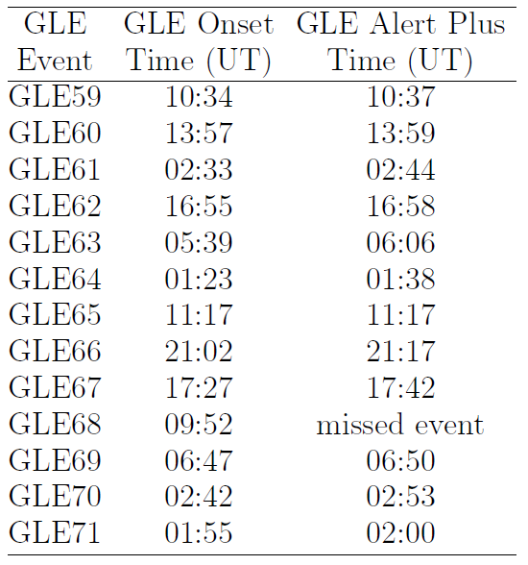
Validation of the GLE Alert Plus
A0. Archived data: GLEs spotted by GLE Alert Plus
GLE Alert Plus has been tested against historical records from January 2000 to December 2012. In 12/13 GLE cases GLE Alert Plus issued alarm signals very close to the initiation of the GLE event.
GLE Alert Plus did not issue an Alert for GLE68 (17 Jan 05).
Gopalswamy et al., 2011
Souvatzoglou et al., 2013
ESWW10 Session 13 ,Cosmic Ray Detectors
Antwerp | 22.11.2013

Slide 24
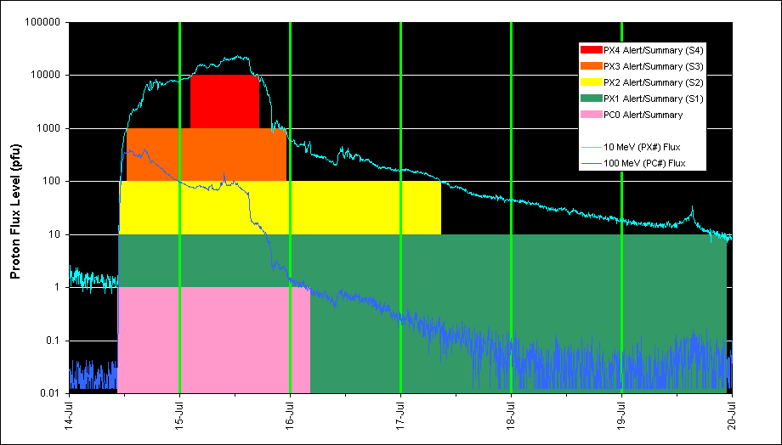
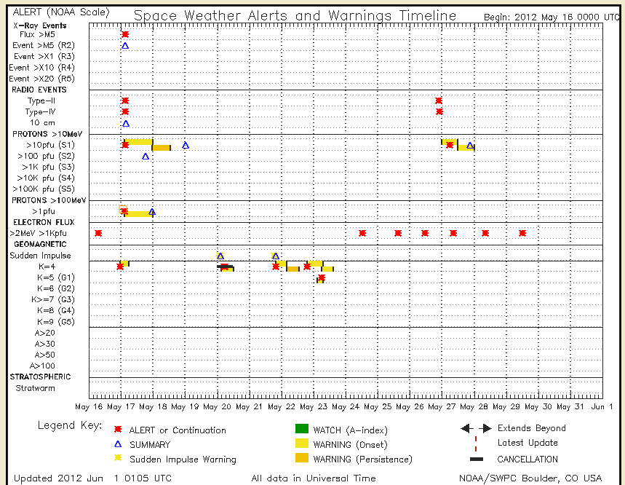
Validation of the GLE Alert Plus
A1. Archived data: Comparison with GOES Alert
NOAA Scale for Solar Radiation Storms | Proton 10 MeV Integral Flux exceeds
S5 - Extreme | 100,000 pfu
S4 - Severe | 10,000 pfu
S3 - Strong | 1,000 pfu
S2 - Moderate | 100 pfu
S1 - Minor | 10 pfu
http://www.swpc.noaa.gov/alerts/description.html
ESWW10 Session 13 ,Cosmic Ray Detectors
Antwerp | 22.11.2013

Slide 25

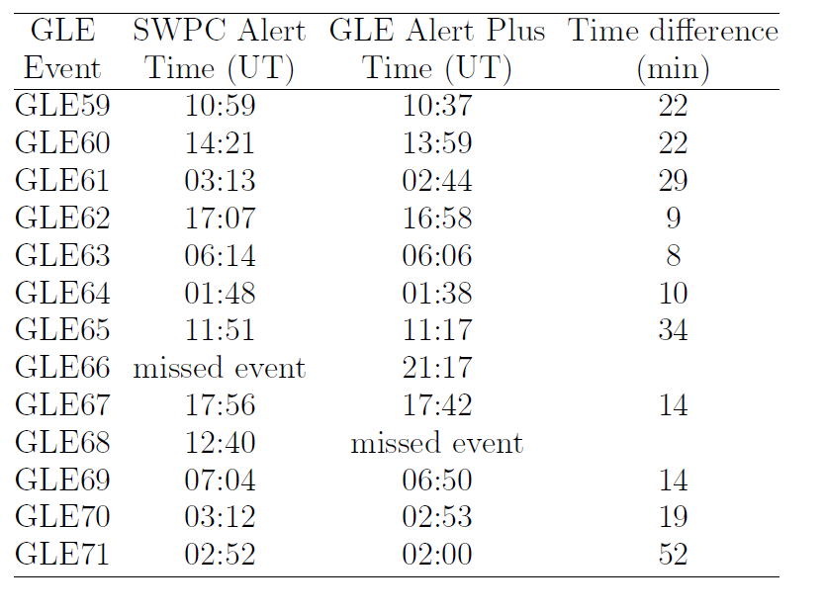

Validation of the GLE Alert Plus
A1. Archived data: Comparison with GOES Alert
http://www.swpc.noaa.gov/alerts/warnings_timeline.html
http://cosray.phys.uoa.gr/index.php/glealertplus
GLE Alert Plus and NOAA/GOES missed one event each
GLE Alert Plus precedes the NOAA/SWPC Alert in all cases by 8-52 minutes
ESWW10 Session 13 ,Cosmic Ray Detectors
Antwerp | 22.11.2013

Slide 26
Validation of GLE Alert Plus
A1. Archived data: Comparison with GOES Alert
GLE59
GLE65
GLE60
GLE66
GLE67
GLE61
GLE69
GLE62
GLE63
GLE70
GLE64
(Black) Event onset [GOES, NM]
(Yellow) Watch [NM]
(Green) Warning [GOES, NM]
(Red) Alert [GOES, NM]
GLE71
[Adapted by Kuwabara et al., 2006]
Souvatzoglou et al., 2013
ESWW10 Session 13 ,Cosmic Ray Detectors
Antwerp | 22.11.2013

Slide 27
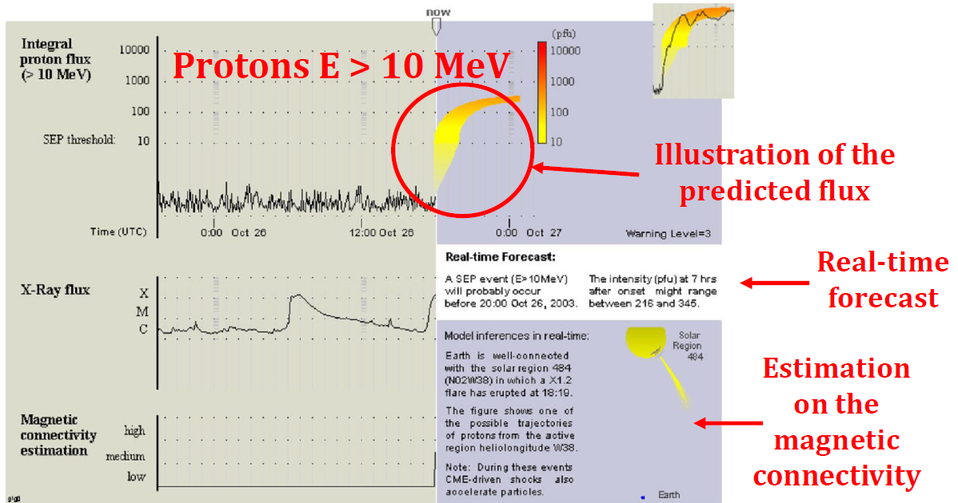
Validation of GLE Alert Plus
A2. Archived data: Comparison with UMASEP
UMASEP analyzes soft X-ray, diferential and integral proton flux data in order to recognize precursors of three different proton flux situations: well-connected SEP events, poorly-connected SEP events, and "all-clear" situations
Protons E > 100 MeV
Núñez, 2011
http://spaceweather.uma.es/performance_results_100mev.html
ESWW10 Session 13 ,Cosmic Ray Detectors
Antwerp | 22.11.2013

Slide 28
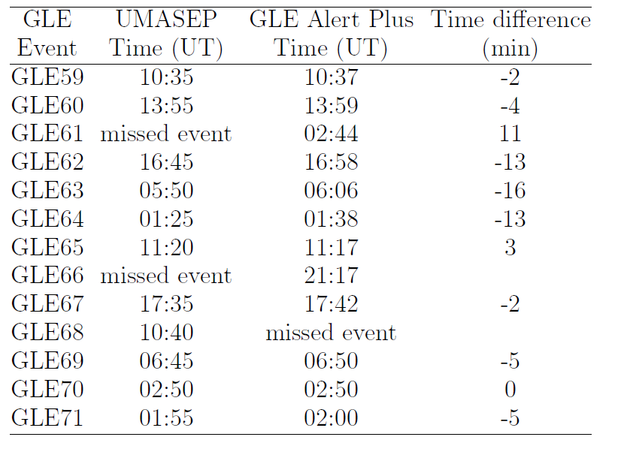

Validation of GLE Alert Plus
A2. Archived data: Comparison with UMASEP
http://spaceweather.uma.es/performance_results_100mev.html
http://cosray.phys.uoa.gr/index.php/glealertplus
GLE Alert Plus missed one event, whereas UMASEP missed two events
UMASEP precedes GLE Alert Plus in 8/13 cases with a varying window of 2-16 minutes.
GLE Alert Plus precedes UMASEP in 2/13 cases with a varying window of 3-11 minutes.
The UMASEP results are courtesy of Prof. M. Núñez, private communication, 2013
ESWW10 Session 13 ,Cosmic Ray Detectors
Antwerp | 22.11.2013

Slide 29
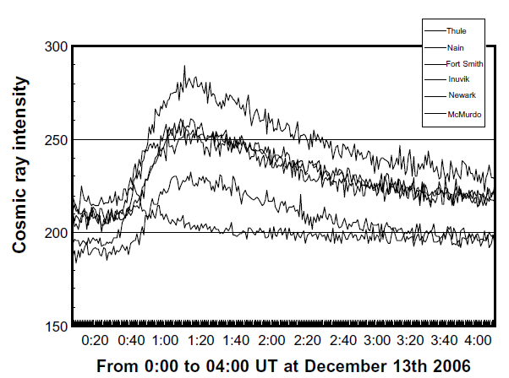
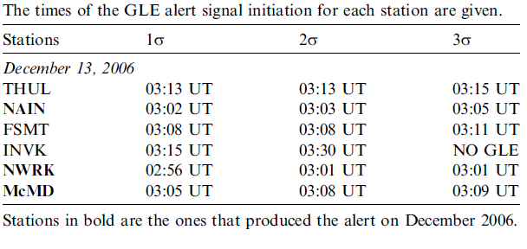
Validation of GLE Alert Plus
B. Real-time data
GLE70 – 13.12.2006
GLE71 – 17.05.2012
2 / 2 GLE events recorded by the algorithm since 2006
0 false alarms
Souvatzoglou et al., 2009
Papaioannou et al., 2013
ESWW10 Session 13 ,Cosmic Ray Detectors
Antwerp | 22.11.2013

Slide 30
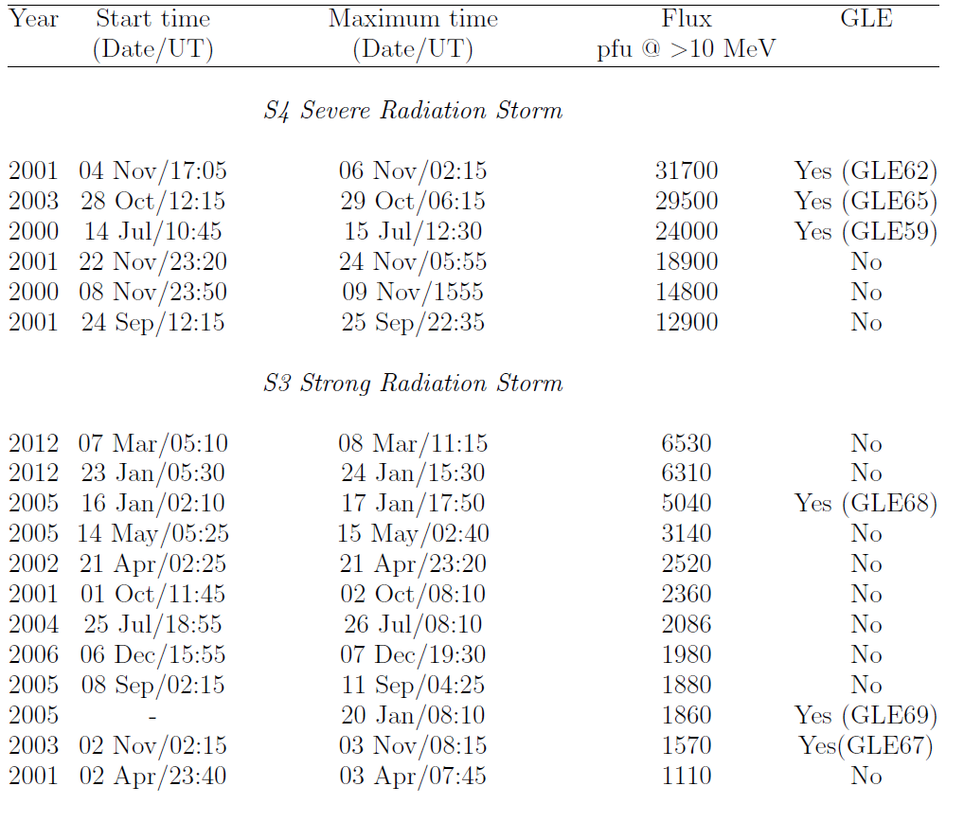
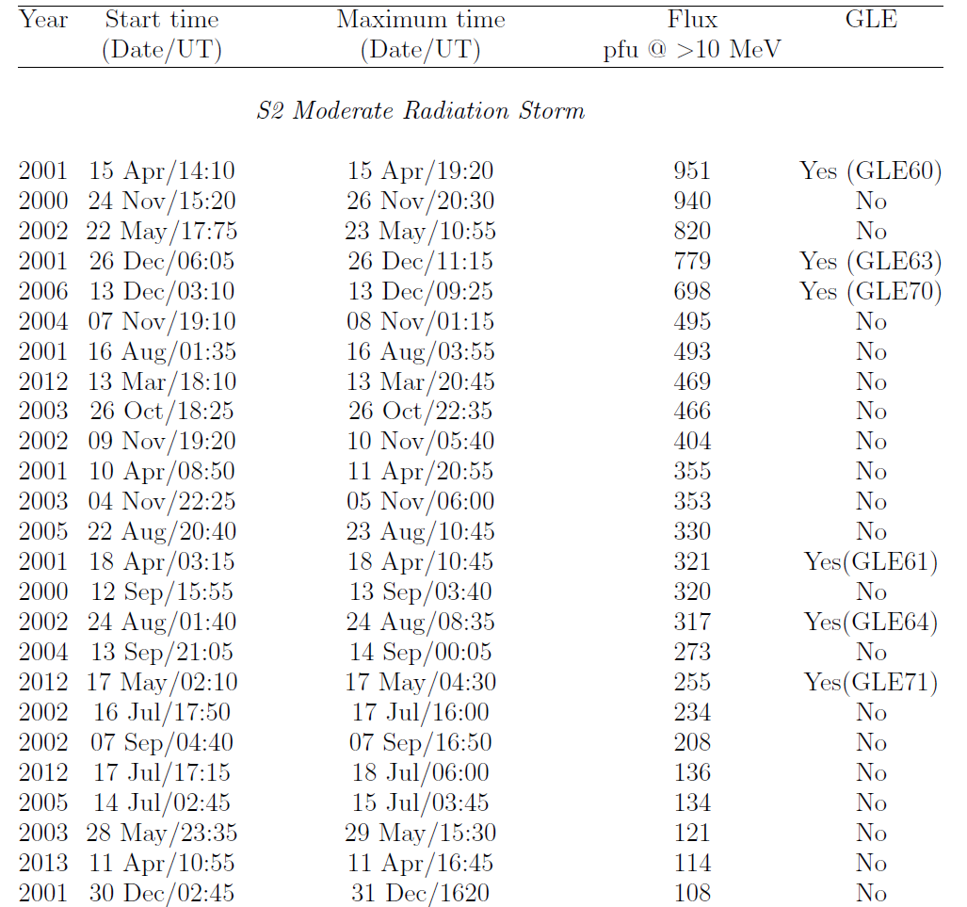
Validation of GLE Alert Plus
Occurrence rate of GLEs vs SEPs
- 50% at S4
- 24% at S2
- 25% at S3
- 12/13 GLEs accompanied SEPs
[Adapted by Kuwabara et al., 2006]
Souvatzoglou et al., 2013
ESWW10 Session 13 ,Cosmic Ray Detectors
Antwerp | 22.11.2013

Slide 31
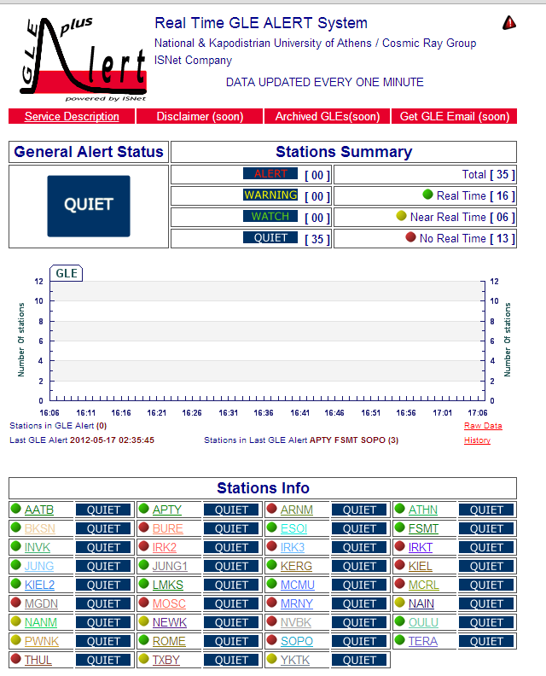
Provision of the GLE Alert Plus
Summary of the provided information
Service Description / Archived GLEs / Get GLE Email
General GLE Alert Status/ Stations Summary
General GLE Alert / Graphical representation
Stations Info
ESWW10 Session 13 ,Cosmic Ray Detectors
Antwerp | 22.11.2013

Slide 32
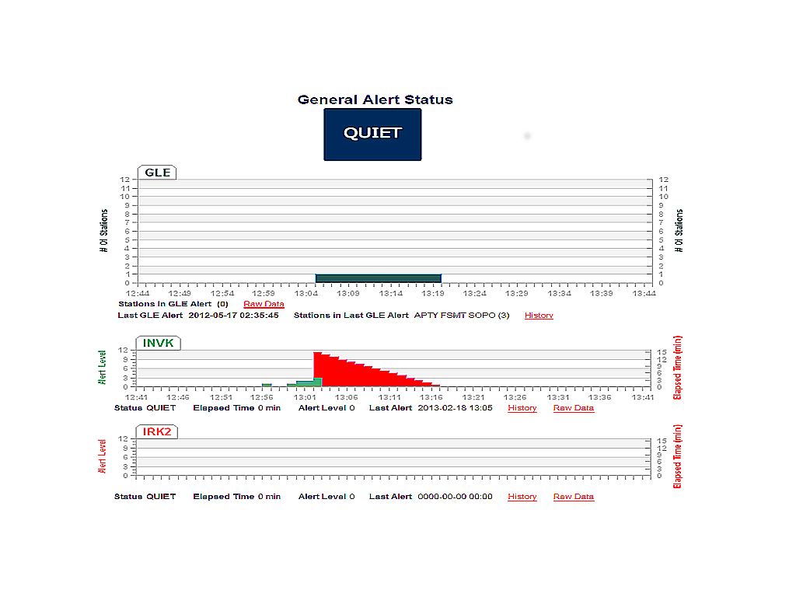
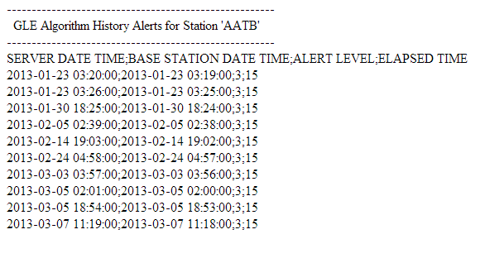
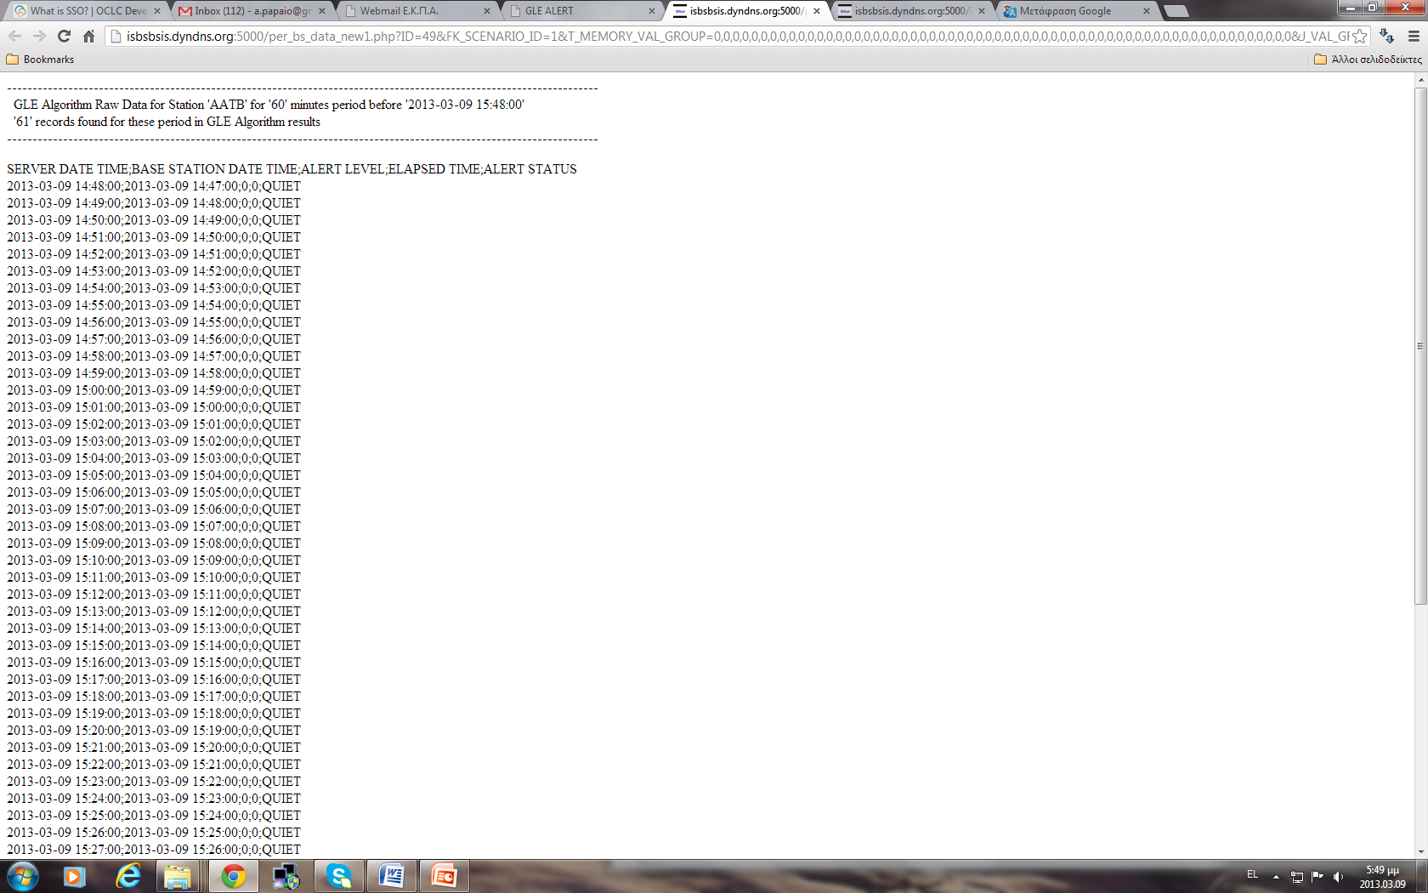
Graphical layout of GLE Alert Plus
A. Station Alert
NM station at ‘Station Alert’ mode
ESWW10 Session 13 ,Cosmic Ray Detectors
Antwerp | 22.11.2013

Slide 33
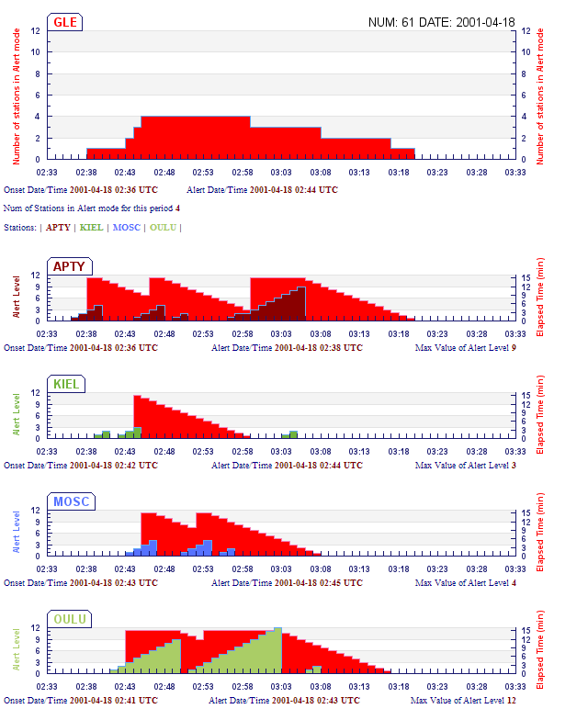
Graphical layout of GLE Alert Plus
B. General Alert
General GLE Alert
First NM station at ‘Station Alert’ mode – Watch Stage
Third NM station at ‘Station Alert’ mode – Alert Stage
Second NM station at ‘Station Alert’ mode – Warning Stage
ESWW10 Session 13 ,Cosmic Ray Detectors
Antwerp | 22.11.2013

Slide 34
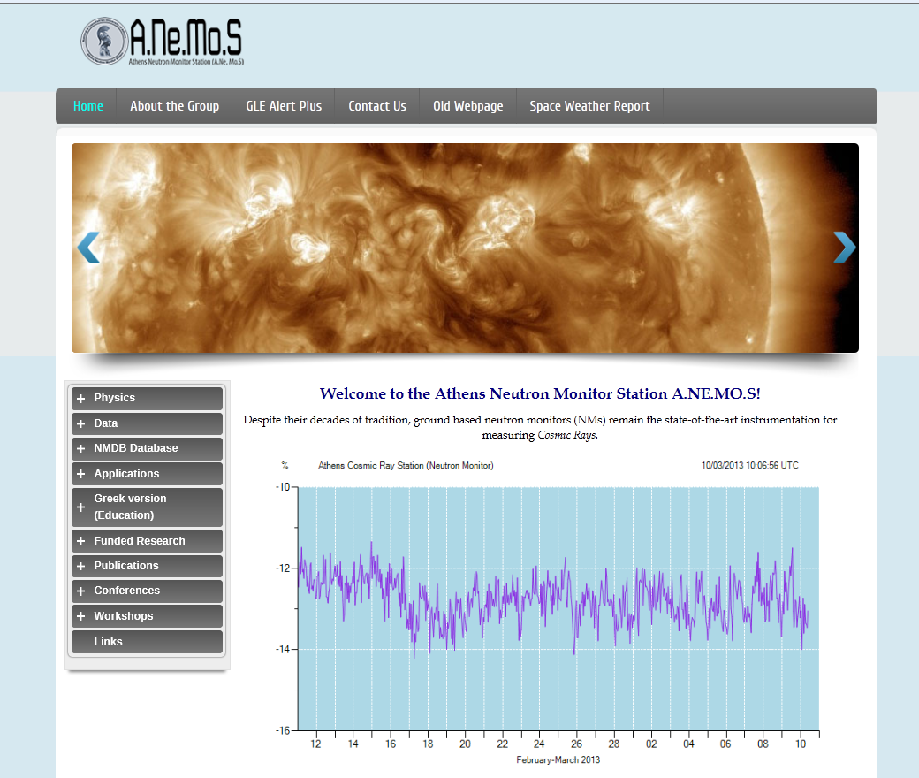
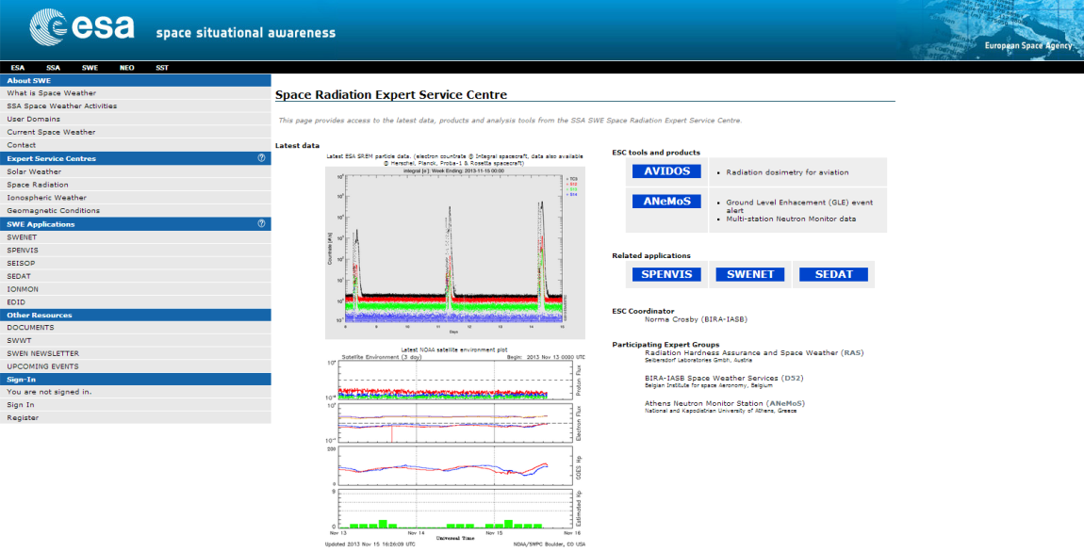
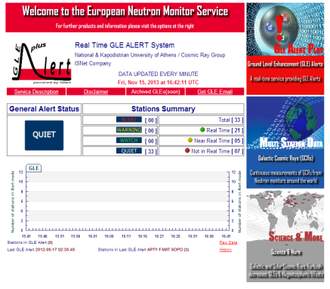
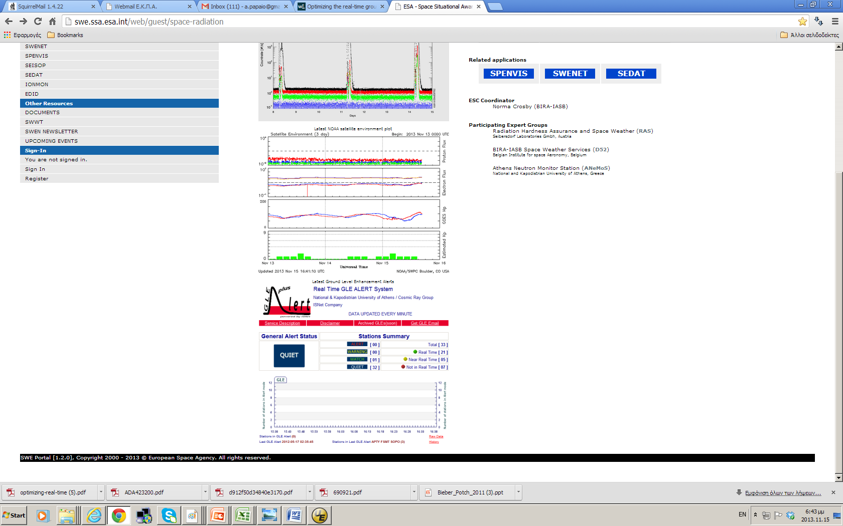
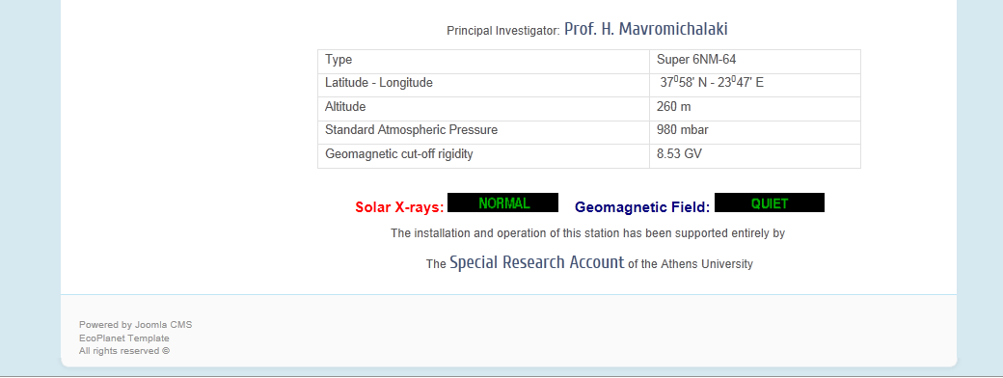
Provision of the European NM Service
http://cosray.phys.uoa.gr
http://swe.ssa.esa.int/
ESWW10 Session 13 ,Cosmic Ray Detectors
Antwerp | 22.11.2013

Slide 35
Thank you for your attention
Acknowledgements
The research leading to these results has received funding from the European Space Agency (ESA) under contract ESA Tender: RFQ/3-13556/12/D/MRP [Space Weather Precursors Services Operations (SNIV-3) - European ionosonde and neutron monitor service] and has utilized the Neutron Monitor Database (NMDB), which has received funding from the European Community’s Seventh Framework Programme [FP7/2007–2013] NMDB under Grant Agreement No. 213007.
AP wishes to thank Prof. M. Nùnez and Dr C.T. Steigies for the provision of their results and material used in this presentation.
Special thanks to Prof. A. Chilingarian and Prof. K. Kudela for the invitation
ESWW10 Session 13 ,Cosmic Ray Detectors
Antwerp | 22.11.2013

