Slide 1
PROBA2 a Space Weather Monitor
Matthew J West
ESWW10 - Nov 2013

Slide 2
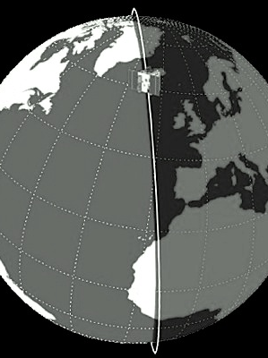
PROBA2
Movie: ESA
Microsatellite in sun-synchronous orbit
Launched on November 2, 2009
725 km altitude ☀ Period: ≈100 min
Commanding and data processing at P2SC (ROB, Brussels).
Funded by ESA / SSA

Slide 3
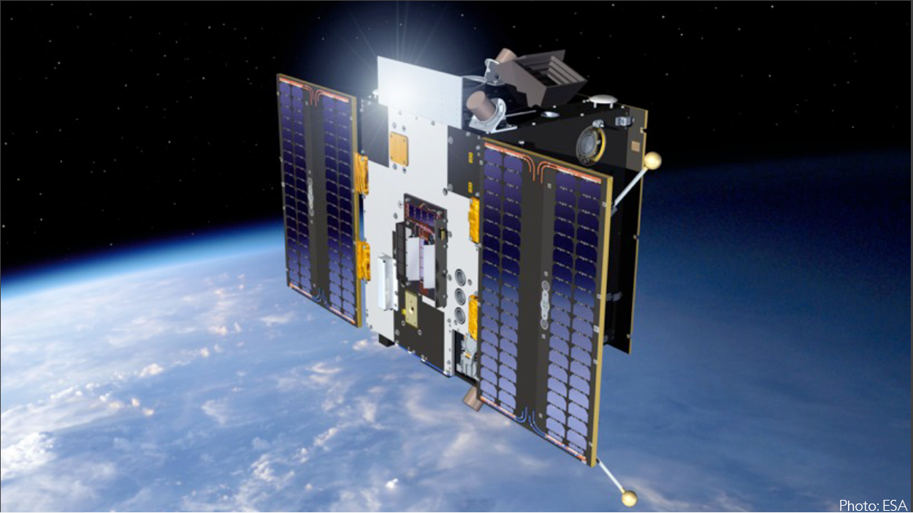
PROBA2 - 4 innovative instruments
PROBA2 originally an ESA technology mission.
Currently a scientific instrument and space weather tool.
Large Yield Radiometer (LYRA)
Thermal Plasma Measurement Unit (TPMU)
Sun Watcher using APS & Image Processing (SWAP, an EUV imager)
The Dual segmented Langmuir probe (DSLP)
Two particle detectors to monitor the plasma environment of the spacecraft.
Two instruments to monitor solar activity – operated from P2SC Belgium

Slide 4
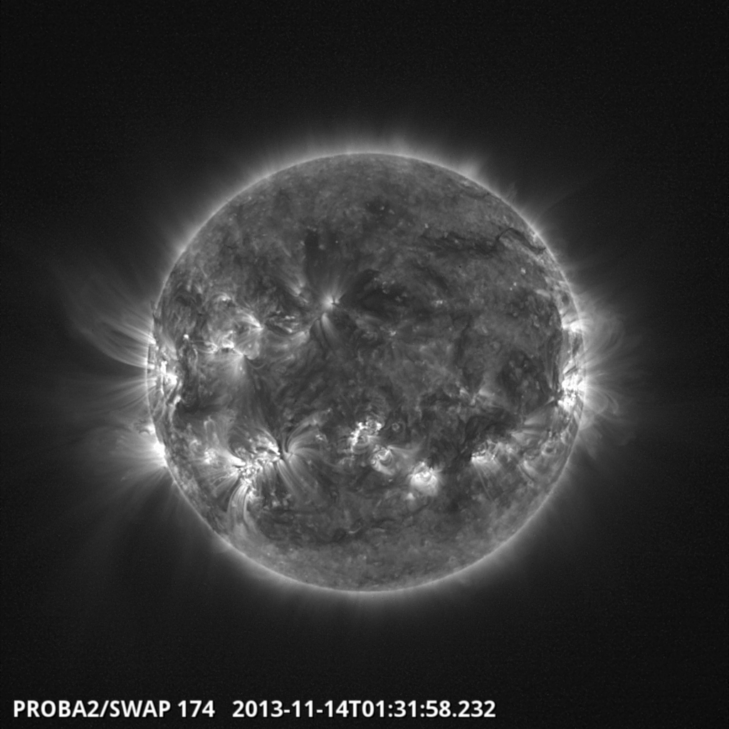
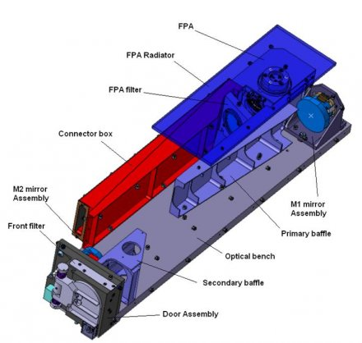
SWAP – EUV Imager
Exercise in miniaturization: off-axis Ritchey-Chrétien scheme.
Observes the 1 million degree corona in EUV light

Slide 5
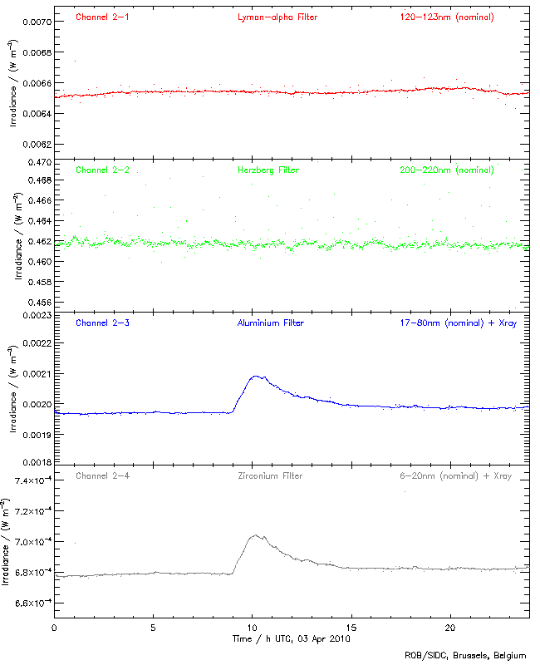
LYRA – Large Yield Radiometer
LYRA monitors the solar irradiance in four UV pass-bands.
Chosen for their relevance to solar physics, aeronomy and Space Weather:
Lyman-α channel (120-123 nm)
Herzberg continuum channel (190-222 nm )
Aluminium filter channel (17-80 nm + a contribution below 5 nm), including strong He II at 30.4 nm
Zirconium filter channel (6-20 nm + a contribution below 2 nm), rejecting He II.
Providing time series of solar irradiance with a very high sampling cadence (up to 100 Hz).
The wavelengths are complimentary to GOES/EUVS, SDO/EVE, SOHO/SEM etc.

Slide 6
PROBA2 as a Space Weather Monitor
&
Observing the sources of Space Weather

Slide 7
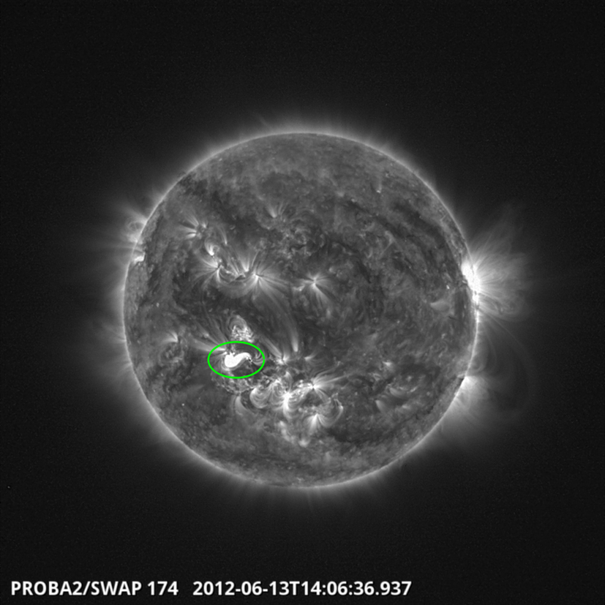
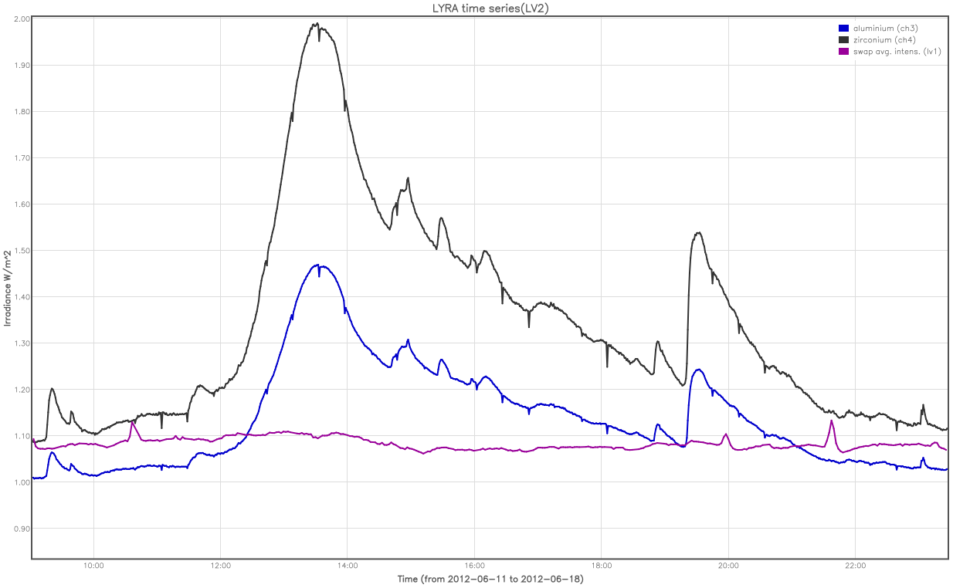
Observing Flares I
SWAP
LYRA
13th Jun 2012, at 11:29 UT, an M1.2 flare occurred in AR11504
Useful for observing the sources of space weather.

Slide 8
Observing Flares II – SWAP Limited Blooming
2010 02 07 00:14:00
02:40
2010 02 07 00:14:15
02:44
EUVI-A
Limited blooming due to CMOS detector
Nominal cadence of ~2 min
Max cadence ~18 sec

Slide 9
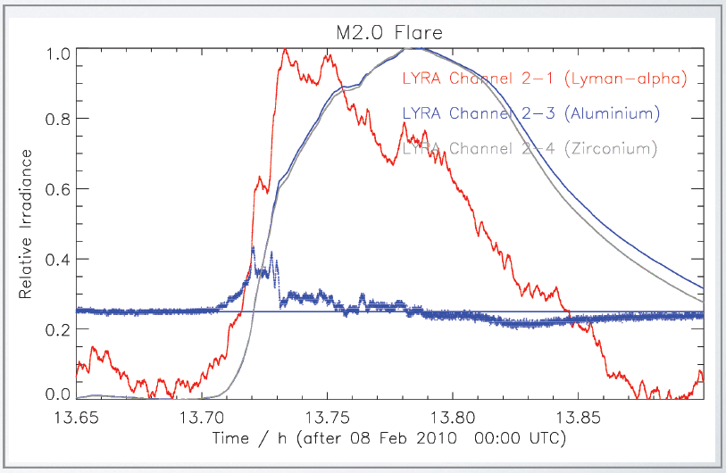
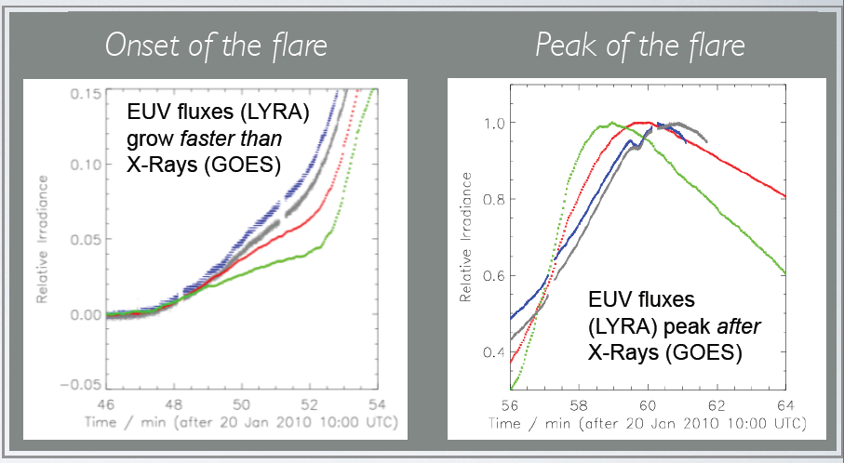
Observing Flares III – LYRA High Resolution
Nominal temporal resolution of 20 Hz
Maximum temporal resolution of 100 Hz
M-flare 20 Jan 10
Notes:
Fig 4 shows LYRA channels 1, 3, and 4 normalized between their min and max, plus the first derivative of channel 3 in arbitrary units on the 0.25 level. You see here a subset containing 15 minutes of the flare. It is obvious that the Lyman-alpha curve precedes the short-wavelength channels and somehow follows the derivative. - I leave it to the specialists to explain what the derivative of the SXR has to do with the HXR and with Lyman-alpha or Bremsstrahlung. Absolutely not my field.
Al = 0-4 nm & 17-60 nm
Zr = 0-3 nm & 7-20 nm
There are two types of flares: Flares which rise very quickly, and flares
that rise slower. The impulsive ones have a correlating signal in the
Ly-alpha channel, even when they are not so strong.
possible candidates are flare numbers:
5800 (M1.8)
6880 (C9.9)
7080 (C4.2) incl. its unclassified follower
7510 (C6.8)
7790 (M1.0)
As mentioned before, a certain strength is necessary, but it is not the only condition: there must be a very fast rising phase.
Page 2 shows a 1-hour subset of these three hours, between 13:30 and 14:30 UTC. According to GOES, this flare starts at 13:32 (which I cannot confirm), has its peak at 13:47, and "ends" (half-max?) at 13:50. This figure is shown in the full data resolution: gaps are filled relative to page 1, and the widths of the curves show the noise variation. It becomes obvious that the flare as shown in the short-wavelength channels is not smooth but has a structure, and that the flare consists of several parts (e.g. varying velocities in the rising phase). On the other hand, it does *not* contain a spacecraft rotation nor an eclipse, which helps a lot.

Slide 10
Solar Activity
We can observe various forms of solar activity:
Flares
CMEs
Prominence eruptions
EIT Waves

Slide 11
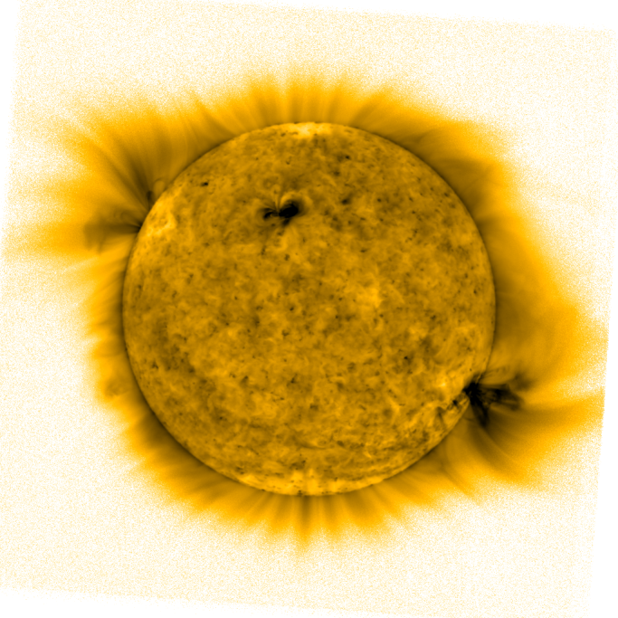
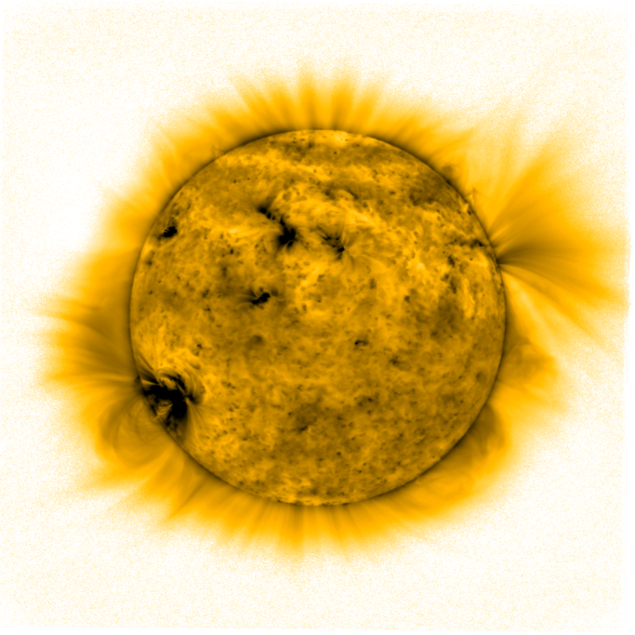
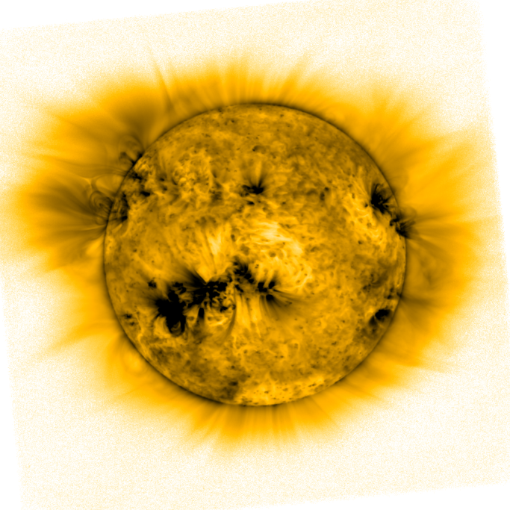
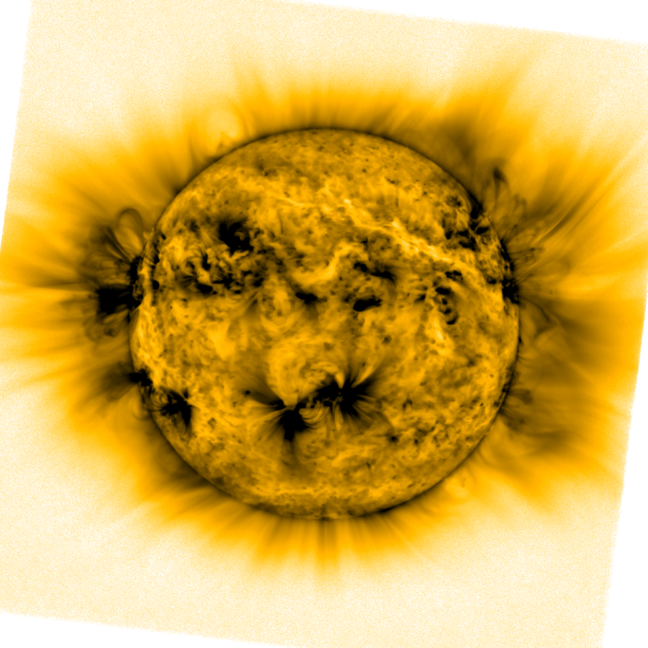
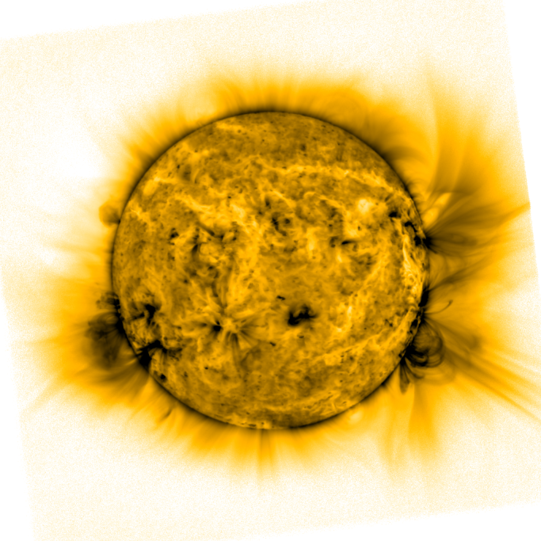
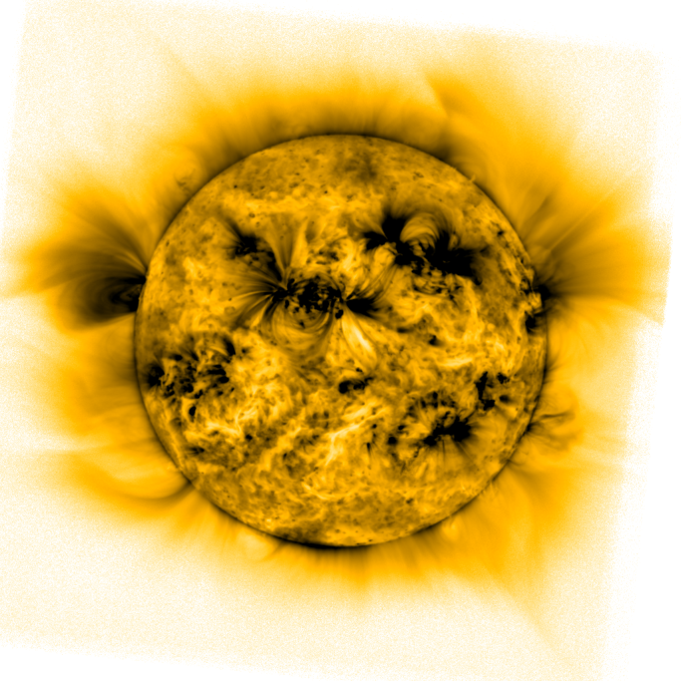
Active Regions (Inverted colours)
Notes:
Inverted color table

Slide 12
Discussion I
PROBA2 is an effective Space Weather monitor.
Provides:
High cadence, Large view, EUV imaging (SWAP)
Prominence eruptions / CMEs
EUV Jets
Flares
ARs
High cadence Solar irradiance observations (LYRA)
Flares
Eruptions

Slide 13
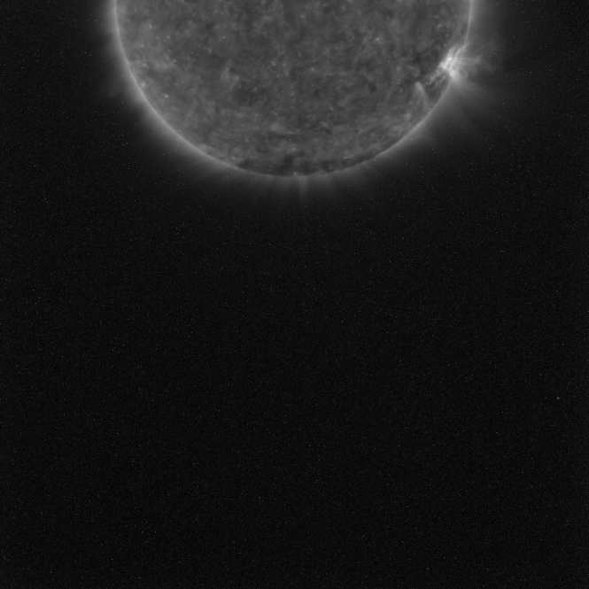
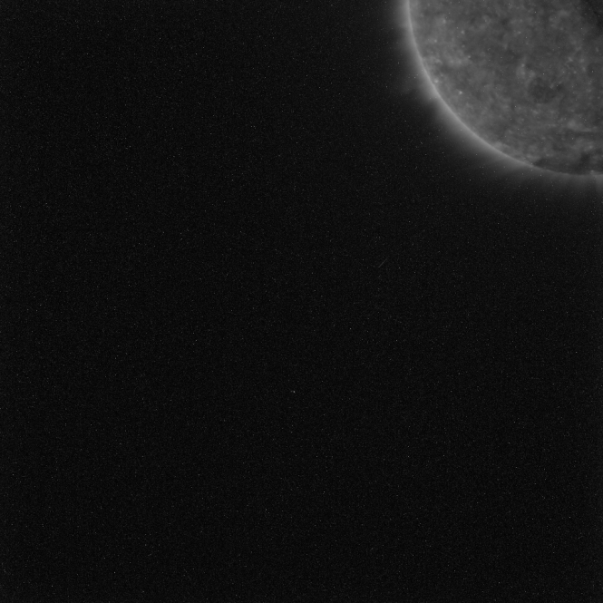
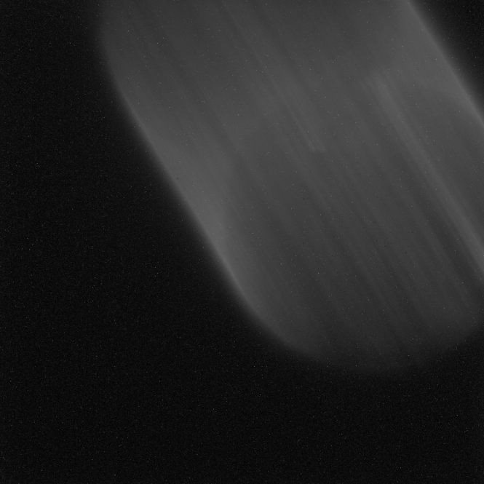
Discussion II
Advantages of a small mission:
We can easily undertake special off pointing campaigns.
Useful for prominence, CME and comet tracking.
We can control the satellite from anywhere with an internet connection.

Slide 14
Discussion III
PROBA2 has two downlink stations:
REDU (Belgium) & Svalbard.
We receive data every 2-3 hours.
Once the data reaches the ground -> ~30 minutes to prep and output.
However, due to the low altitude polar sun sync orbit:
We have eclipse seasons which interrupt signals and potentially miss events.
Experience interference from SAA
Note, we attempt to use both events to study the atmosphere.

Slide 15
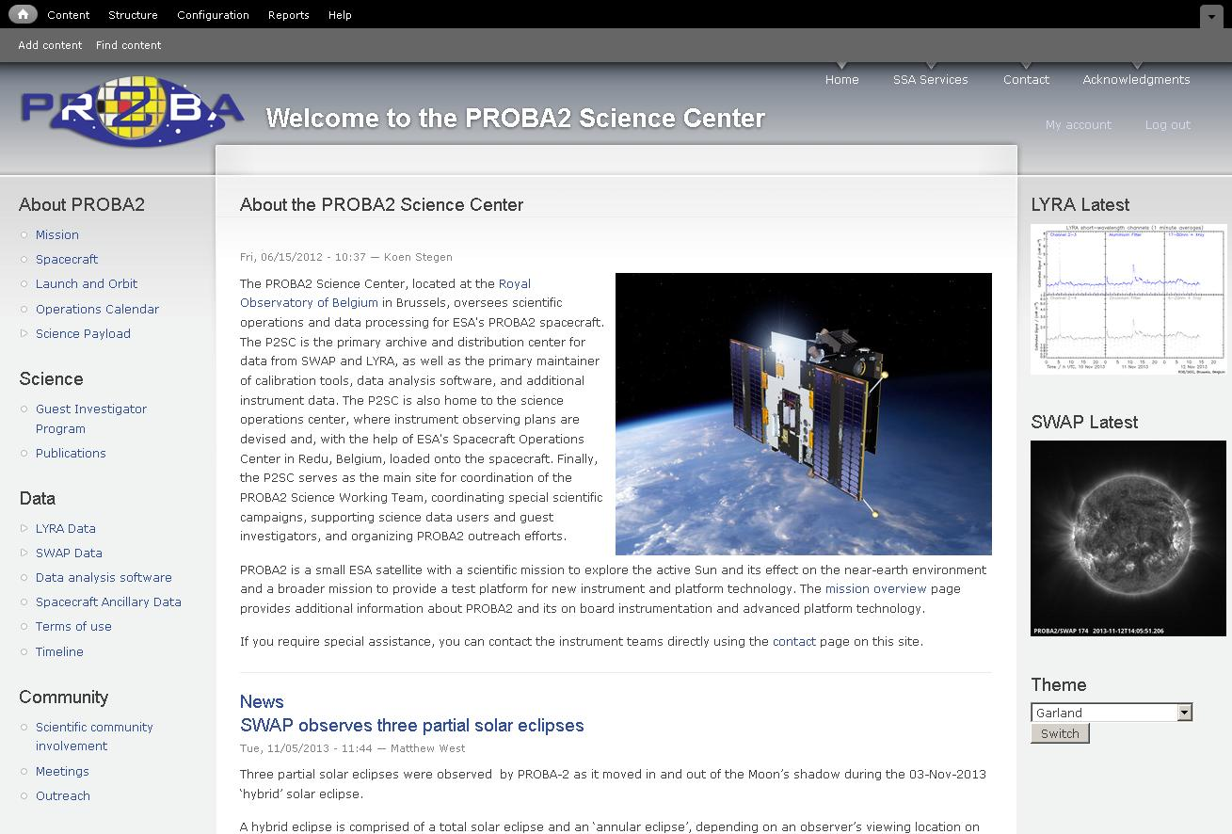
www. http://proba2.oma.be/

Slide 16
For more information and to discuss the potential of PROBA2:
Visit the PROBA2 stand at the ESWW Fair on Wednesday 16:30
The PROBA2 Splinter Session on Thursday 17:15-18:45

