Slide 1
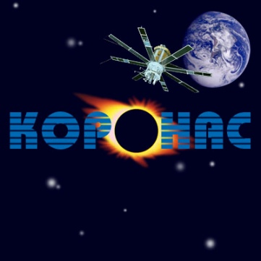
Influence of the upper atmosphere of the Earth on solar EUV observations from LEO satellites
10th European Space Weather Week November 18-22, 2013 Antwerp, Belgium
V. Slemzin¹, A. Ulyanov¹, S. Kuzin¹, K. Gaikovitch², D. Berghmans³, M. Dominique³, B. Nicula³, F. Hourrier⁴ ¹ LPI, Moscow, Russia, ² IPM RAS, N.Novgorod, Russia, ³ ROB, Brussels, Belgium, ⁴ OSUC, Université d'Orléans , France
The work has been supported by the FP-7 eHEROES Project № 284461 of the European Commission

Slide 2
The goals of the work
analysis of absorption of the solar EUV radiation during orbital occultations in various phases of the solar cycle
simulations of absorption by the NRLMSISE-00 model and comparison with measurements
retrieval of the extinction coefficients from absorption data
study of the atmosphere response on geomagnetic storms

Slide 3
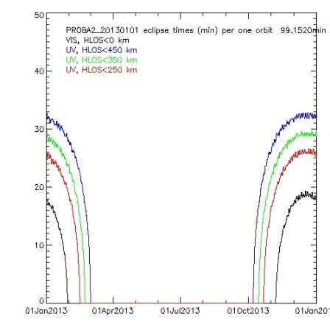
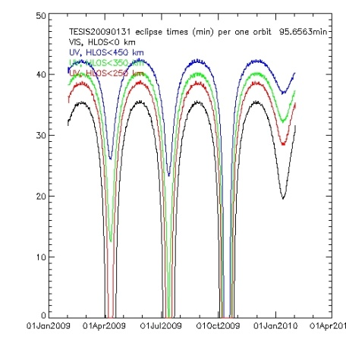
Absorption of solar radiation in the Earth atmosphere during orbital occultations
SPIRIT 304/175 A
h = 550 – 200 km
EUV occultations for different orbits
Proba 2/SWAP Coronas/TESIS
Sun-synchronous orbit
K_{ext} – volume extinction coefficient,
Dens_a_{i}(h_{x})– density of the component a_{i} at h_{x}
σ_{ai} (λ) – photoionization cross-section of the component a_{i} at the wavelength λ

Slide 4
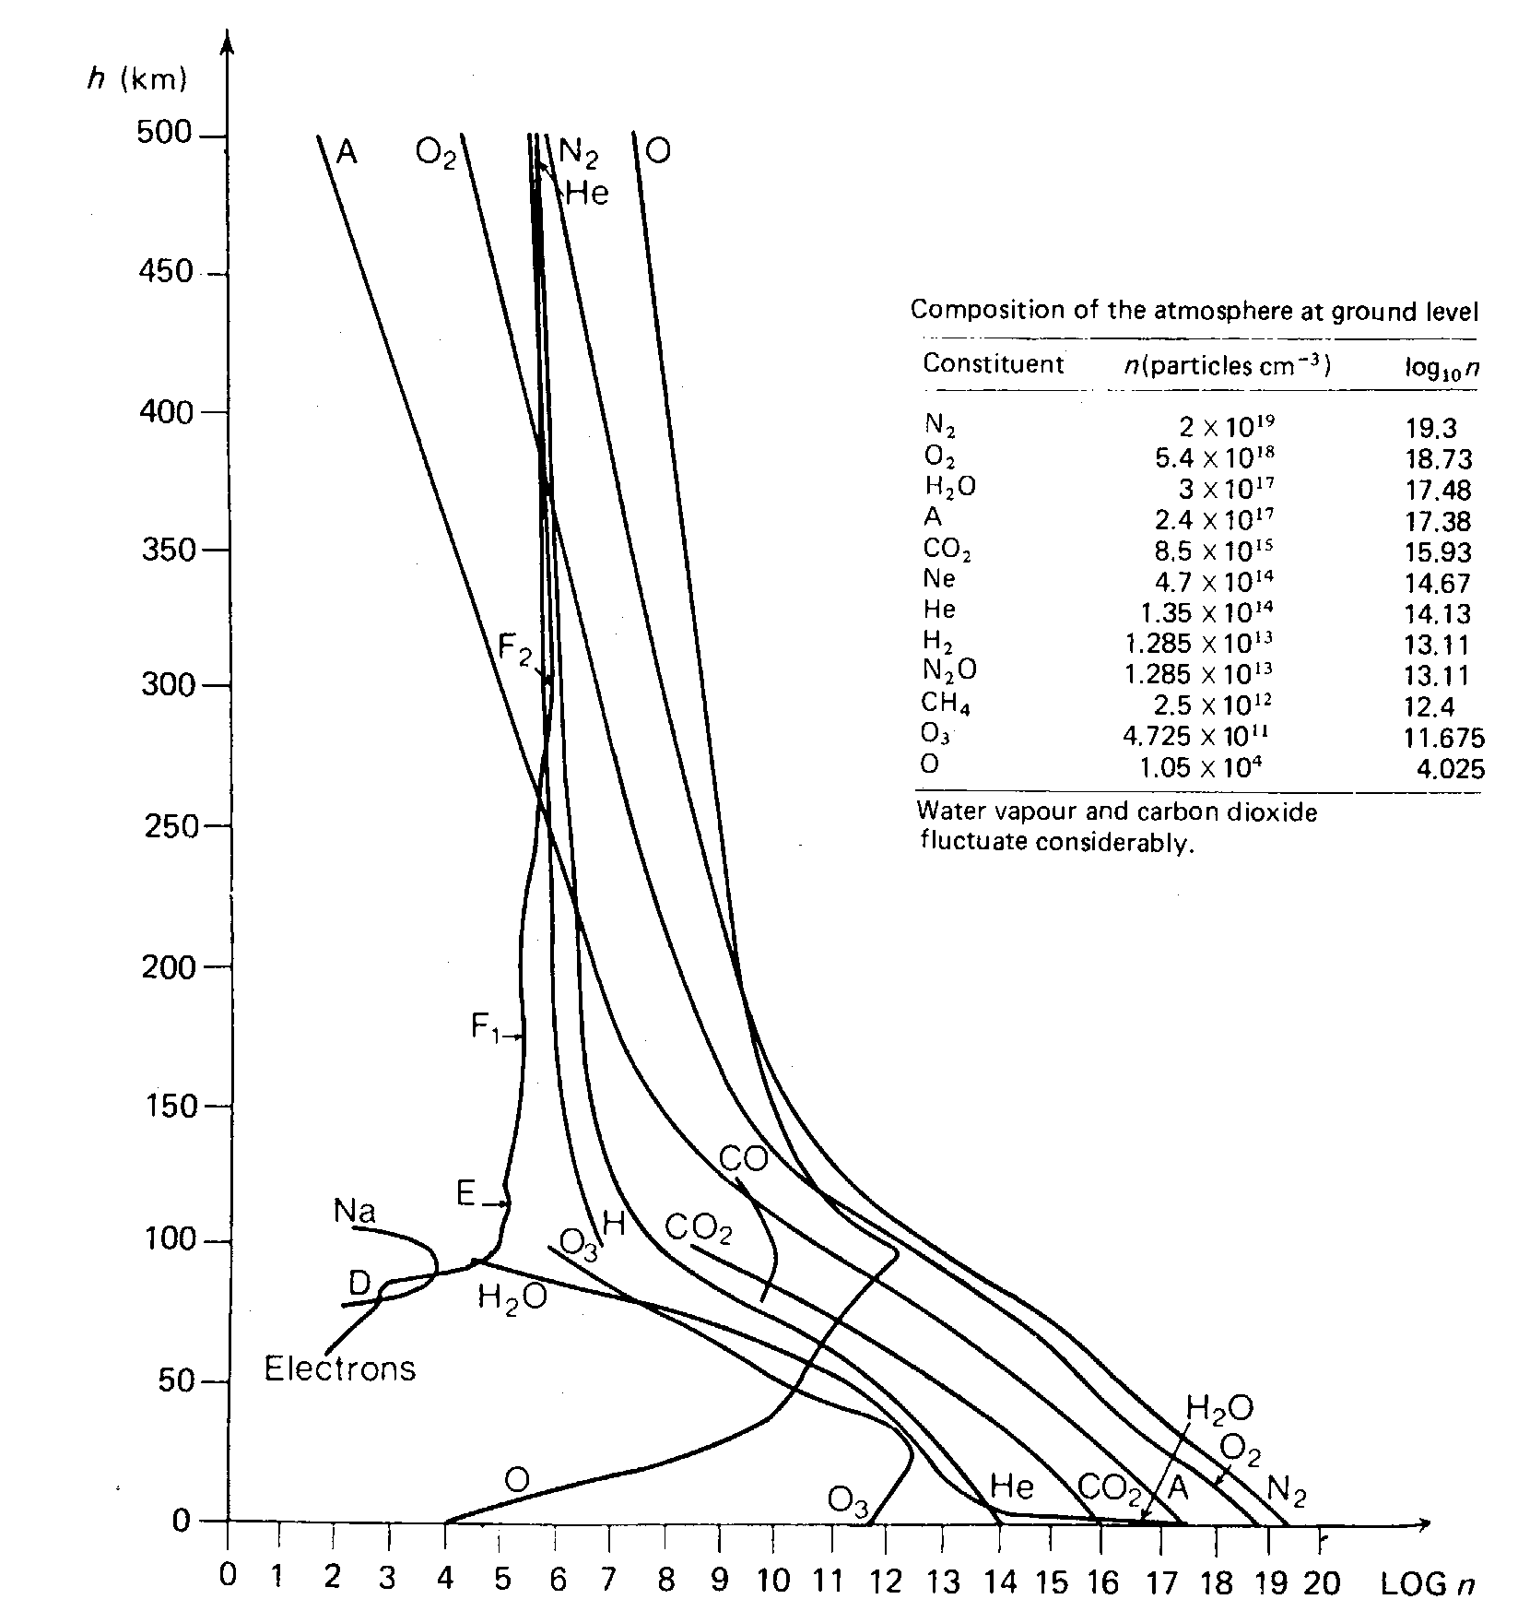
Structure of the Earth’s atmosphere
Penetration of solar radiation
Through Earth atmosphere
exosphere
EUV 100 – 1000 A
XUV 10-100 A
VUV 2000 – 3000 A
thermosphere
The main constituents of atmosphere at h=150-500 km:
O, N₂, O₂, N, H, He
mesosphere
stratosphere
troposphere

Slide 5
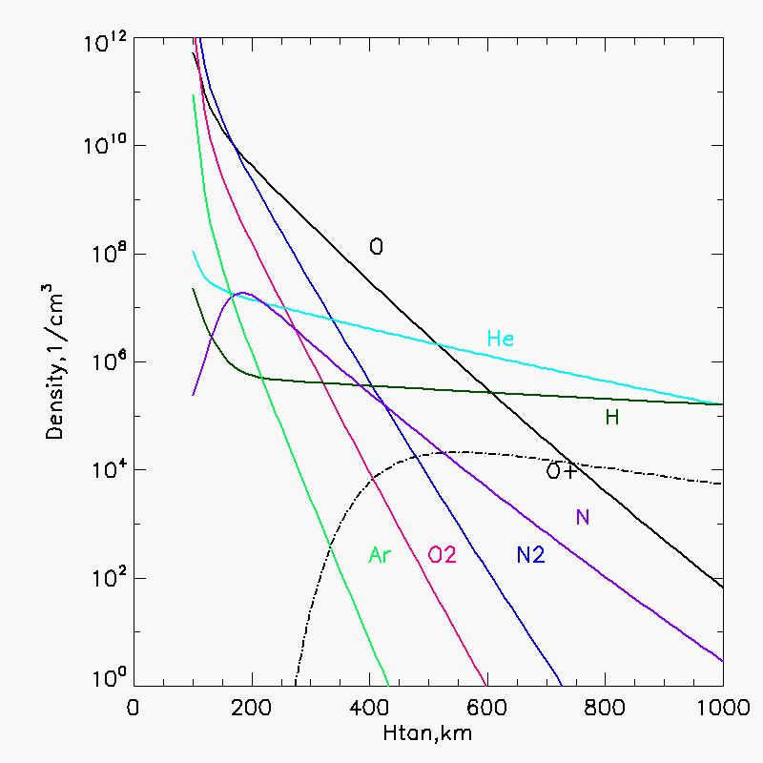
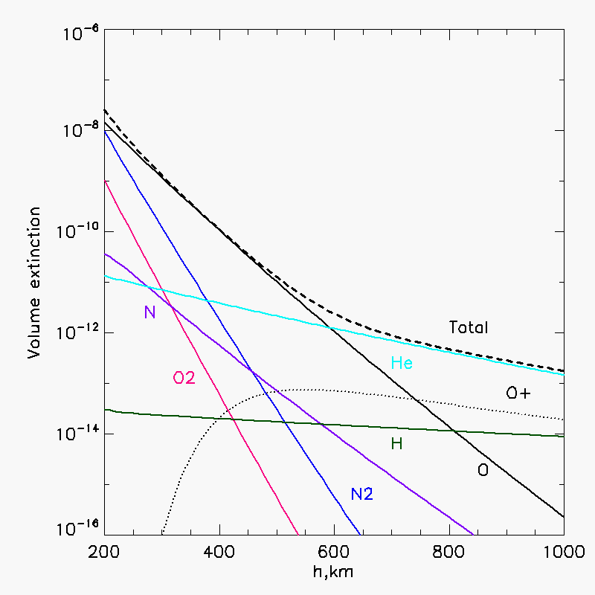
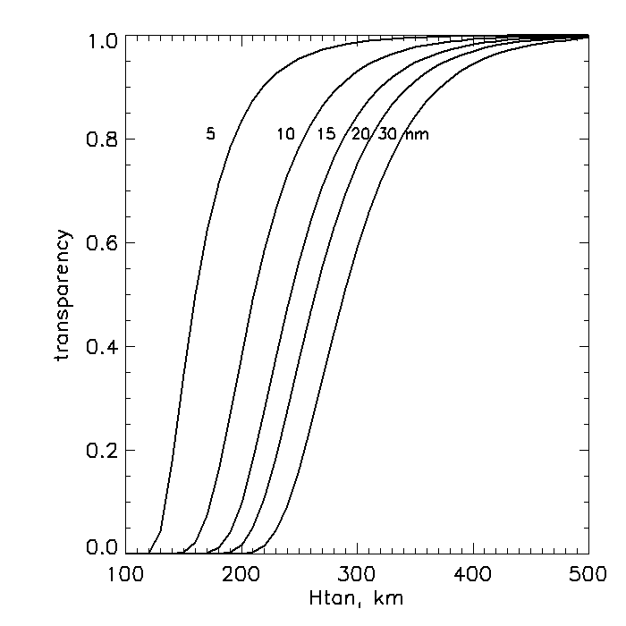
NRLMSISE-00 model
J.M. Picone, A.E. Hedin, D.P.Drob JGR 107, A12, 1468, 2002 http://ccmc.gsfc.nasa.gov/modelweb/models/nrlmsise00.php
Photoionization cross-sections were taken from:
D. Verner et al. ApJ 465, 487 (1996);
J.A. Fennelly, D.G. Torr. Atomic data and nuclear data tables, v.51, 321-363, 1992.
Occultation measurements with solar EUV telescopes working in the 17-40 nm range allow to monitor the thermoshere at h=200-500 km in order to:
correct the atmosphere density models;
understand a response of atmosphere to solar and geomagnetic activity.
λ

Slide 6
Measurements of atmosphere absorption in EUV
Most of absorption data were obtained in UV-Vis range, mainly, in the ozone band (Nimbus 7, TOMS, SAGE, UARS, ENVISAT, etc).
In EUV:
Rocket flights of 1960:
Hinteregger, 1962, Journ. Atmos.Sciences, 19, 351
Measurements at low zenith angles ,λ = 283 – 1216 A, h ~ 100 – 200 km
TIMED/SEE: 2002 – c.t., EGS solar occultation data in 27-195 nm, Δλ=0.4 nm, one point in altitude in orbit
Found deviations from NRLMSISE-00 model
We present the results of:
CORONAS-F/SPIRIT telescope, 2001-2005, 17.5/30.4nm band, Δλ=0.6 nm
CORONAS-Photon/TESIS telescope, 2009 Feb-Nov, 17.1/30.4 nm band, Δλ=0.25 nm
PROBA2/SWAP telescope, 2010-c.t., 17.4 nm band, Δλ=0.25 nm
PROBA2/LYRA radiometer, 2010-c.t., Lyα [120-123nm] , Herzberg [190-222nm],
Al [<5nm] + [17-80nm], Zr[<2nm] + [6-20nm] .
CORONAS : non solar-synchronous orbit, h_{orb}= 550 km, 82.5⁰,
PROBA 2: solar-synchronous orbit , h_{orb}=720 km

Slide 7
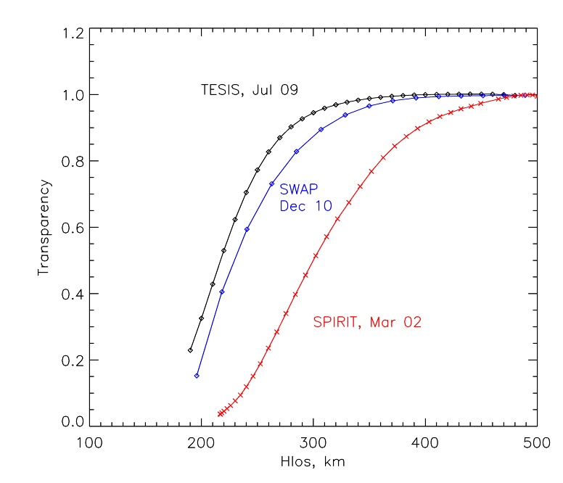
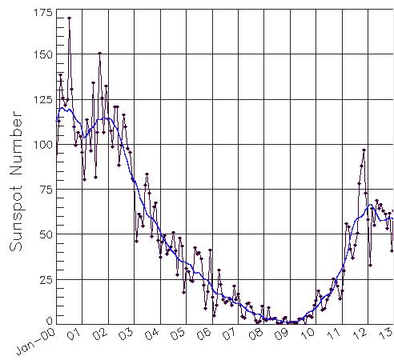
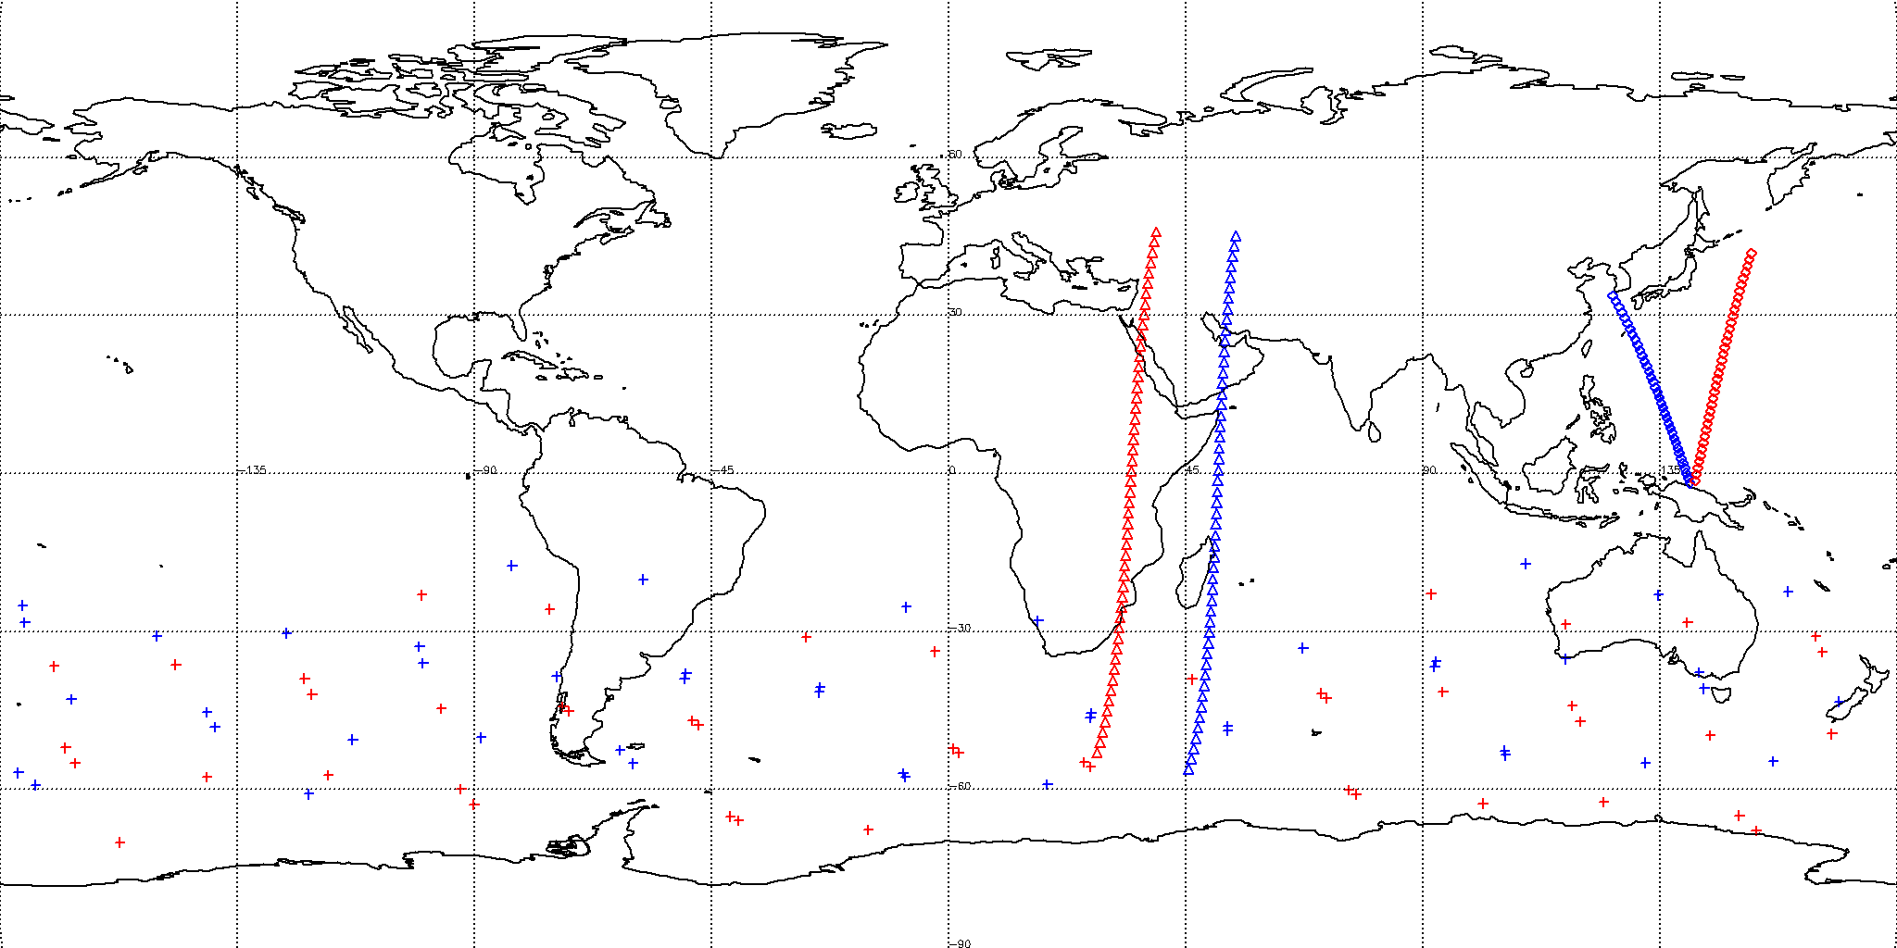
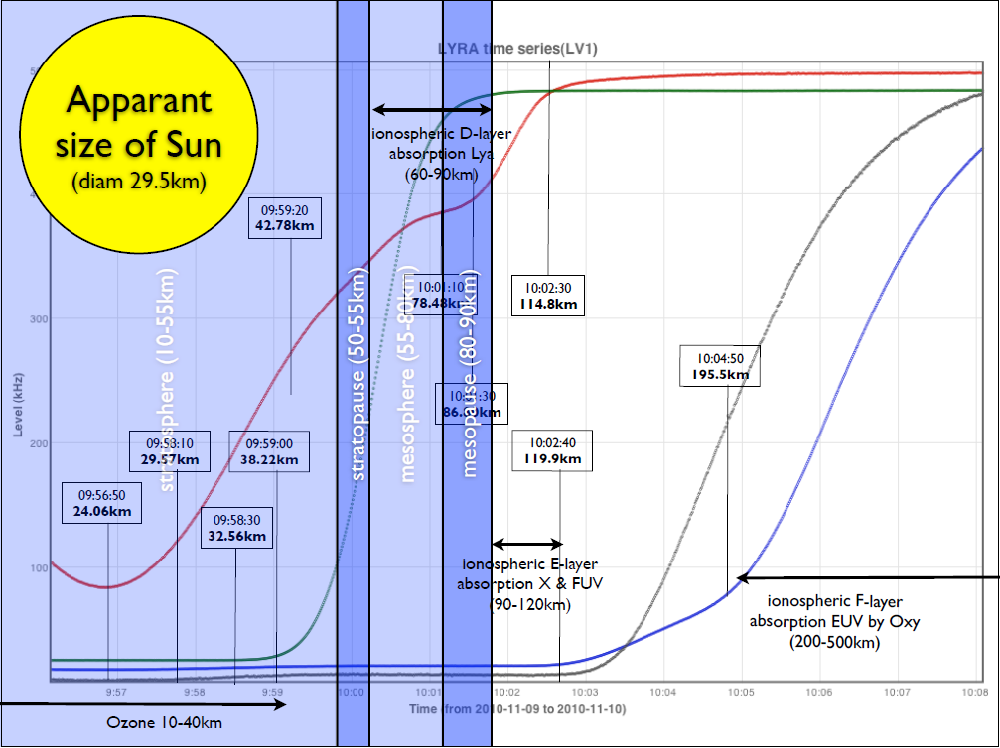
Measurements at different solar activity
SPIRIT
SWAP&LYRA
TESIS
Map of occultation locations
SPIRIT
5 Mar 2002
SWAP
22 Dec 2010
TESIS
17-19 July 2009
Red – locations of satellites
Blue – locations of occultation

Slide 8
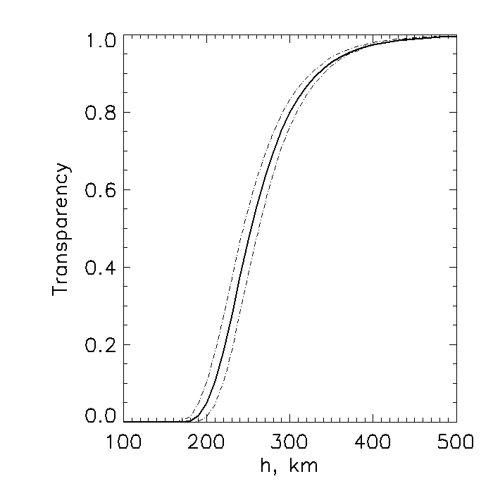
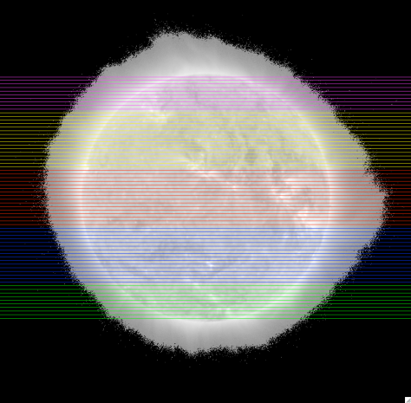
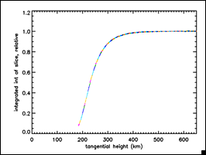
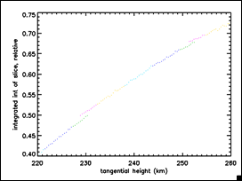
Improvement of spatial resolution by using the solar EUV images
Two possible modes: integrated flux mode and imaging mode
1. Integrated flux mode: averaging on dh
2. Imaging mode: differentiation on slices in an image
dh
H_{orb} = 500 km,
dh =18 km
The points for different slices diverge at ~0.5 km, probably, due to temporal variation of solar structures
No fine structure has been detected from SWAP images of Dec10 and Jan 11.
The transparency curve for conic beam coincides with the central ray within <0.5 km

Slide 9
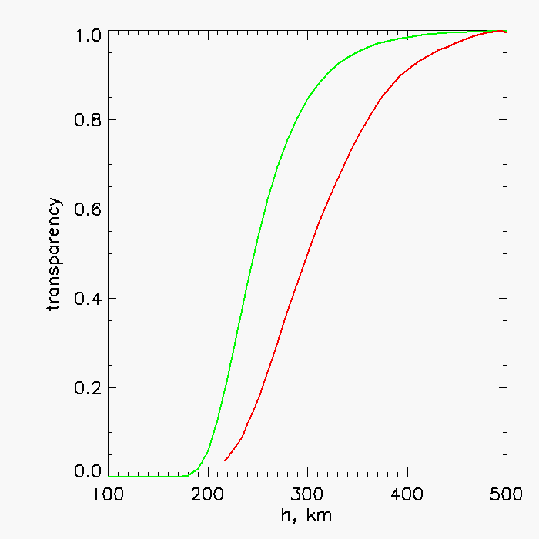
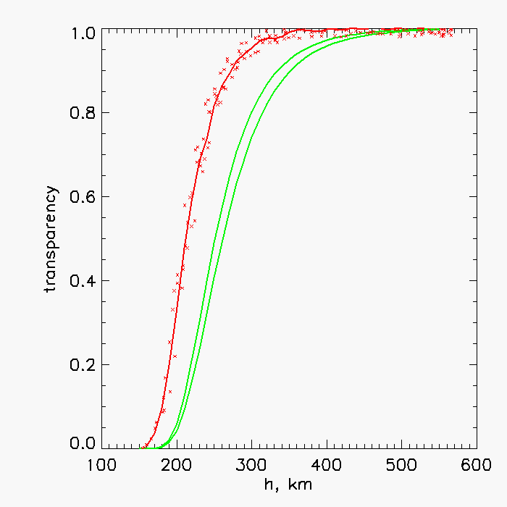
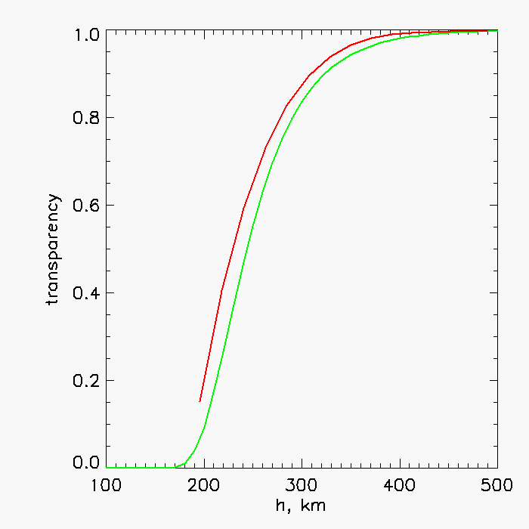
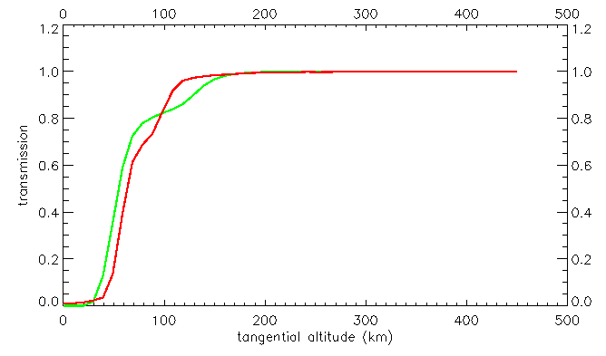
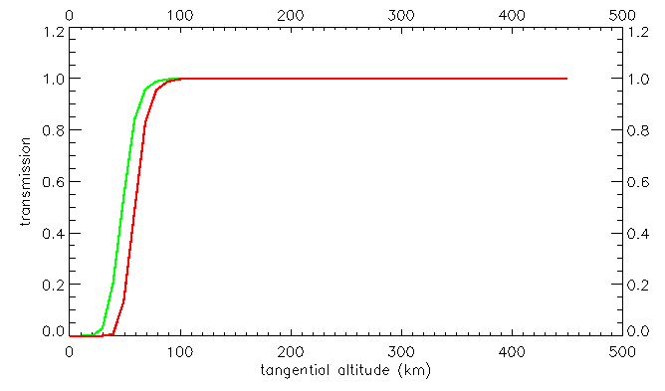
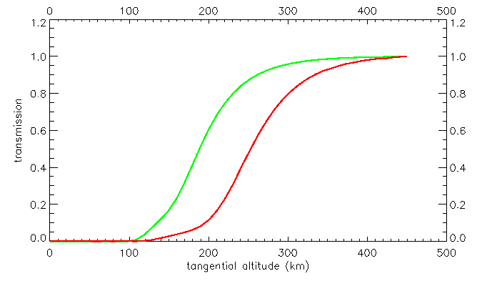
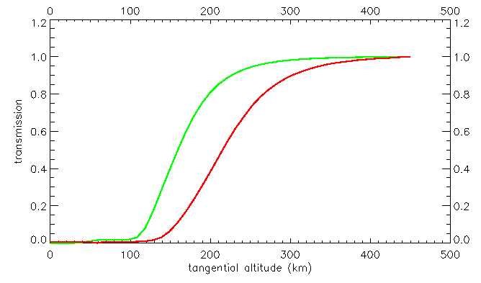
Comparison with NRLMSISE-00 model
SPIRIT, 2002-03-05, F10.7=169 TESIS, 2009-07-17_19, F10.7=70 SWAP, 2010-12-22 F10.7=75
lat -5.5⁰ , long 43.7⁰ lat -69.1⁰ … +43.7⁰ , lon 0…360⁰ lat 41.8⁰ , lon 152.3⁰
Model
Lat/lon variation
Data
Moderate
activity
Solar max
Solar min
Model < data Model > data Model ≈ data
LYRA 2010-01-09, F10.7=78
Ly-α 120-123nm
Herzberg 190-222nm
Agreement is better for long-wavelength bands (below h=100 km) than for short-wavelength bands (100-300 km).
Al λ<5+ 17-80nm
Zr λ <2+ 6-20nm

Slide 10
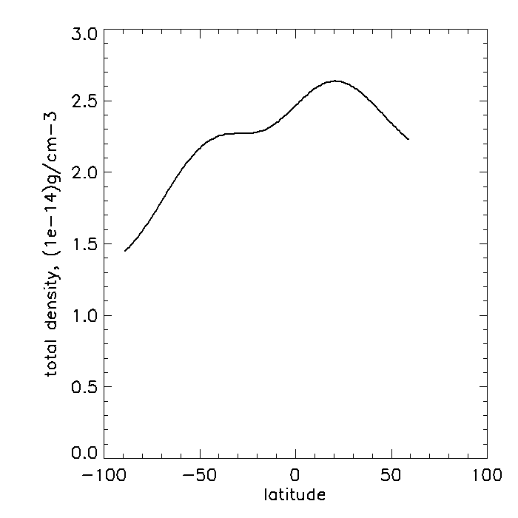
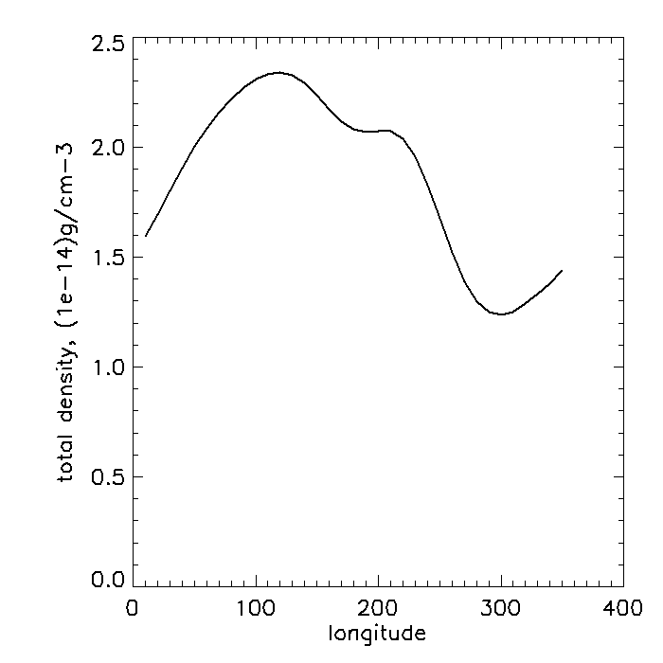
Variation of the total density at h=300km on latitude and longitude
Solar minimum, 2009-07-19 05:30
Longitude 120⁰
Latitude 50⁰
Variation 53% 55%

Slide 11
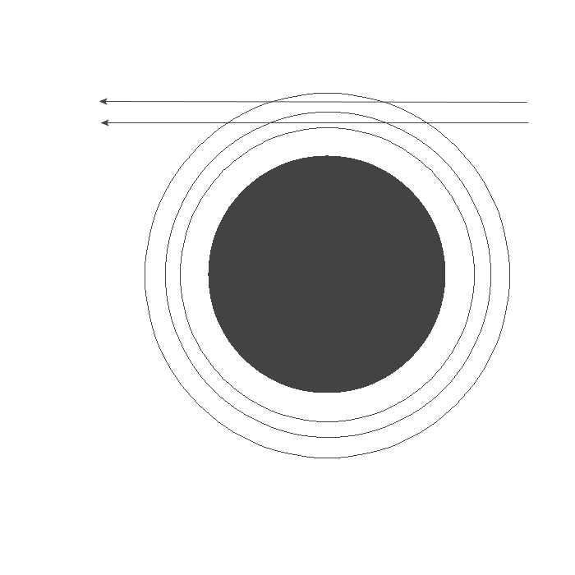
Retrieval of extinction coefficients
1. Onion peeling method
1
2
Layer N
N+1
2. Solution of the absorption integral equation by the Tikhonov’s method of generalized discrepancy
The extinction function y(r) is found as a solution of the
Fredholm I – type integral
Which minimizes the functional of generalized discrepancy:
The value of regularization parameter α can be found from the measurement errors δ and the kernel errors h_{k}

Slide 12
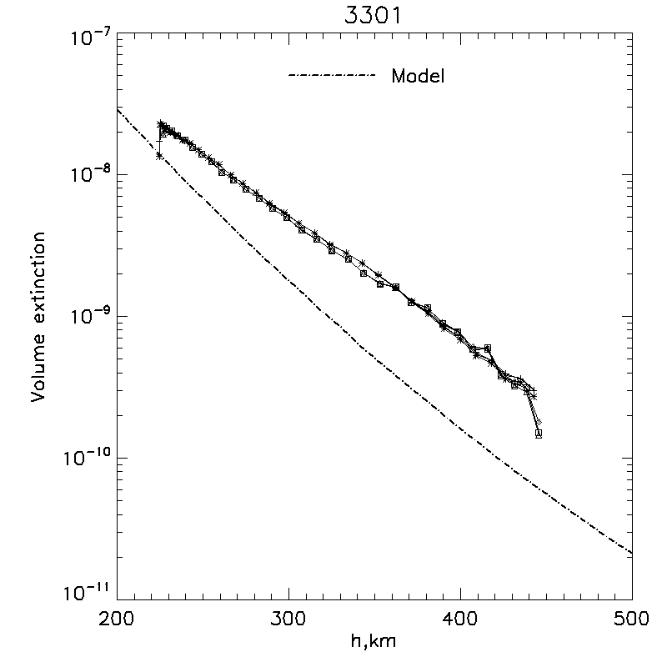
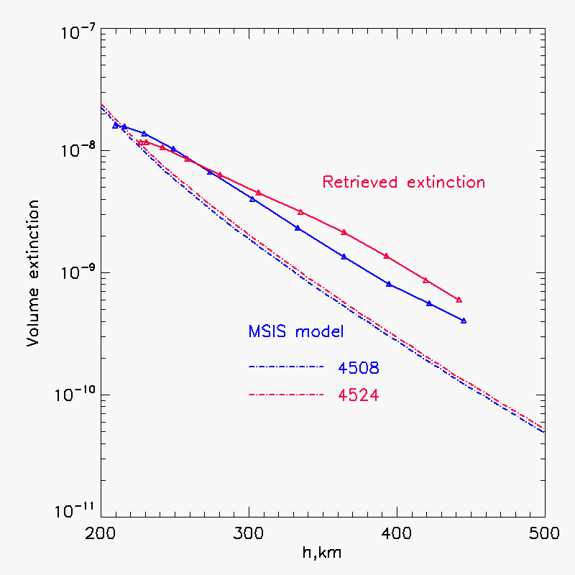
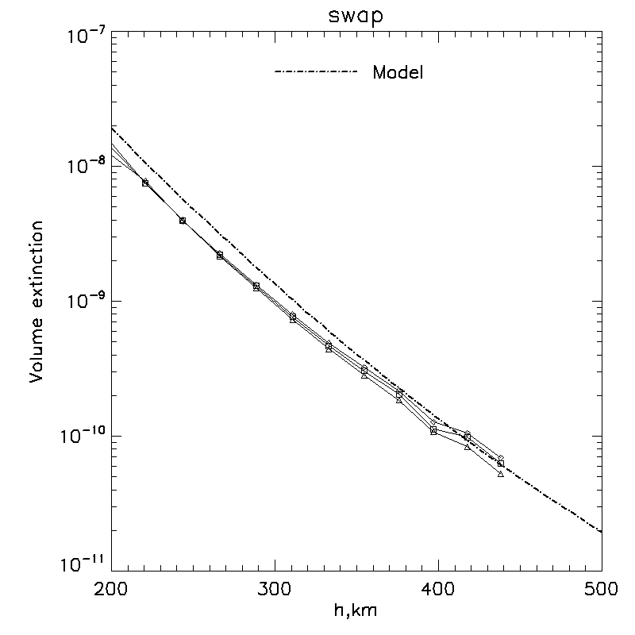
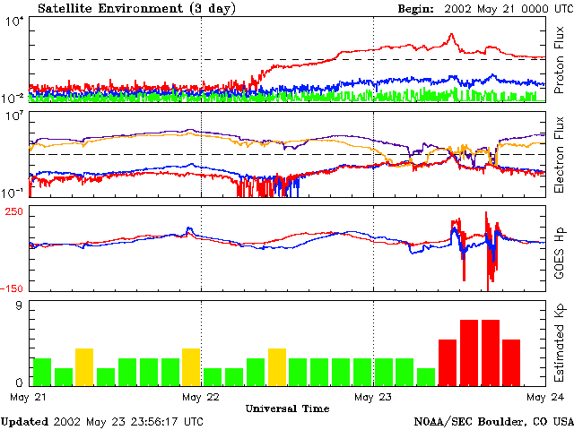
Quiet atmosphere
Disturbed atmosphere (storm)
SPIRIT data for 2002-05-23
Orbit 4508 - before storm, Ap=12
Orbit 4524 – during storm, Ap=236
SPIRIT (solar max, high latitudes)
Retrieved extinction
storm
MSISE model
quiet
SWAP (solar min, low latitudes)
4508 4524
MSISE model
Retrieved extinction

Slide 13
Conclusions
Absorption of the solar EUV radiation (17-30 nm) at altitudes in the atmosphere above 200 km is very sensitive on solar activity and condition of the Earth magnetosphere
In the imaging mode the altitude resolution can be improved to ~0.5 km.
3. At altitudes 220-400 km the measured absorption in 17.5 nm shows differences in comparison with the NRLMSISE-00 model.
In quiet magnetosphere conditions:
- at solar max (SPIRIT) the measured extinction exceeds the
model value in 2-3 times;
- at deep solar min of 2009 (TESIS) the modeled absorption is on
one order higher than the measured one (averaged over wide range of
latitudes and longitudes);
- at moderate activity (December 2010) at low latitudes (SWAP) the
measured extinction agrees with the modeled one within 20-30%.
4. In storm conditions the measured extinction at 400 km is higher in 2 times
that in quiet state, whereas the model gives an increase only on less than 10%.

Slide 14
Thank you for attention

