Slide 1
ESWW10 Splinter Session: Space Weather Analysis: GOES Particles and Fields
Juan Rodriguez
NOAA National Geophysical Data Center
Boulder, Colorado USA
21 November 2013

Slide 2
GOES Space Environment Data
Periods of interest:
27 Feb 2013 - 20 Mar 2013
13 May 2013 - 5 Jun 2013
21 Jun 2013 - 25 Jul 2013
Satellites available during these periods: GOES-13 (75°W) and GOES-15 (135°W)
Following plots are for GOES-15
Produced by Dan Wilkinson, NGDC
Available at http://satdat.ngdc.noaa.gov/sem/goes/data/new_plots/2013/
Phenomena common to periods of interest:
Solar energetic particle events
Elevated MeV electron fluxes
Particle injections (substorms)

Slide 3
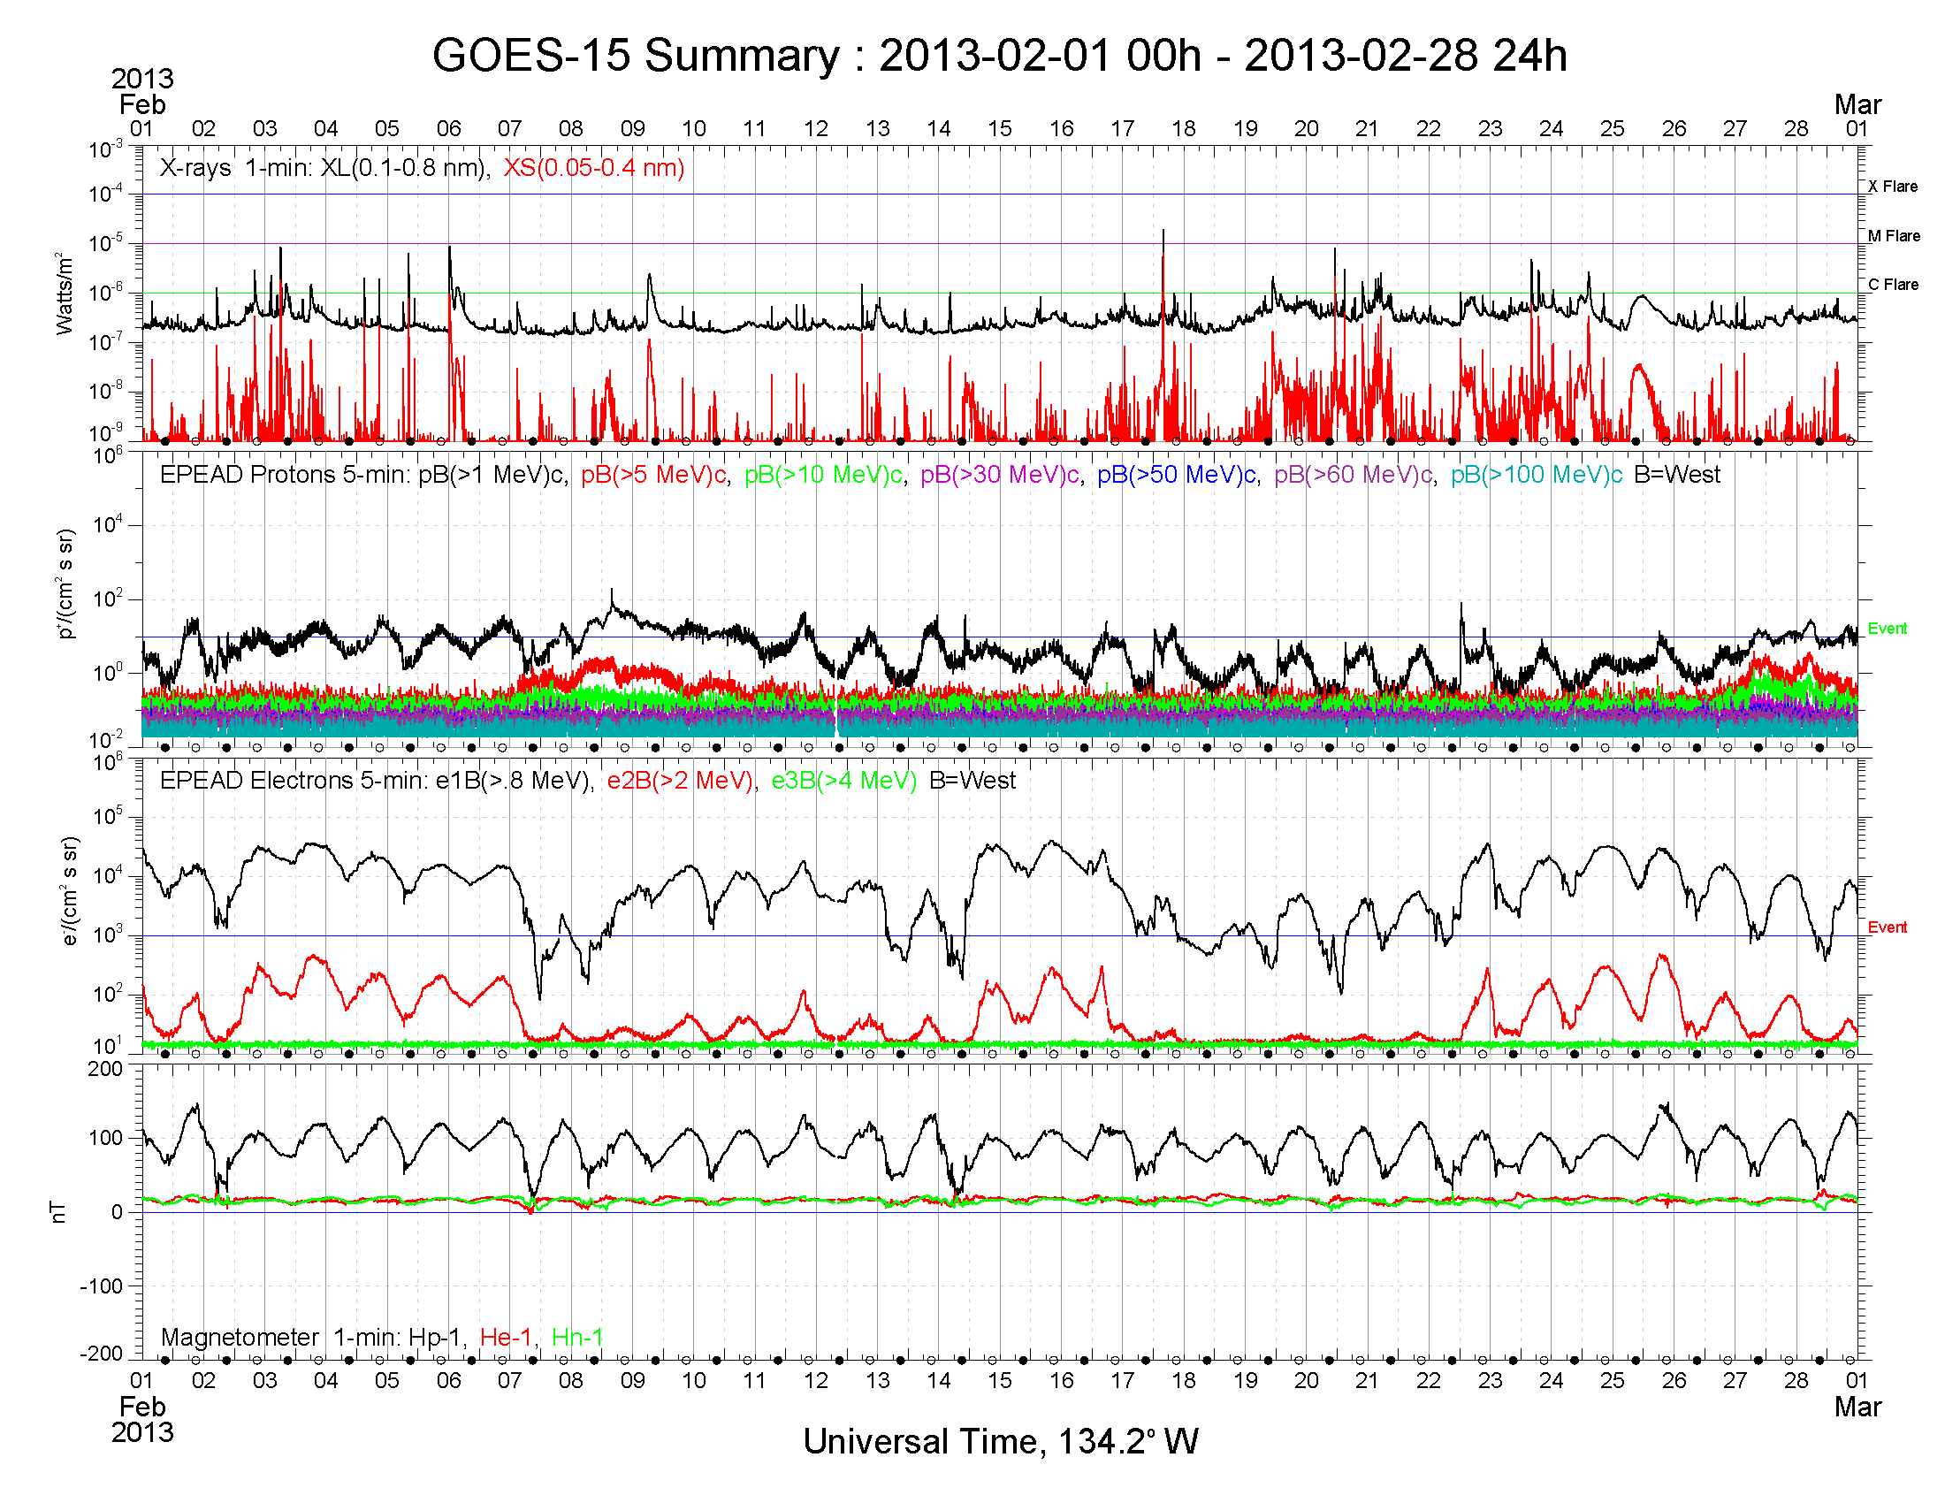

Slide 4
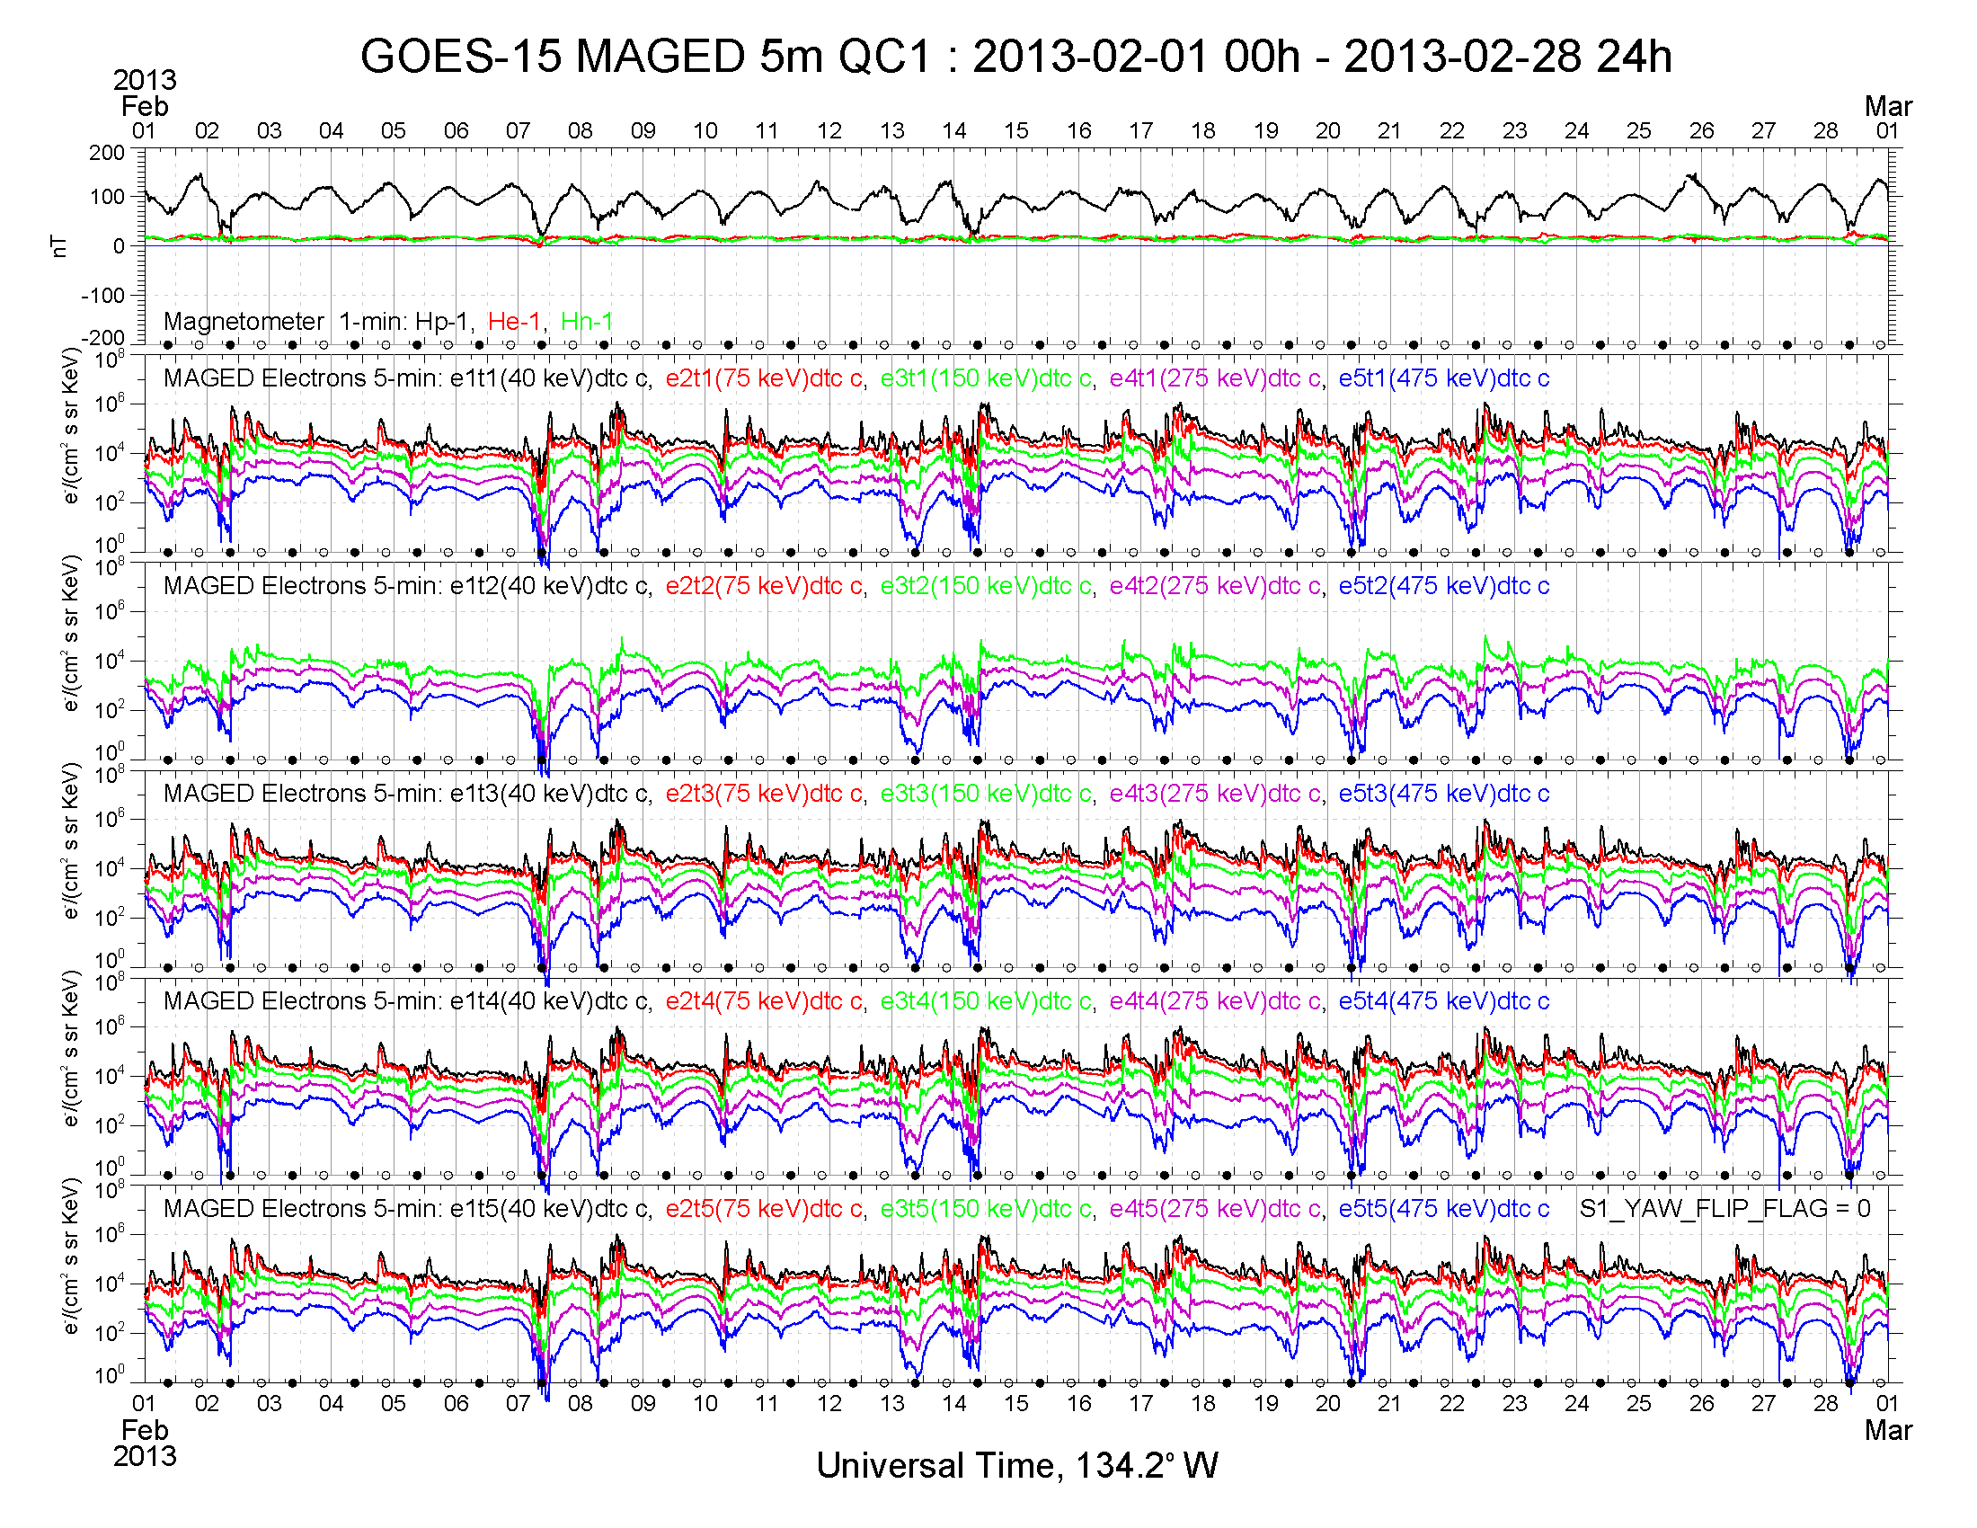

Slide 5
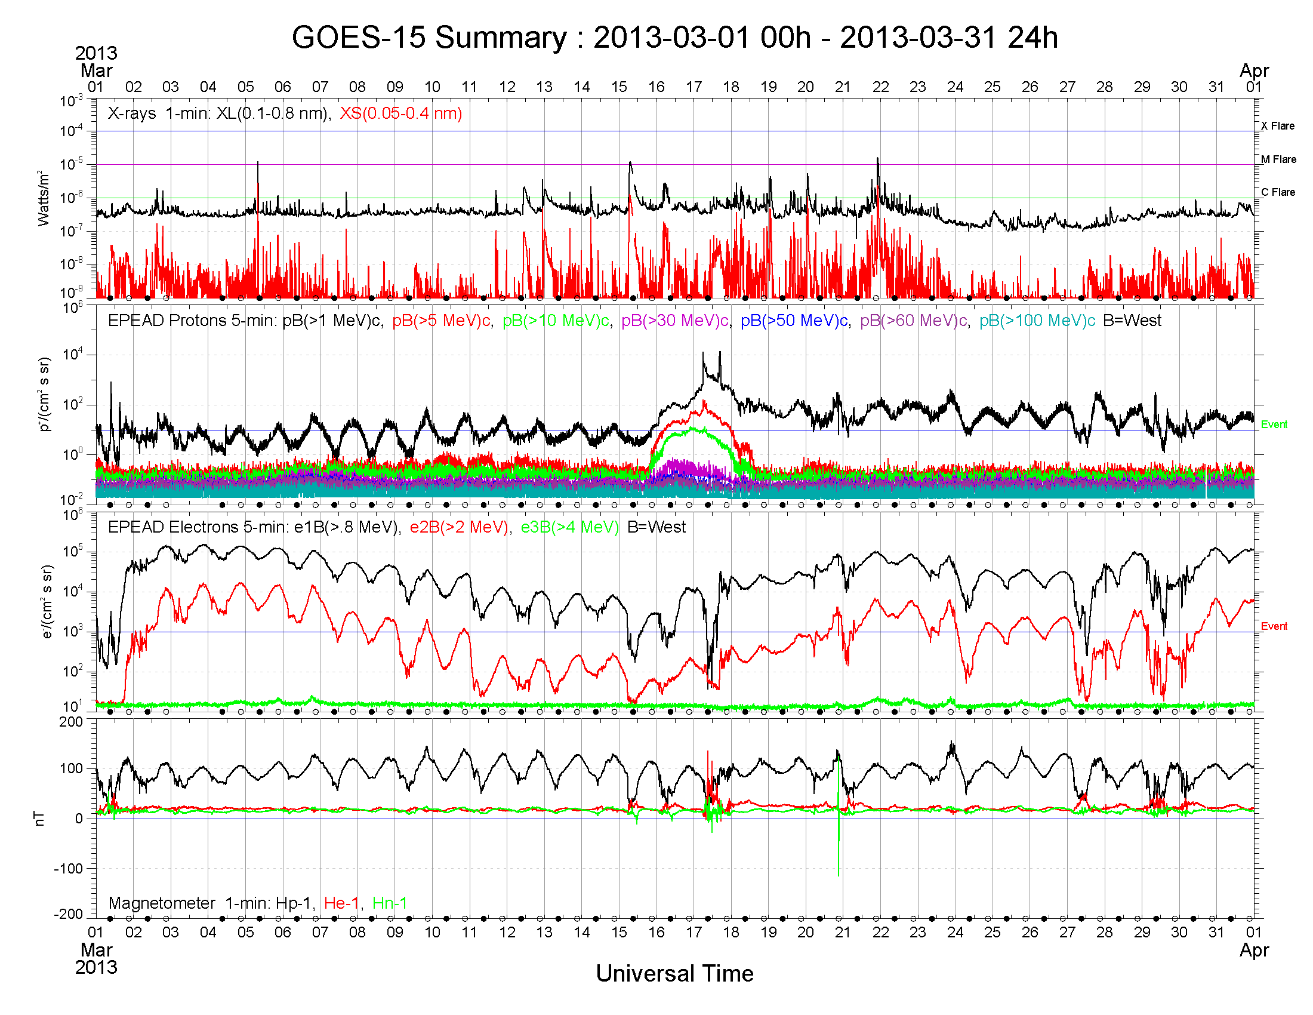

Slide 6
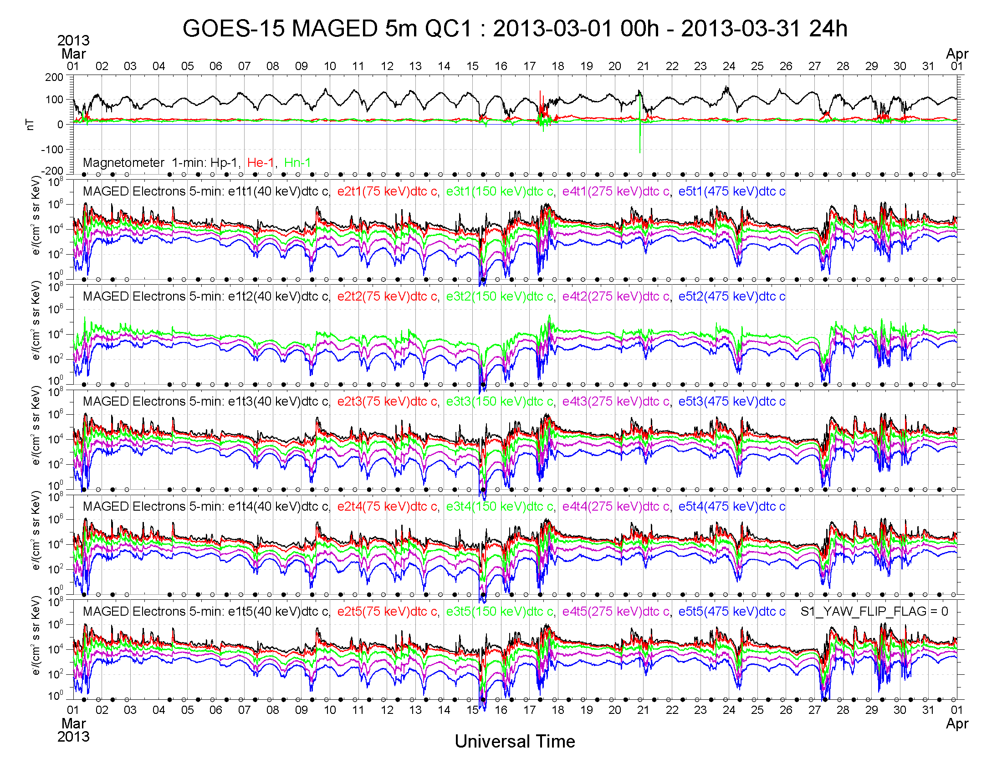

Slide 7
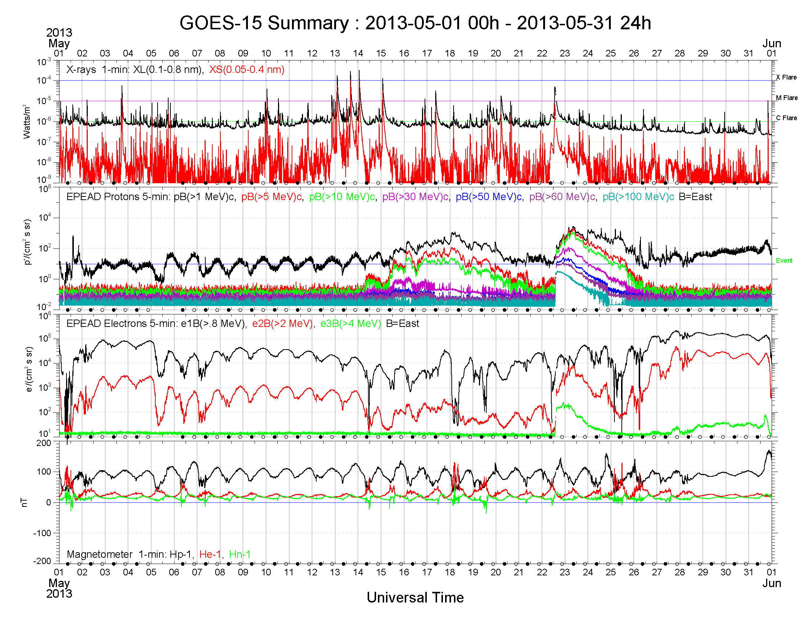

Slide 8
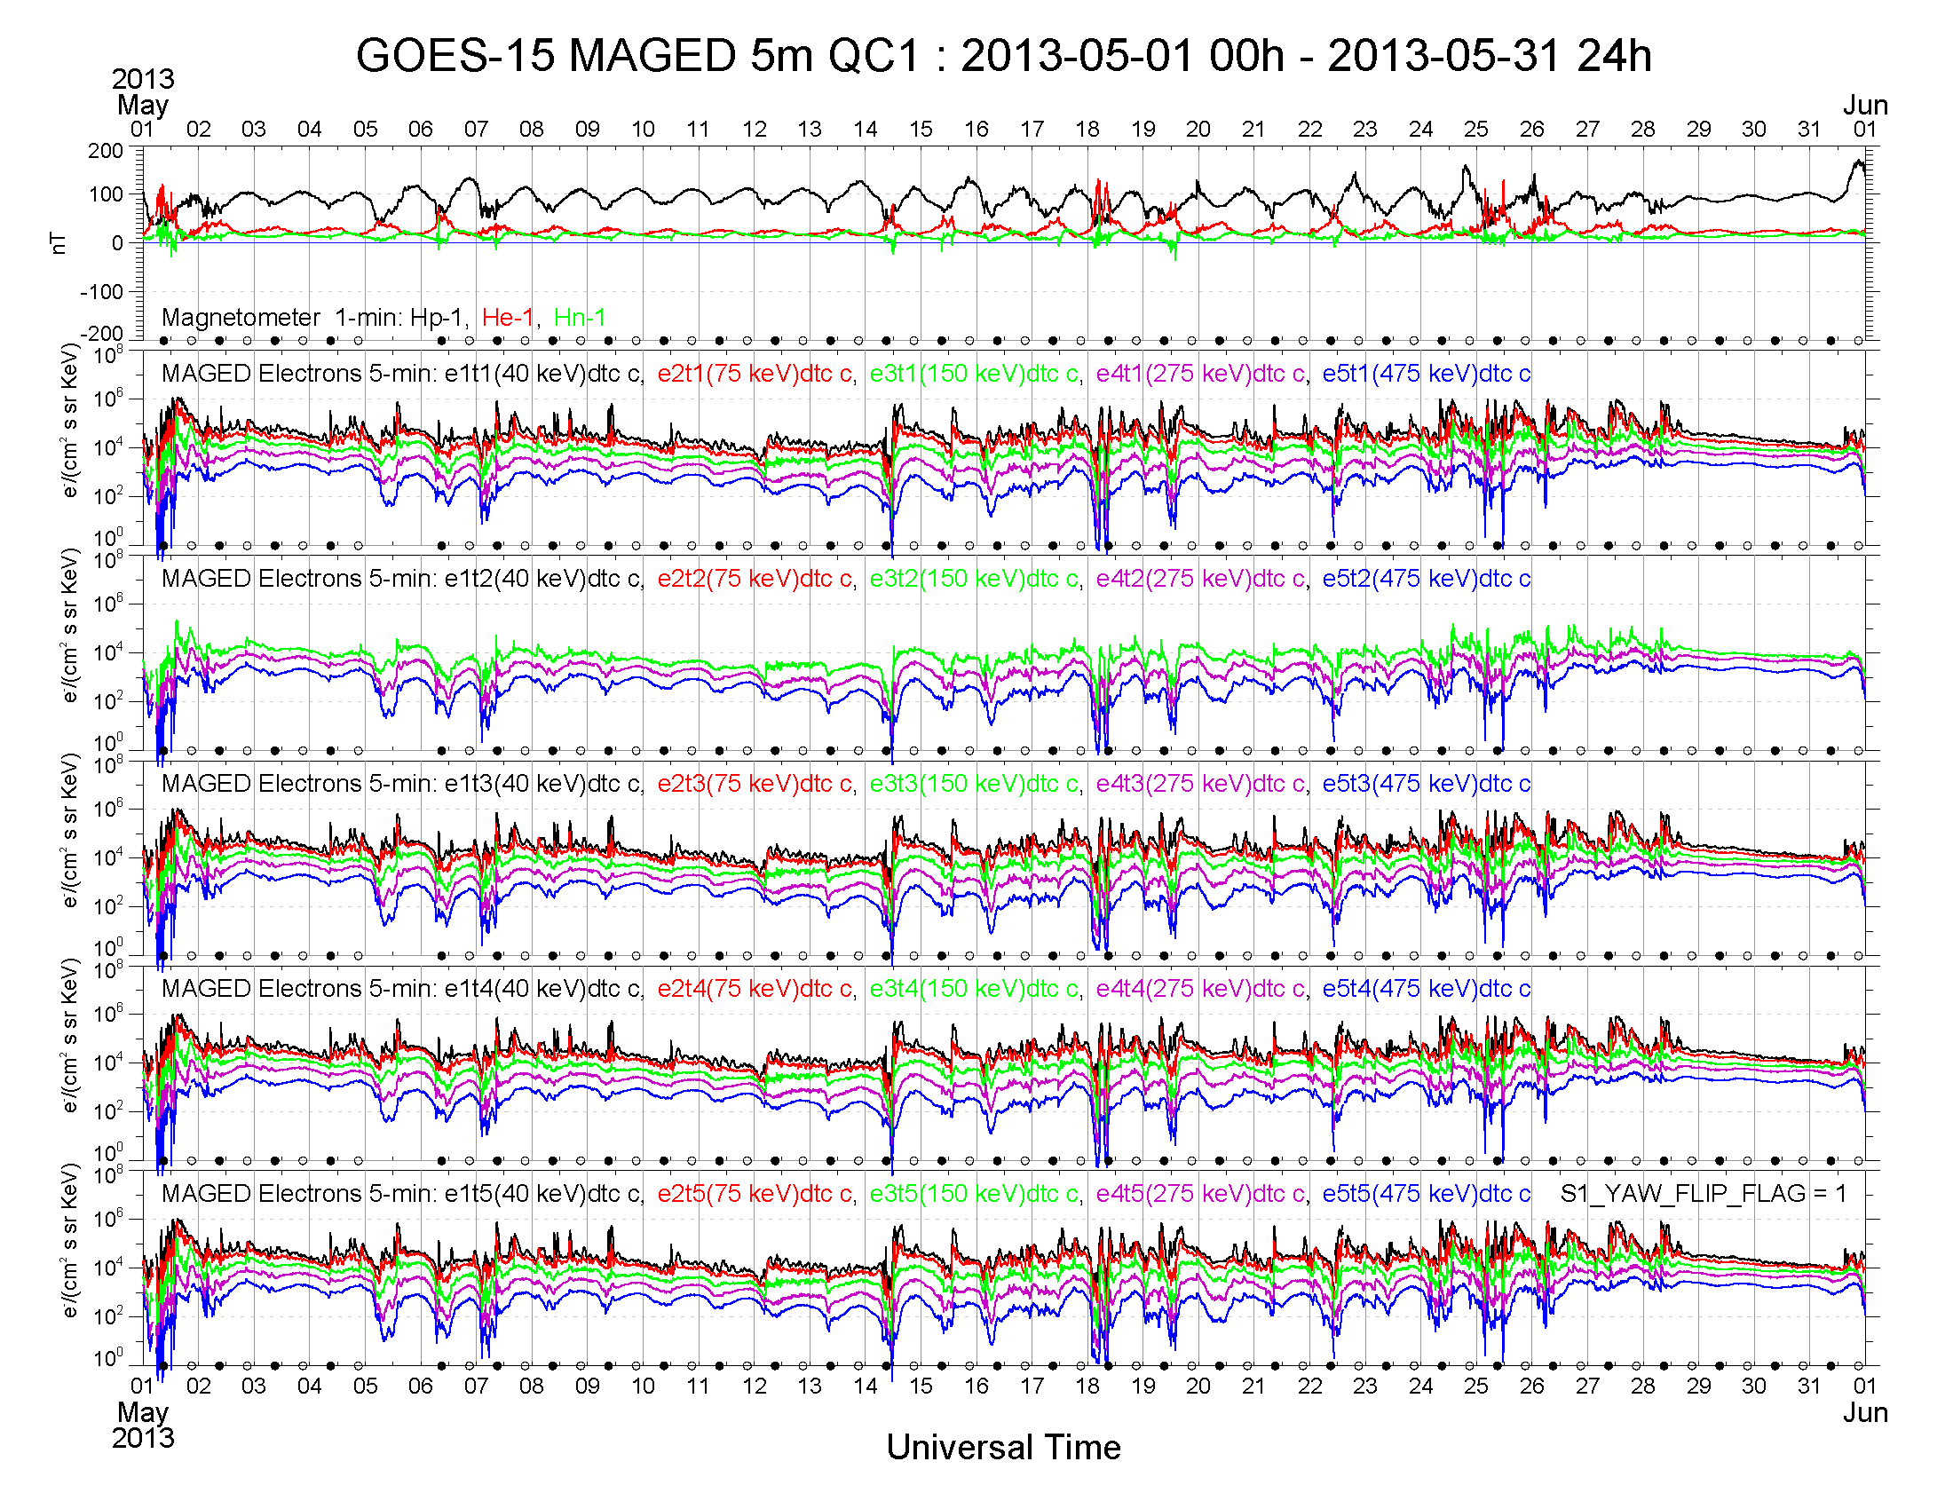

Slide 9
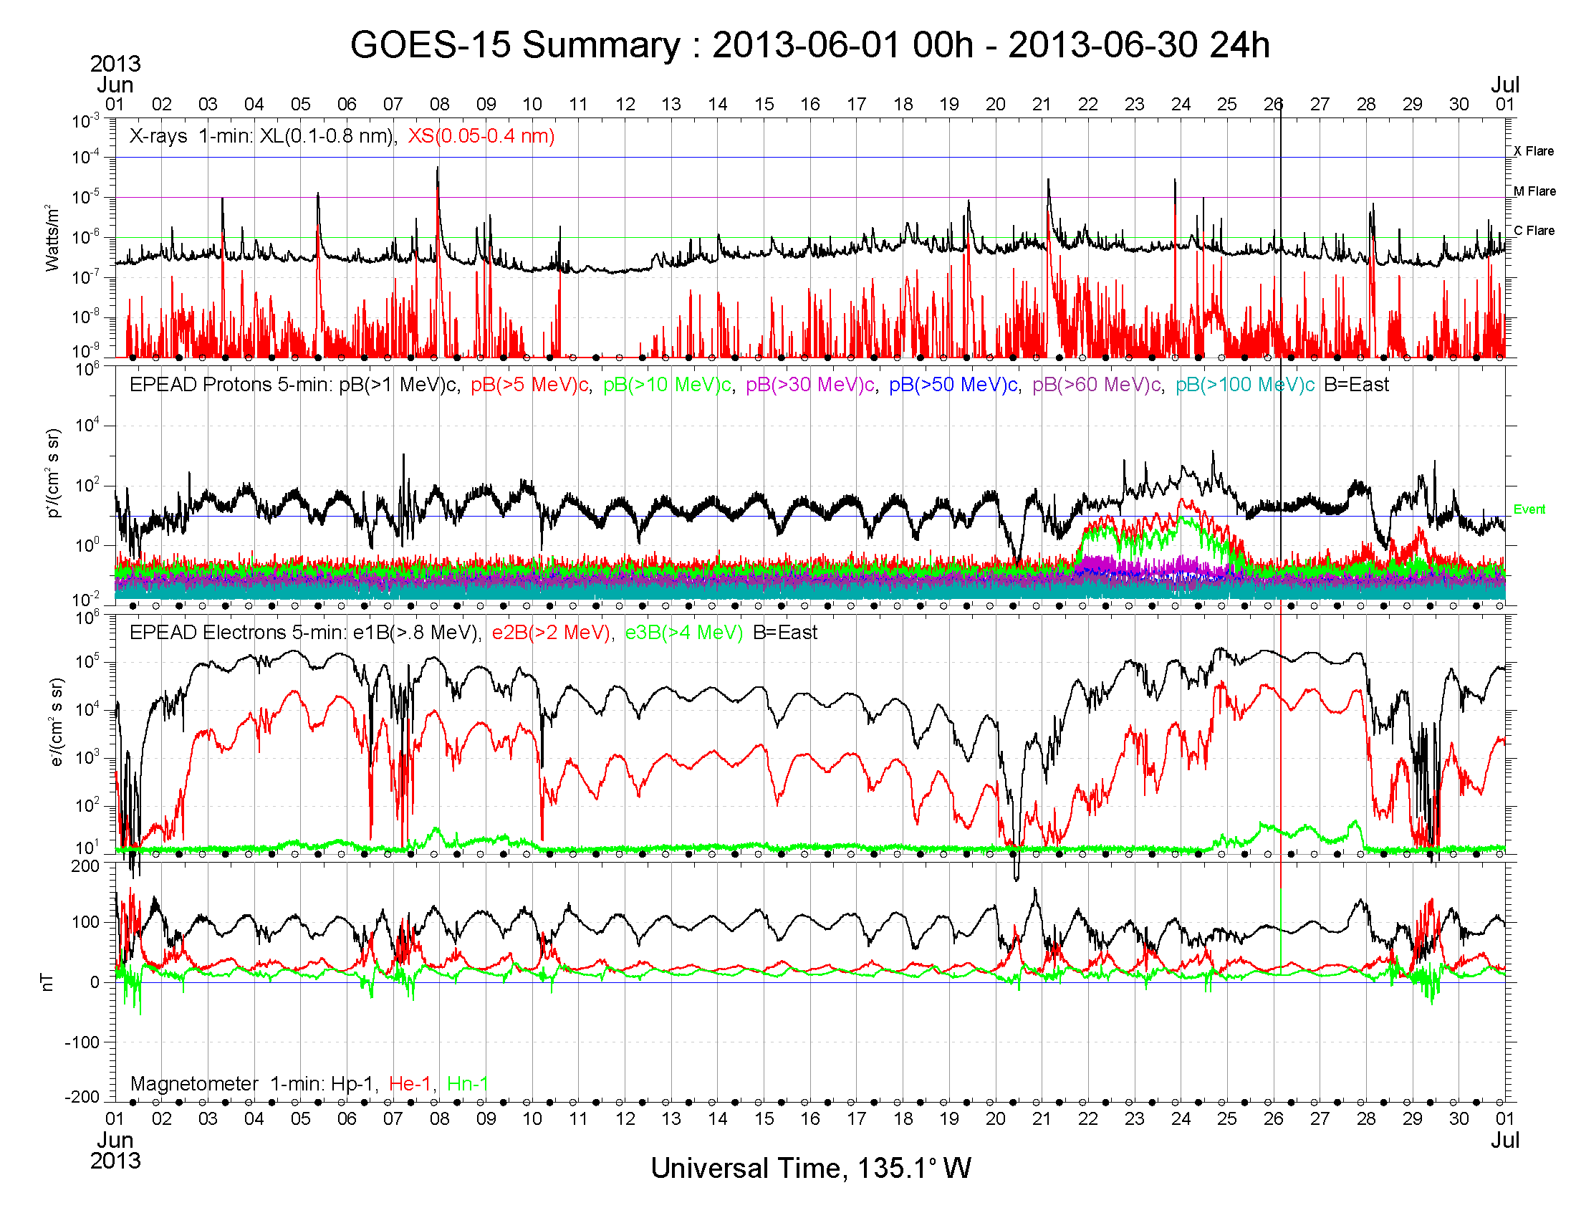

Slide 10
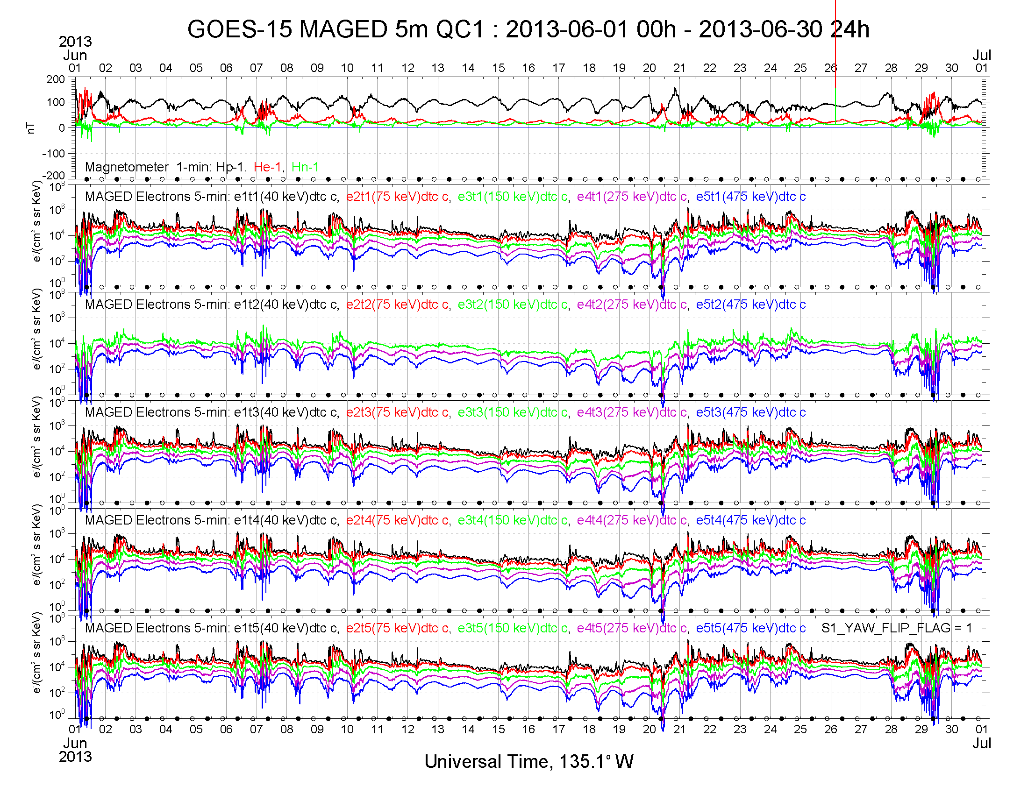

Slide 11
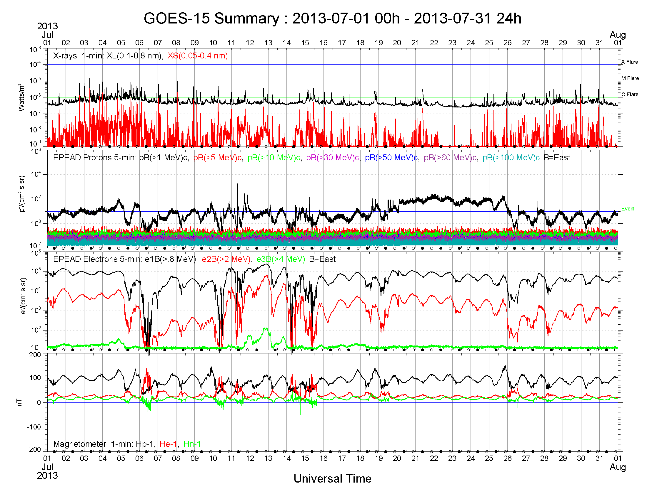

Slide 12
