Slide 1
Analysis of a C4.1 flare occurred in a δ spot using SDO and SST data
S.L. Guglielmino¹, F. Zuccarello¹, P. Romano², A. Cristaldi^{3,4}, M. Falco¹, I. Ermolli⁴, S. Criscuoli⁵
¹Dipartimento di Fisica e Astronomia – Università di Catania, Italy ²INAF – Osservatorio Astrofisico di Catania, Italy ³Dipartimento di Fisica– Università Roma Tor Vergata, Italy ⁴INAF – Osservatorio Astronomico di Roma, Italy ⁵NSO – National Solar Observatory, Sunspot, USA

Slide 2
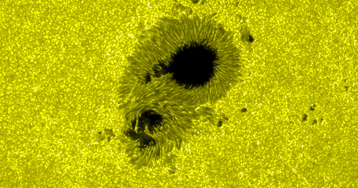
Delta spot characteristics
Delta spot: a sunspot with umbrae of opposite polarities inside the same penumbra
Strong shear flows are often observed along the PIL of flaring δ spots (Denker & Wang, 1998).
Curved penumbral filaments, cospatial to these shear flows and almost tangential to the sunspot umbra, can be observed,
These tangential penumbral filaments provide a first indication of highly twisted (sheared) magnetic field lines.
Many of the strongest and most geo-effective flares occur in δ spots!!!
Cristaldi et al. (2014), ApJ 789, A162

Slide 3
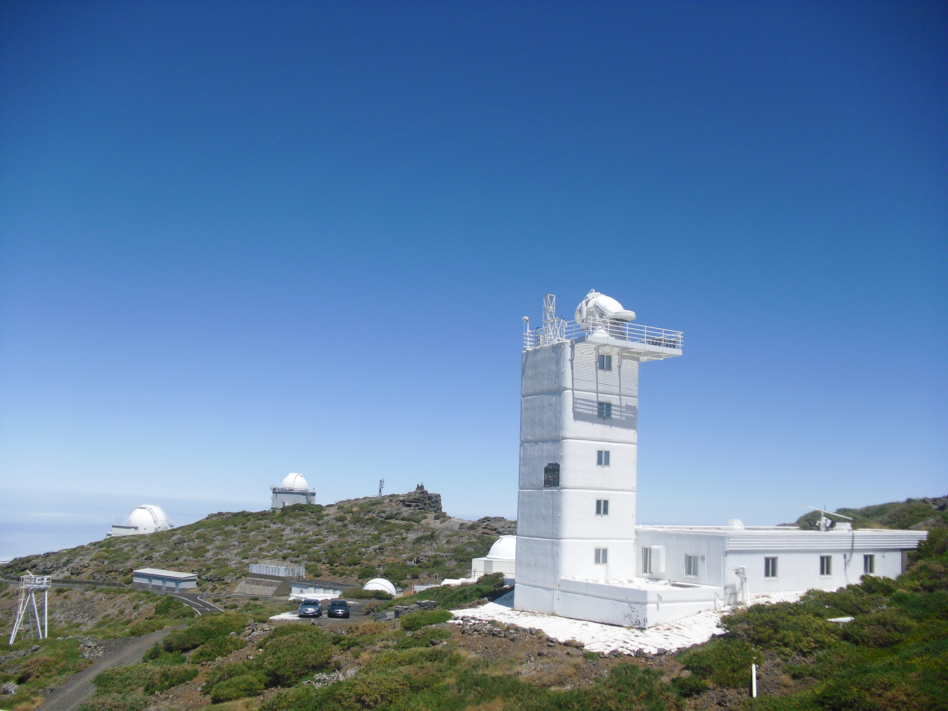
Observational data sets – NOAA 11267
Observed on the 6th of August, 2011
37 minutes of observations , from 09:00:05 UT
Instruments | Wavelength | Spectral points | Pixel size (arcsec) | Time resolution (sec) | Observation days
SST | Fe I 5576 Å | 20 | 0.0592 | 28 | 6 - 19 Aug 2011
 | Fe I pair 6302 Å | 15 | 0.0589 | 28 | 6 - 19 Aug 2011
 | Ca II H core and WB | - | 0.0338 | 9 | 6 - 19 Aug 2011
SDO | hmi.M magnetograms | - | 0.5 | 720 | 5 - 7 Aug 2011
 | hmi.IC continuum | - | 0.5 | 720 | 5 -7 Aug 2011
 | hmi.V Doppler velocities | - | 0.5 | 720 | 6 Aug 2011
 | aia.171 intensity | - | 0.6 | 120 | 5 -7 Aug 2011
 | aia.193 intensity | - | 0.6 | 120 | 5 -7 Aug 2011

Slide 4
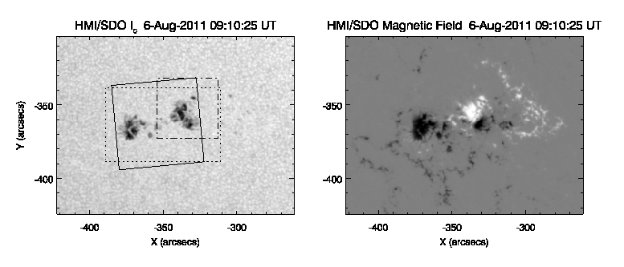
HMI/SDO: magnetograms and continuum images
SST FoV
SDO subFoV
SDO Doppler velocities subFoV
At the time of the observation the AR 11267 was 2-days old
Classified as βγδ
6 C-class flares during its passage across the solar disk

Slide 5
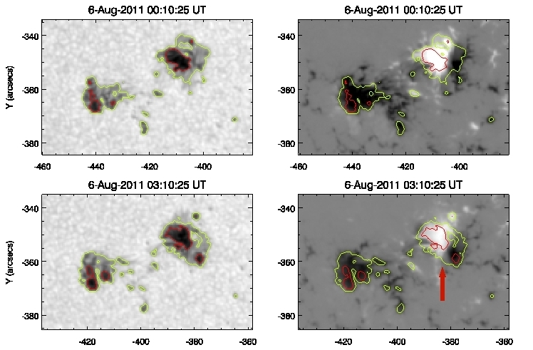
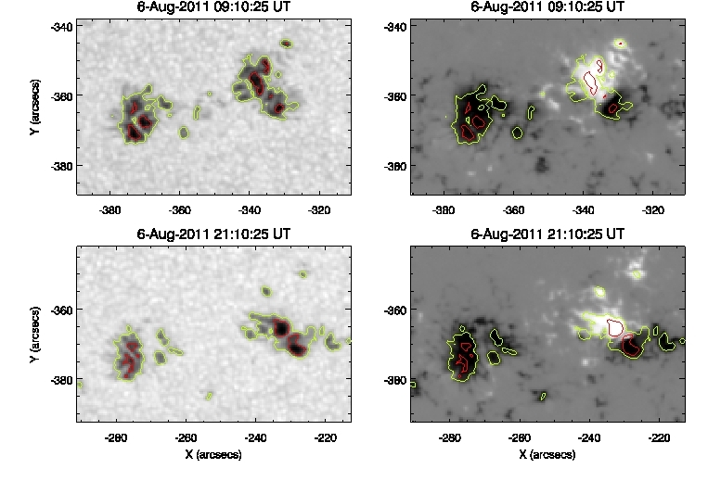
HMI/SDO: magnetograms and continuum images
Evolution of AR NOAA 11267
red contours: umbra
yellow contours: penumbra
red arrow: δ spot
During the 21 hours reported in this sequence the δ spot changes its shape: the positive umbra decreases, but the presence of the negative fragment persists

Slide 6
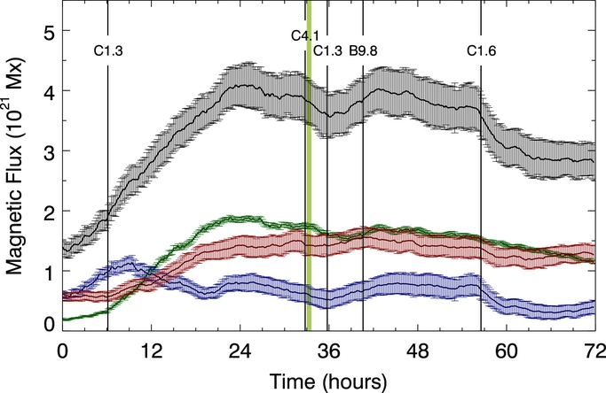
HMI/SDO: Magnetic flux trend in NOAA 11267
The green band indicates the CRISP observing period
The vertical lines indicate the flares and their magnitude
During the time of CRISP observations the negative magnetic flux (blue symbols) is in a decreasing phase
The positive flux is almost constant (red symbols)
The analyzed time interval corresponds to HMI magnetograms acquired from 00:00:00 UT on 5 August to 23:59:00 UT on 7 August.

Slide 7
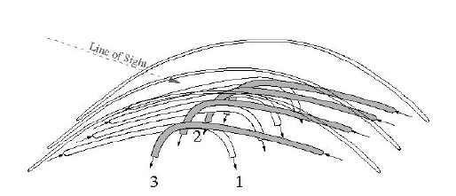
Velocity fields in delta spots
Earlier LOS velocity measurements of the region of separation between opposite polarities in δ spots (δ spot PIL) gave indication of upward motions.
More recently:
Supersonic downflows (14 km/s) and lower upflows of 1.5 km/s were detected along the δ spot PIL for about 3 hours
Martinez Pillet et al, 1994 →
Lites et al., 2002; Denker et al., →
2007; Prasad Choudhary & Deng, 2012
Takizawa et al., 2012 →
Downflows and upflows (3 km/s) along the PIL: origin in the Evershed flow due to fluted penumbral filaments with opposing flows in interleaved magnetic field lines:
abrupt bending of the penumbral filaments in proximity of the PIL
Motions due to the submergence of an Ω-loop

Slide 8
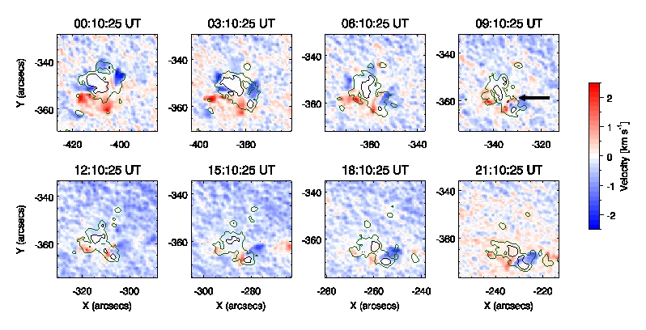
HMI/SDO Dopplergrams
Black arrow: location of the PIL separating the two opposite polarities of the delta spot.
The LOS motions in the proximity of the δ spot PIL lasted for almost 15 hours !!

Slide 9
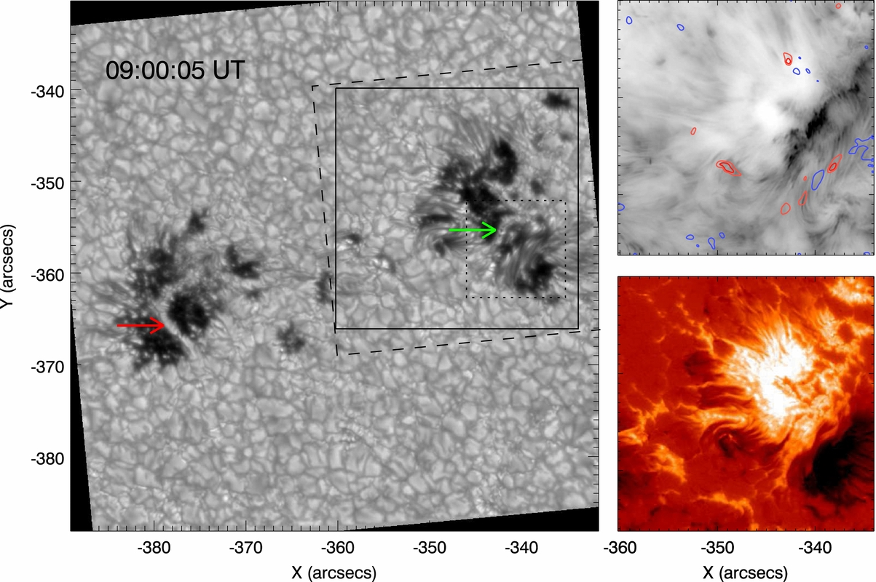
CRISP/SST data analysis
Indication of the location of upward (- 3 km/s) and downward (3 km/s) motions along the δ spot PIL in the chromospheric image (inverted colors)
Chromospheric brightenings: ribbons during the post-flare phase…
Part of SST FoV selected for SIR inversion
FoV of the figures displayed in the right panel
FoV of the zoomed region

Slide 10
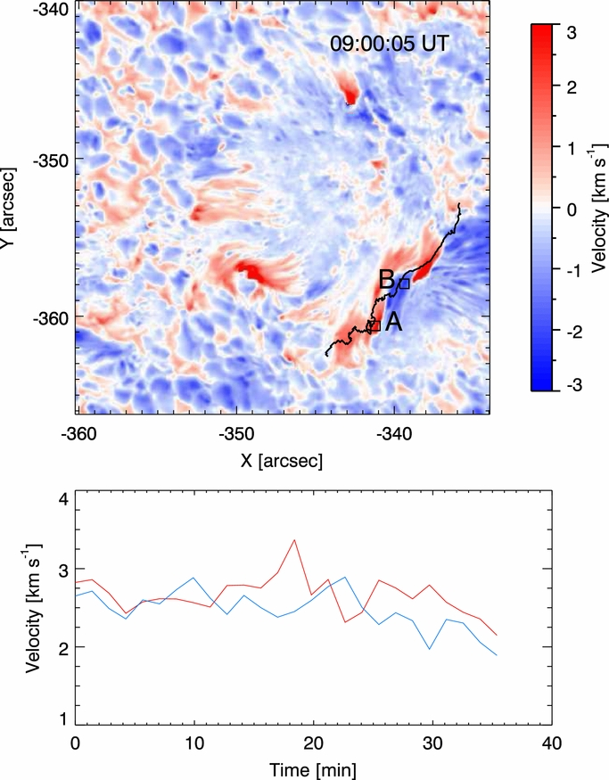
CRISP/SST velocity fields along the δ spot PIL
Velocity map obtained from the Gaussian fit of the 557.6 nm line
Strong evidence of upflows and downflows along the PIL separating the two magnetic polarities of the δ spot
The temporal behavior of the velocity in squares (9 x 9 pixels) A and B are reported in the plot
The trend reported indicates persistent upflows and downflows in the regions analyzed
The velocity measured in squares A and B can reach up to +/- 3 km/s
A
B
C

Slide 11
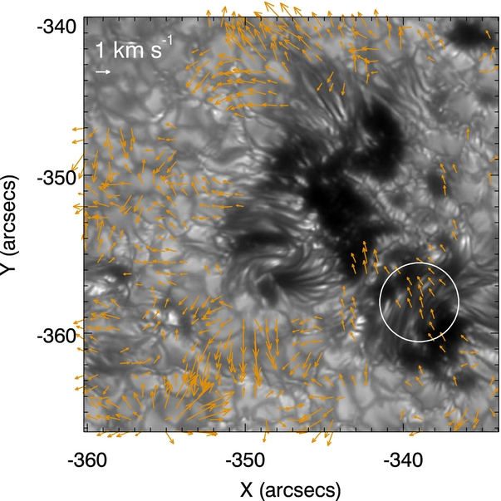
Local Correlation Tracking (LCT)
Map of the horizontal velocity field
deduced using the LCT on wide band Ca II images
convergence in the region between opposite polarities

Slide 12
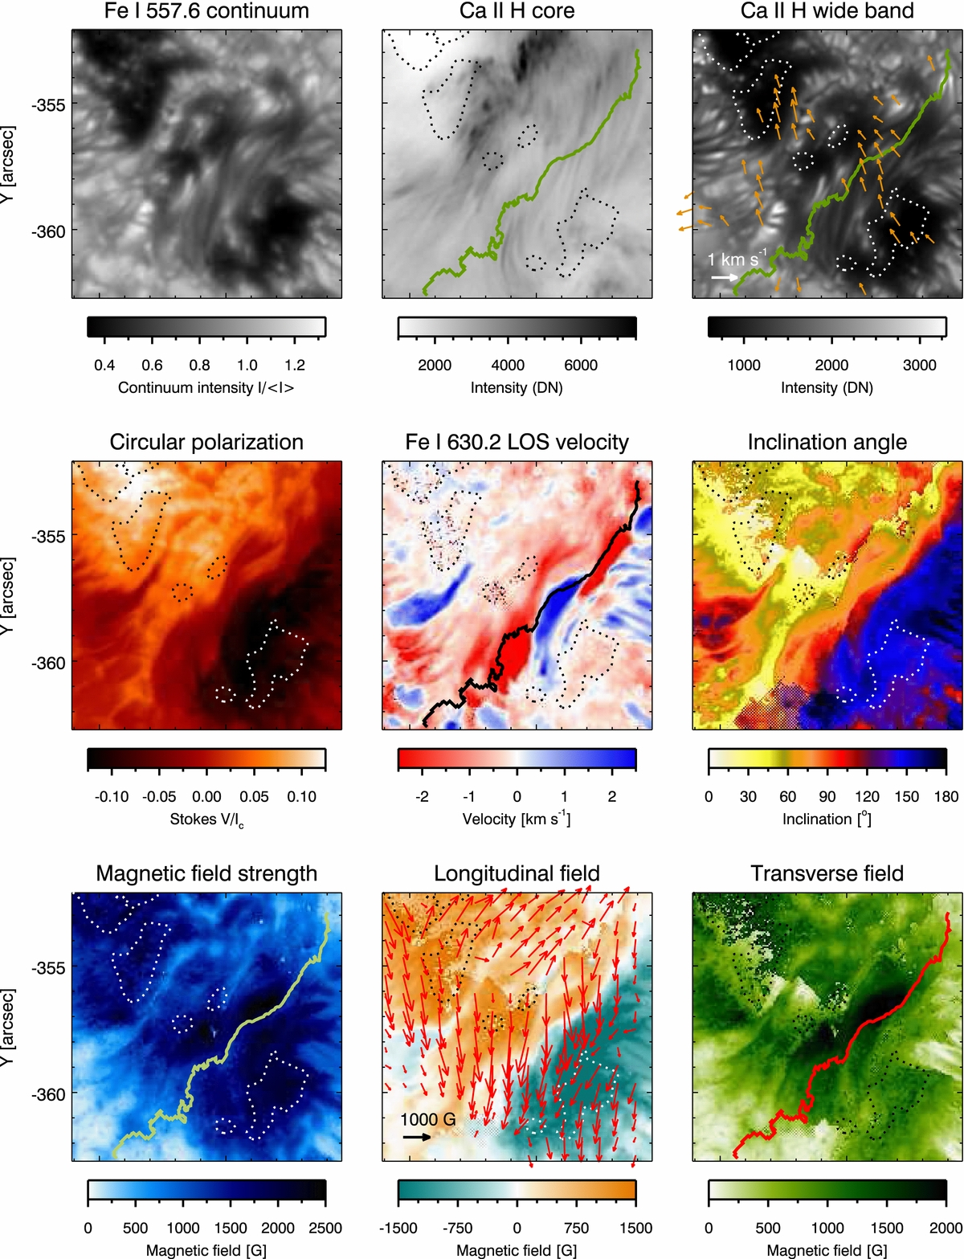
Maps from SIR inversion of CRISP data - zoom

Slide 13
SST: Ca II H WB and line core at 396.8 nm
Light bridges are present in the AR
The region between the two magnetic polarities of the δ spot is not separated by a “segmented light bridge”,
We observe a filamentary structure, having the aspect of a collection of highly sheared penumbral filaments

Slide 14
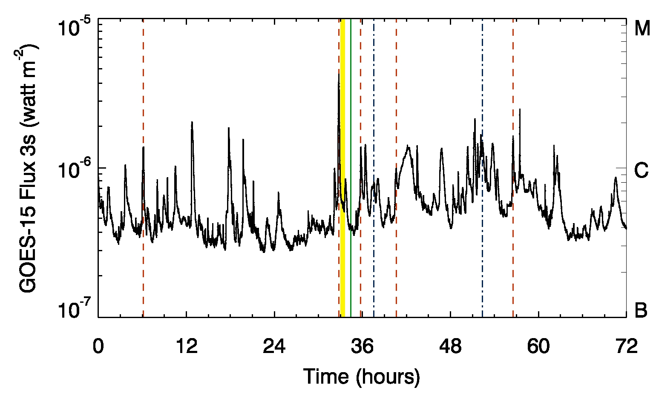
Delta spot & flares
The complex configuration of δ spots magnetic fields often gives rise to a number of flares and eruptive phenomena, due to rearrangement of the magnetic field lines, due to reconnection
We study such events in AR NOAA 11267
The yellow band indicates the CRISP observing period
The vertical lines indicate the flares and the eruptive phenomena
orange lines: flares
green line: CME
blue lines: ERU and LEA events

Slide 15
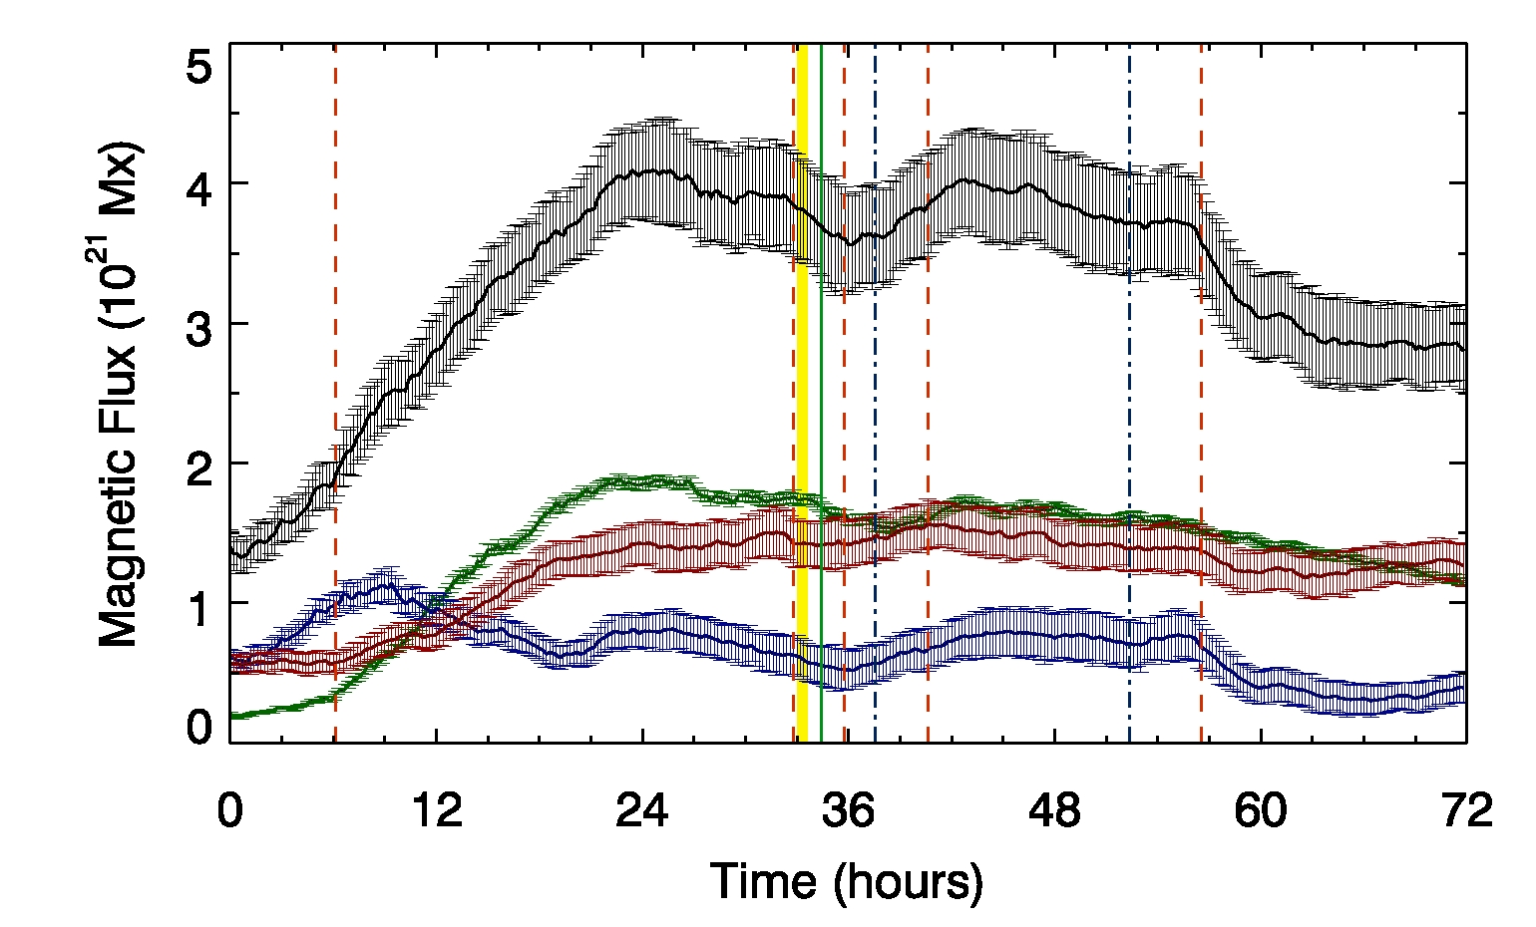
HMI/SDO: Magnetic flux trend in NOAA 11267
The C4.1 flare occurs during a flux decay
The vertical lines indicate the flares and the eruptive phenomena

Slide 16
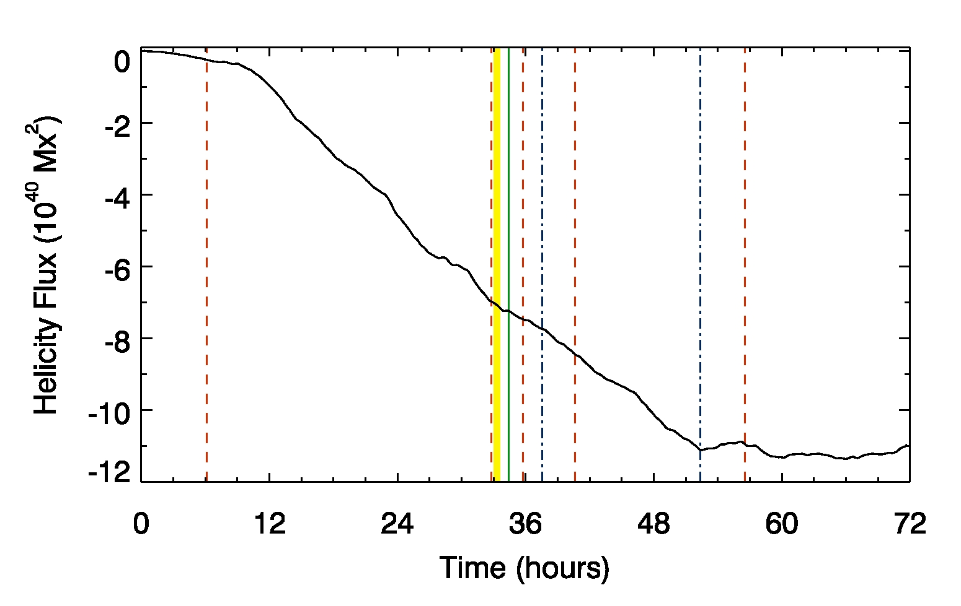
HMI/SDO: Helicity flux trend in NOAA 11267
Most of the flares occur during the increasing phase of the helicity flux

Slide 17
AIA/SDO: the C4.1 flare in NOAA 11267
Isophotes suggest that the C4.1 flare takes place in the δ spot

Slide 18
Conclusions
Observations of persistent downflows and upflows (3 km/s) observed with CRISP (40 minutes) and HMI (15 hours) in proximity of the δ spot PIL
The magnetic field is highly sheared along the δ spot PIL
The region shows a filamentary structure resembling a bunch of penumbral filaments wrapped around the negative polarity
The most probable process is related to penumbral filaments bending and diving in the subphotospheric layers, not to Ω-loop submergence
. The observed motions may be
therefore related to the Evershed
flow in the bending field lines
+++
- - -

Slide 19
Future work
Analyze the AIA observations of the flares occurring in δ spot
The C4.1 flare occurred in NOAA 11267 seems to be related with a CME observed after about 1.5 hour
Determine with full SDO spectropolarimetric measurements the helicity flux in this region
Study more in detail the evolution of the CME
Analyze high-resolution observations to deduce the presence of flare precursors

Slide 20
Observational data sets – NOAA 11267
NOAA 11267
(6 August 2011)
S17E24
Here is the δ spot !!

