Slide 1
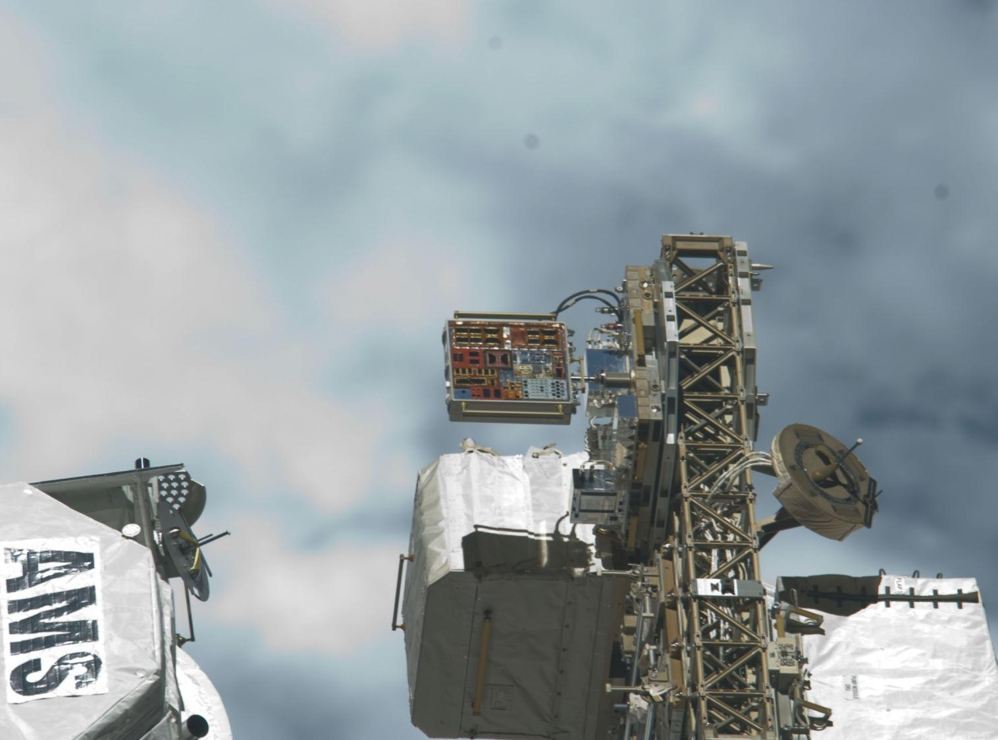
Initial Post-Flight Results of the Primary Arcing on Solar Cells At LEO (PASCAL) Flight Experiment
Justin J. Likar¹, Teppei Okumura², Shunsuke Iwai³,
Philip Jenkins⁴, Mengu Cho⁵, Alexander Bogorad⁶, and Steven Gasner⁶
¹Lockheed Martin Space Systems Company (now with UTC Aerospace)
²Japan Aerospace Exploration Agency (JAXA)
³Kyushu Institute of Technology (now with Mitsubishi Electric Corporation)
⁴United States Naval Research Laboratory (NRL)
⁵Kyushu Institute of Technology
⁶Lockheed Martin Space Systems Company

Slide 2
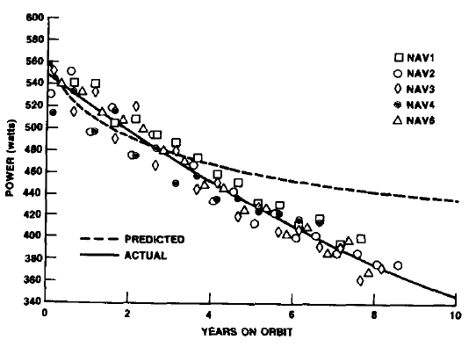
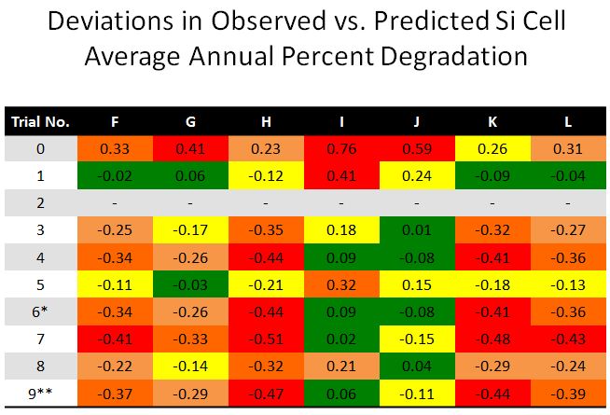
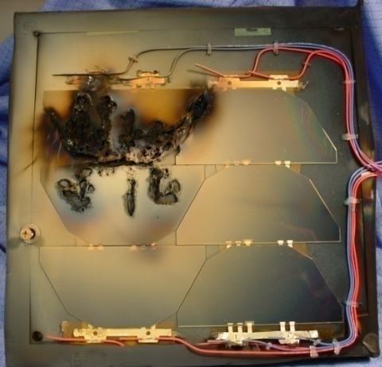
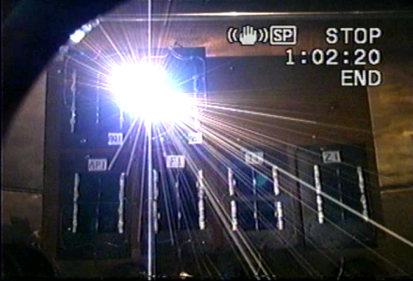
Introduction & Motivation
20%-25% of satellite anomalies are associated with Power subsystem (Wade, 2014)
It is well established that spacecraft charging and associated electrostatic discharges (arcing) cause anomalies on spacecraft solar arrays
ISO, ECSS, AIAA, NASA, & proprietary guidelines illustrate industry responsiveness
Cho (2005) and Ferguson / Katz (2014) are among those attempting to estimate number of arcs on a GEO satellite
  Most recent value lies between 100 and 800 annually
    Studies are based upon rigorous analyses of GEO plasma conditions (LANL & GOES instruments)
Cumulative low power arcs may cause “weak” or “dropped” strings on typical EPS
Gradual variation in observed performance & prediction
is not caused by catastrophic Sustained Arcs (PSA or TSA)
Unexplained anomalous performance / deviations of ~1%
over time is not explained by Sustained Arcs (PSA or TSA)
Marvin (1988)
≠
≠
Lohmeyer (2014)

Slide 3
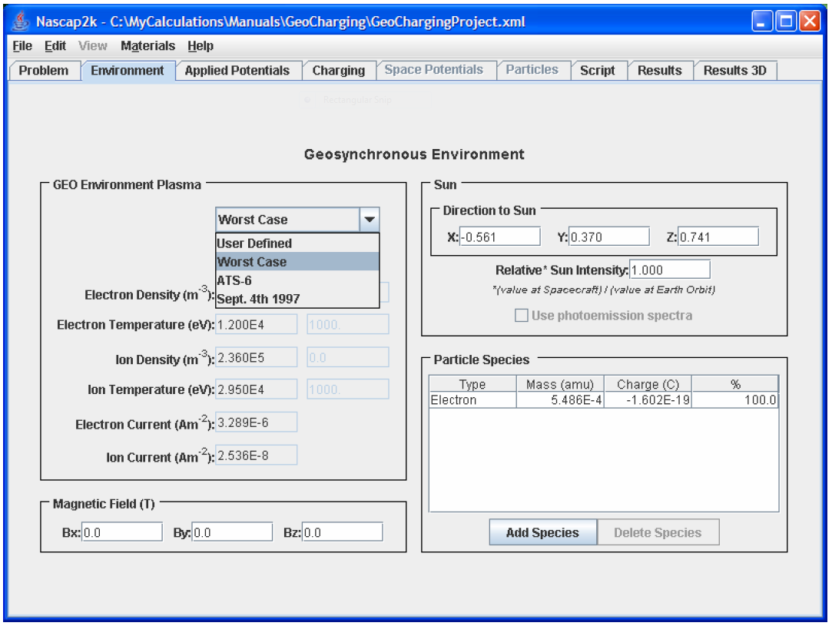
Space Weather Conditions Lead to ESD on Solar Arrays
Arc initiation most commonly occurs in one of two ways
  Differential charging at Triple Point (Top Figure)
    Most common in GEO, MEO, and PEO (Polar)
    In a substorm electron current increases and exceeds photocurrent →driving spacecraft & CG potentials negative
    Due to differences in SEE coefficients the CG potential may drop slower than that of the spacecraft body → IPG
  Extreme Negative bias in high density plasma (Lower Figure)
    Achievable in LEO or in Electric Propulsion plume plasmas
Both initiation processes relate to spacecraft charging mechanisms including floating potential, differential charging, …
  Ultimate thresholds for each depend upon unique spacecraft design parameters → determines risk or propensity to arc
Consider parameters commonly used in spacecraft charging engineering tools (NASCAP2K, SPIS, SPENVIS, MUSCAT, …)
  N_{e,i}, T_{e,i}, Maxwellian indices, …
  GEO Charging Index (E_{min} of 9 keV)
Real-time (or forecasted) data along with credible knowledge of satellite susceptibility enables informed decisions
Likar (2006)

Slide 4
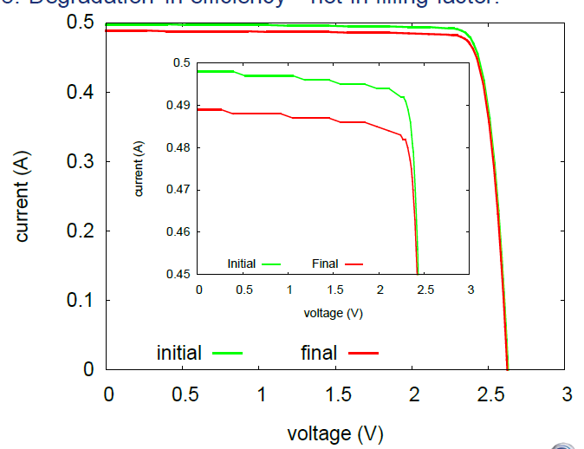
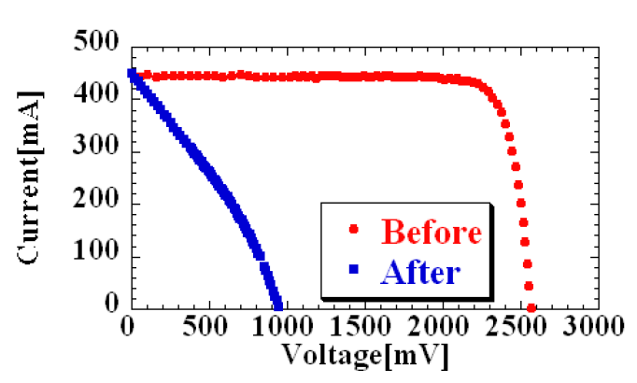
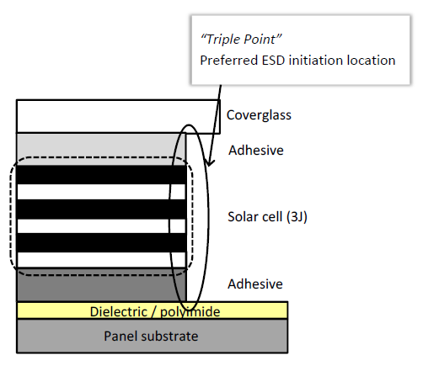
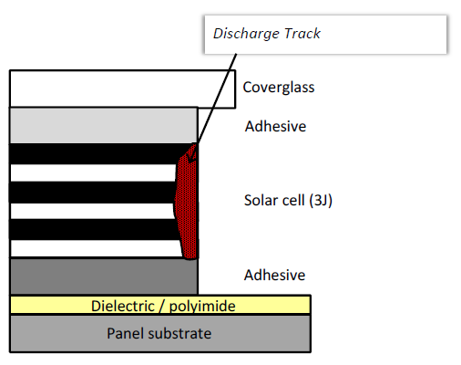
Do Primary or Flashover Arcs Degrade Performance?
Gerhard (2014)
Okumura (2007)
Definitive conclusions remain elusive
Ground laboratory studies are plentiful but generate debates as well as results
Recent conclusions are non-complementary
  Flashover / primary arcs degrade performance
  Flashover / primary arc energy insufficient to damage cells and degrade performance
No definitive flight experience to supplement growing library of data until now
  Most recent ground testing was supplemental EMAGS3 testing performed on AZUR 3J cell & Si cell at Airbus
  No evidence of ESD related shunting
Degradation mechanism relies upon discharge induced leak current / shunt paths created within cell or at cell edge
  Degree / presence of degradation is energy dependent which varies by orbit, array design, and CIC design
  Ranges from 100 μJ to >100 mJ
Arc discharge track shunts p-n junctions
Toyoda (2003)
Likar (2013)

Slide 5
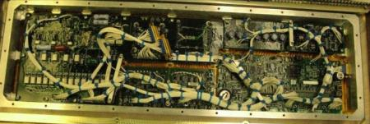
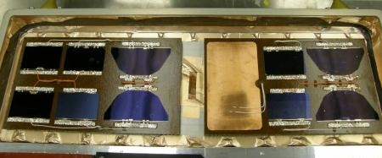
PASCAL Experiment Design Details
Capacitance simulates energy source in primary arc
C represents capacitance between the exterior insulator surface and spacecraft ground that provides the electrostatic energy as the surface flashover current
R1 = 100 kΩ
R2 = 1 Ω
C = Variable (1 nF to 1 μF)
V_{B} = Variable (-50 V to -300 V)
Electronics supplied by KIT & JAXA
Solar cell coupons by Lockheed Martin
  Cells from flight stock
Coupon substrate design is representative of a modern space solar panel substrate
Double insulated cell side dielectric, no grout, but bus bars encapsulated

Slide 6
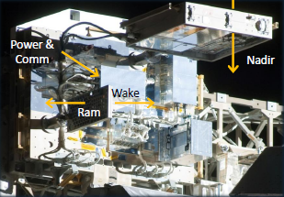
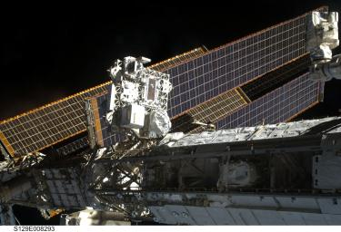
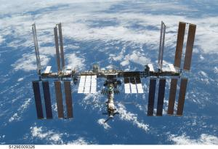
MISSE-8 Architecture & ISS Accommodations
Zenith
PASCAL is included on the NRL- developed Platform for Retrievable Experiments in a LEO Space Environment (PRELSE) platform
  Also known as MISSE-8
  Launched via STS-134 and deployed via EVA
ISS accommodations on ELC2 top deck
  Installed into MISSE-7 PECa pedestal
  PASCAL on zenith facing surface
Uses ISS power and communications / telemetry
Photo Credit: NASA
Photo Credits: NASA
Mission Details
Orbit | (ISS) 350 km to 450 km at 51.5º
Duration | 2.14 yr
Plasma¹ | 10⁴ cm⁻³ to 10⁶ cm⁻³ and T_{e} 0.02 eV to 2.0 eV
Attitude / Orientation | Zenith facing (neither ram or wake)
Location is ELC2 (ULF3)
¹Authors are grateful for assistance of J. Minow of NASA MSFC

Slide 7
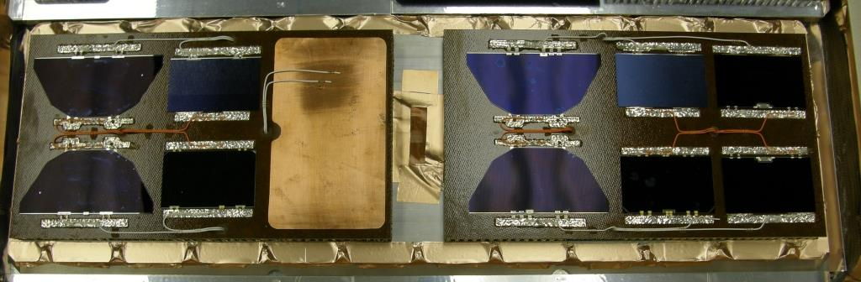
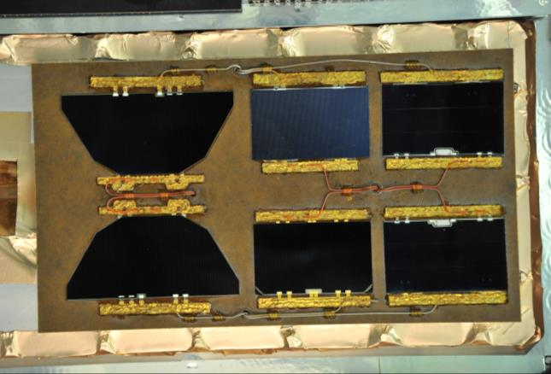
Coupons
Clean Room (Pre-Launch)
UTJ
Si
ATJM
Si
MJ
UTJ
XTJ
ATJM
ZTJM
MJ
UTJ
Si
ATJM
Si
MJ
UTJ
XTJ
ATJM
ZTJM
MJ
Clean Room (As Returned)

Slide 8
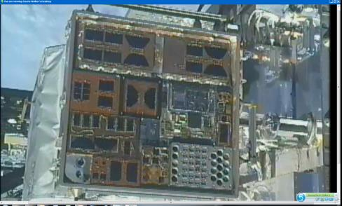
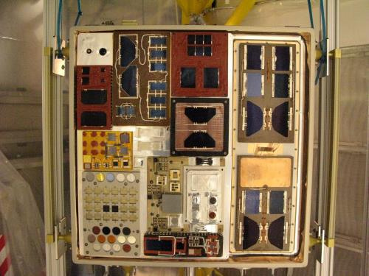
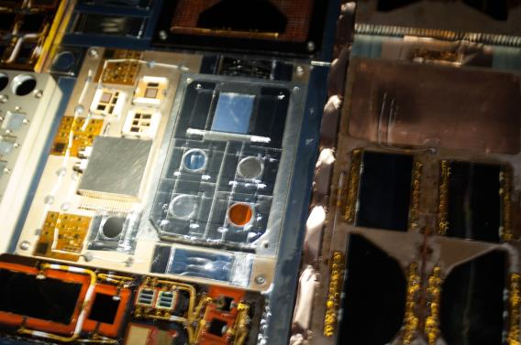
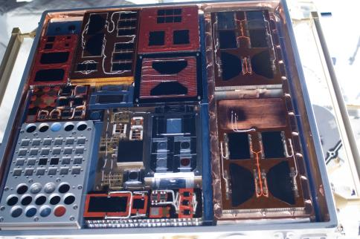
Mission Timeline
January 2013
Operations continue
VIS inspection
January 2011
Integration with MISSE-8 PEC
July 2013
Operations cease
Retrieval via EVA
Store inside ISS
June 2014
Return via Space-X3 (May)
De-integrate with MISSE-8 PEC
May 2011
Launch via STS-134
Install via EVA
Operations commence June 2010

Slide 9
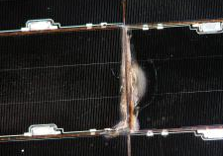
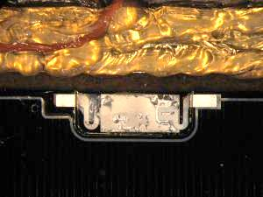
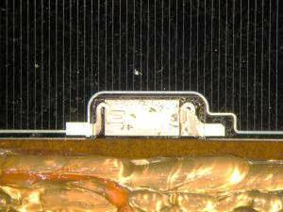
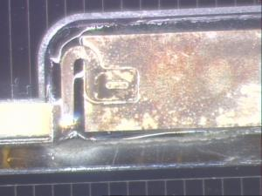
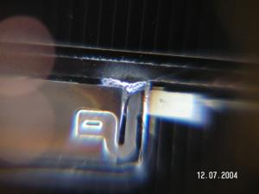
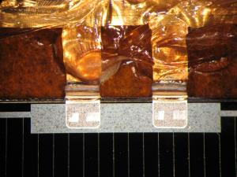
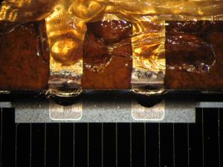
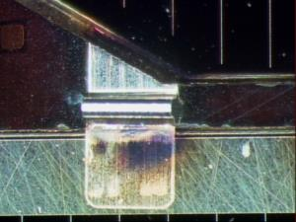
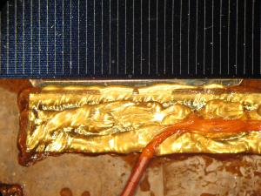
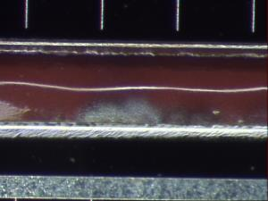
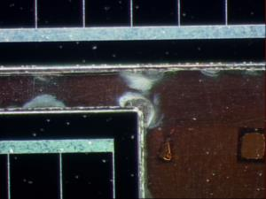
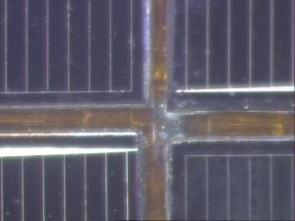
VIS Microscopy Inspections
Permanent Sustained Arc (PSA)
Electrical short between strings
Electrical short to substrate
Damage to substrate
Evidence of deterioration of diode / glass near diodes
PASCAL
Ground Tests
Evidence of melting / explosion near diodes
Little or no evidence of arcing at ICs or cell edges (worst shown)
Observable damage to one IC on one cell (UTJ) – magnitude difficult to discern
Evidence of arc damage on substrate & grout
  At cell edges and ICs

Slide 10
Primary Arc Inception Voltage
>1200 arcs observed in-orbit
On-orbit PA inception voltage compared to published laboratory data & PASP Plus flight data
  60 min to 90 min spent at each bias voltage
With few exceptions, on-orbit threshold is lower
  All cells are different; there is statistical uncertainty in all values
For typical SA grounding methods voltage is approximately spacecraft floating potential
  Floating potential is predictable (real-time?)
Composite of current
transients for ATJM (Cell 5)
Likar (2014)

Slide 11
Analyzing Cell Performance
On-Orbit
PASCAL included capability for in situ LIV & DIV however utility of real-time measurements was ultimately limited
  Neither PASCAL or MISSE-8 are sun tracking
  Cell temperature telemetry not functional
  LIV are performed at random sun angles
Applied typical corrections to data
  Beta angle, measured temperature (from MISSE-8), cell temperature coefficients, radiation, wire impedance
  Uncertainty (±4 min) in sun angle is sufficient to envelope analytical predictions
    ±4 min can yield >20 deg variation in sun angle (and temperature) at high sun angles
Post-Flight
Continuous illumination LIV immediately upon removal from clean room (using X-25 irradiator & filter)
LAPSS (identical to pre-flight measurements)
Analytical predictions
  Corrected for radiation via AE9 / AP9
    Compared to SEDA-AP SDOM¹ & Boeing TLD² measurements
Cell temperature fit to beta angle
BOL (Ground)
ATJM (Cell 5)
13 March 2013
3 July 20111
20 Dec 2012
Unable to measure
current >275 mA
Poor instrument coverage over mission lifetime; maximum 53% but typical <20%
¹Authors are grateful for assistance of K. Koga of JAXA
²Authors are grateful for assistance of J. Wert of Boeing

Slide 12
Post-Flight Performance (X-25)
Cell Type | Manuf | Description | CG Thickness | Voc |  |  | Isc |  |  | FF
 |  |  |  | BOL | EOL | %Change^{1,2} | BOL | EOL | %Change^{1,2} | BOL | EOL | %Change^{1,2}
TJ | Tecstar | GaInP₂/GaAs/Ge | 6 mil | 2.455 | 2.437 | -0.73 | 0.372 | 0.376 | +0.94 | 0.762 | 0.764 | +0.24
TJ | Tecstar | GaInP₂/GaAs/Ge | 6 mil | 2.335 | 2.284 | -2.21 | 0.345 | 0.359 | +4.09 | 0.767 | 0.778 | +1.49
Si³ | Tecstar | n on p | 6 mil | 0.568 | 0.589 | +3.69 | 1.004 | 0.957 | -4.65 | 0.630 | 0.470 | -25.5
Si³ | Tecstar | n on p | 6 mil | 0.557 | 0.582 | +4.45 | 0.945 | 0.922 | -2.41 | 0.639 | 0.470 | -26.5
ATJM | Emcore | InGAP/InGaAs/Ge | 6 mil | 2.678 | 2.615 | -2.35 | 0.535 | 0.544 | +1.63 | 0.763 | 0.770 | +0.88
ATJM | Emcore | InGAP/InGaAs/Ge | 6 mil | 2.655 | 2.540 | -4.35 | 0.551 | 0.547 | -0.65 | 0.749 | 0.768 | +2.54
ZTJ | Emcore | InGAP/InGaAs/Ge | 6 mil | 2.705 | 2.638 | -2.48 | 0.414 | 0.413 | -0.27 | 0.777 | 0.779 | +0.21
UTJ | Spectrolab | GaInP₂/GaAs/Ge | 3 mil | 2.565 | 2.504 | -2.40 | 0.568 | 0.559 | -1.58 | 0.713 | 0.722 | +1.30
UTJ | Spectrolab | GaInP₂/GaAs/Ge | 3 mil | 2.587 | 2.531 | -2.18 | 0.556 | 0.558 | +0.38 | 0.722 | 0.742 | +2.82
XTJ | Spectrolab | GaInP₂/GaAs/Ge | 6 mil | 2.640 | 2.558 | -3.13 | 0.428 | 0.416 | -2.92 | 0.784 | 0.788 | +0.48
¹Error of +/-2% for typical continuous irradiation LIV (X-25)
²Preliminary LAPSS results largely confirm X-25; undergoing continued study
³Silicon results are puzzling; undergoing continued study

Slide 13
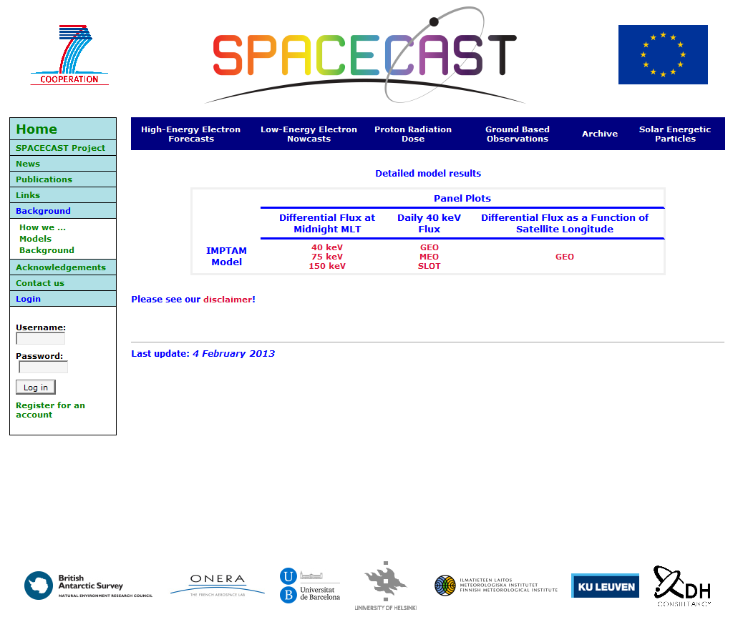
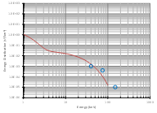
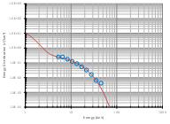
Operational Impacts
Marvin (1988)
Ganushkina (2014)
Likar (2012)
NASCAP2K spacecraft model for spacecraft charging simulations

Slide 14
Conclusions
It is reasonable to suspect that primary arcs be considered as possible reason for slow degradation of space solar array performance
Given the present industry interest in All Electric missions / systems the propensity for primary arcs and spacecraft charging related effects may be increasing
PASCAL intended to advance the understanding of the following question –
  Can non-catastrophic arcs lead to accumulated damage and degraded cell performance?
PASCAL highly successful in generating primary arcs at realistic voltages on ISS
  >1200 arcs were recorded on the two coupons
Very little, if any, evidence of arc induced damage observed by VIS microscopy
Very little, if any, evidence of degradation observed by post-flight LIV (excluding Si)
It appears clear that transients with peak current ~20 A and dissipated energy ~100 mJ do not inflict measureable damage to cell types considered up to 100 – 200 arcs
Applicability of results to PA induced contamination losses under study
  Early results suggest impact is smaller than predicted
Mitigation for secondary arcs on front side, back side, et cetera remains imperative
Optimal solution remains – prevent arcing on array

