Slide 1





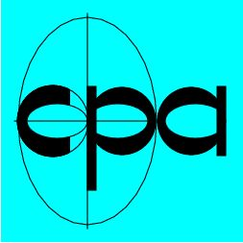

AO/1-6738/11/NL/AT
Virtual Space Weather Modelling Centre – Phase 1
Prof. Dr. Stefaan Poedts
CmPA / Dept. of Mathematics, KU Leuven
ESWW11, Liège, Belgium, 20 November 2014

Slide 2
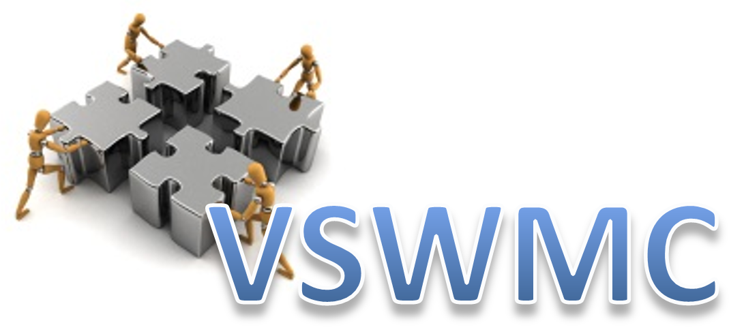

Contents
General project overview
  Consortium overview, SAT, Prime GOALS, Planning and time line
The VSWMC prototype
  Description (+ demo?)
Future Development / roadmap

Slide 3
Consortium overview
KU Leuven / CmPA (prime contractor)
Belgian Institute for Space Aeronomy (BIRA – IASB)
Royal Observatory of Belgium (ROB)
Von Karman Institute (VKI)
DH Consultancy (DHC)
Space Applications Services (SAS)
Science Advisory Team:
R. Horne, A. Aylward, S. Bruinsma, P. Janhunen, T. Amari,
S. Bourdarie, B. Sanahuja, P.-L. Blelly
ESA: Piers Jiggens and Alain Hilgers

Slide 4
Prime GOALS:
to develop the proof-of-concept prototype version of an open end-to-end (= from Sun to Earth) space weather modelling system (“Virtual Space Weather Modelling Centre”),
enabling to combine ("couple") various space weather models in an integrated tool,
with the models located either locally or geographically distributed,
so as to better understand the challenges in creating such an integrated environment,
and at the same time providing proof-of-concept solutions to these challenges.
This is believed a viable roadmap to secure the development of a future complete VSWMC.

Slide 5
Desired Outcomes
  • Phase 1A: Review of Requirements, Development Plan and Initial System Design. Definition of a full-scale future VSWMC, incl. a development roadmap for the next decades based on user & system requirements.
  • Phase 1B: Creation and validation of a Prototype System = the proof-of-concept prototype version of the VSWMC, that addresses the question of the feasibility of the most critical parts of the future complete VSWMC.
  VSWMC aims to combine three roles:
      Repository for models and data
      A facility offering a model coupling infrastructure
      A facility that executes coupled model simulations

Slide 6
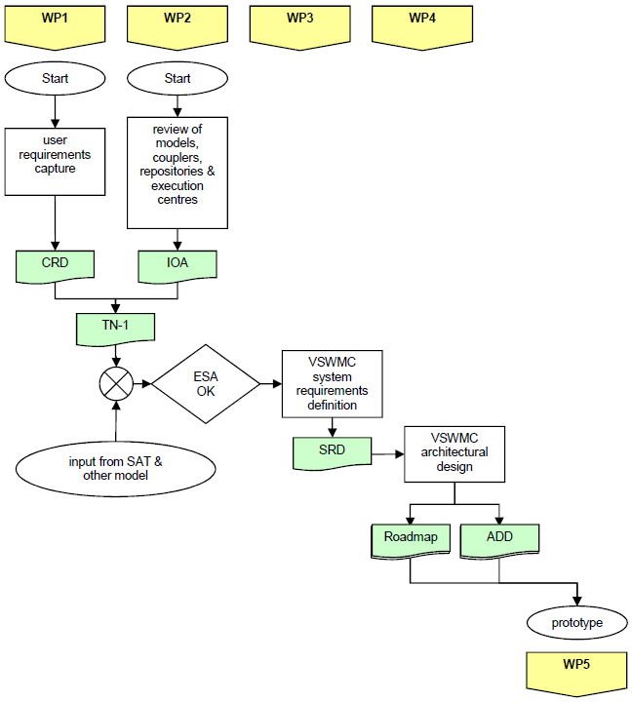
Phase 1A

Slide 7
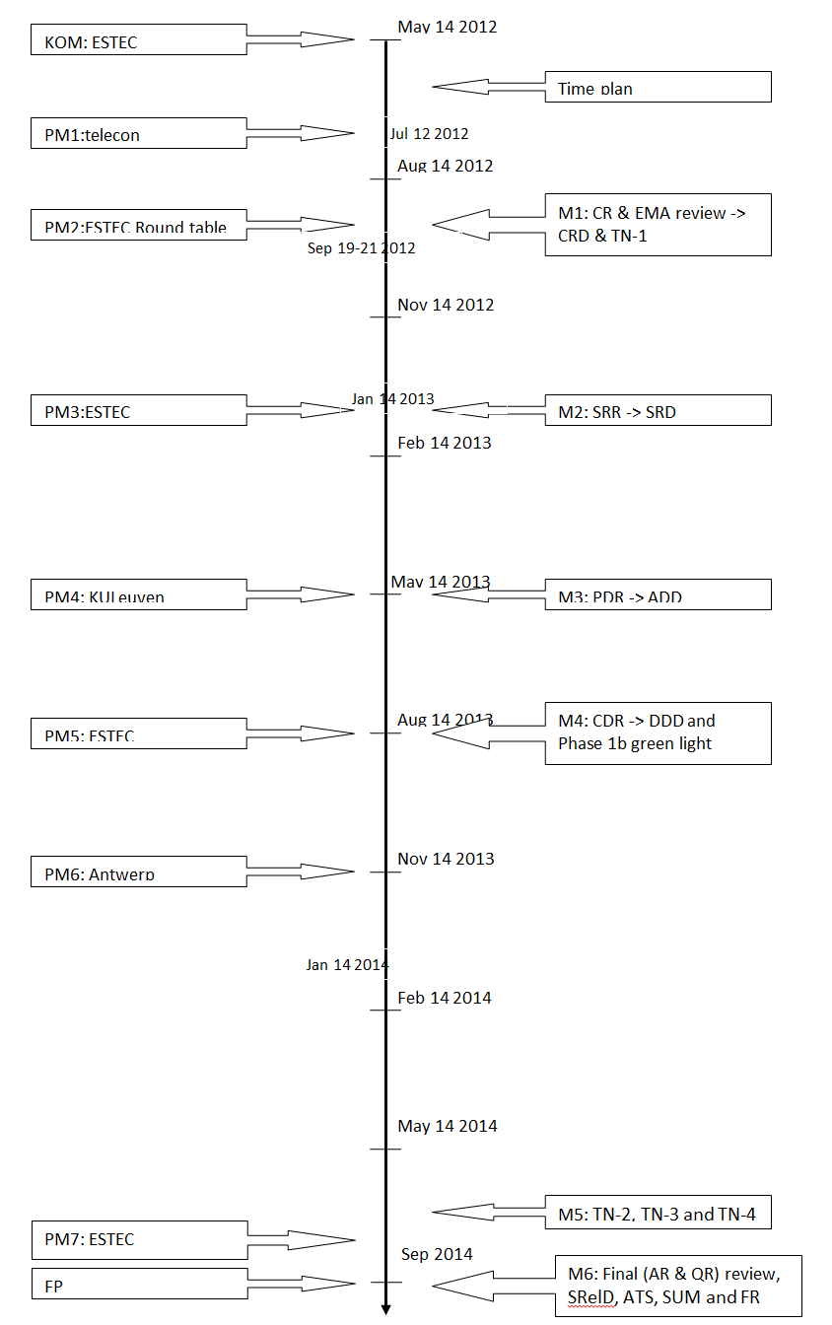
Phase 1A end
Phase 1B start

Slide 8
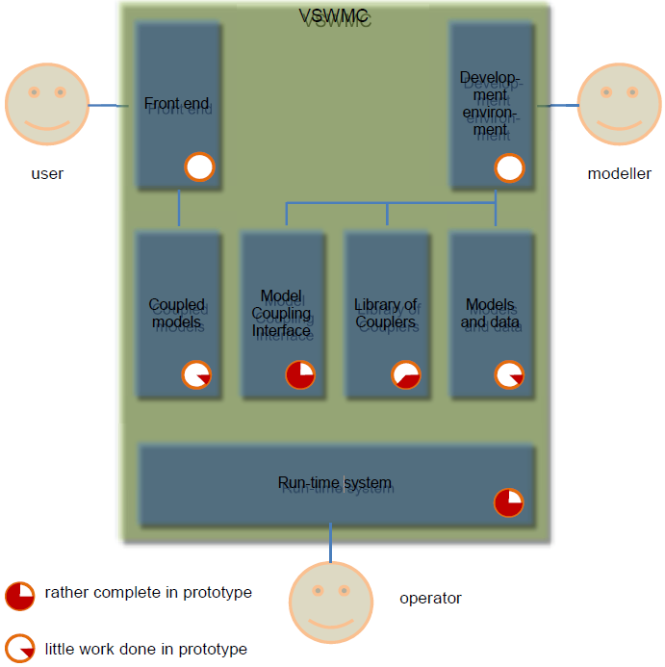
Framework

Slide 9
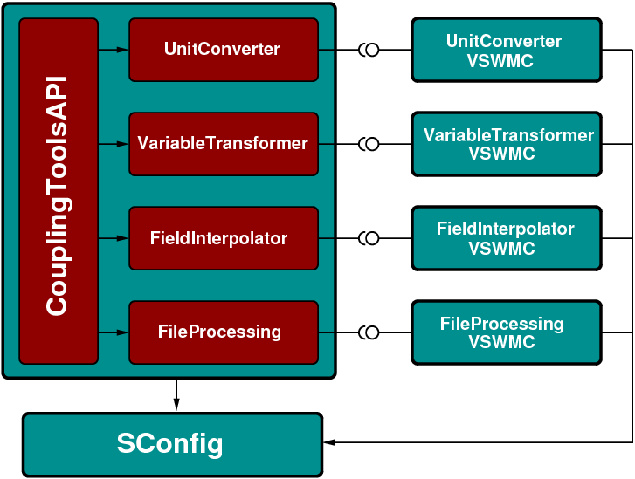
Coupling toolkit high-level design

Slide 10
Verification and validation
VSWMC prototype software was verified and validated, i.e. it was carefully checked that the VSWMC software system meets the specifications and fulfils its intended purpose
Installed models yield correct simulation results
Acceptance test, incl. 64 tests, viz.
    4 tests for validating the GUI (login, finding the federations, etc.);
    39 tests for validating all aspects of the models (‘federations’), i.e. the selection of the model, verifying and modifying the input parameters, launching the model, checking the progress, and validating the output files;
    21 tests for validating the model couplings

Slide 11
High-Level Architecture (HLA)
high-level architecture (HLA) is a general purpose architecture for distributed computer simulation systems (across heterogeneous hardware and software platforms) using interoperability standard (IEEE 1516-2000) for distributed simulation
HLA enables computer simulations to interact (to communicate data and to synchronize actions) with other computer simulations regardless of the computing platforms: reuse without significant code change or development cost
interaction between simulations is managed by a Run-Time Infrastructure (RTI)

Slide 12
VSWMC components
The VSWMC high-level architecture consists of the following components:
Interface specification, that defines how VSWMC compliant simulators interact with the Run-Time Infrastructure (RTI).
Object model template (OMT), that specifies what information is communicated between simulations, and how it is documented.
Rules, that simulations must obey in order to be compliant to the standard.

Slide 13
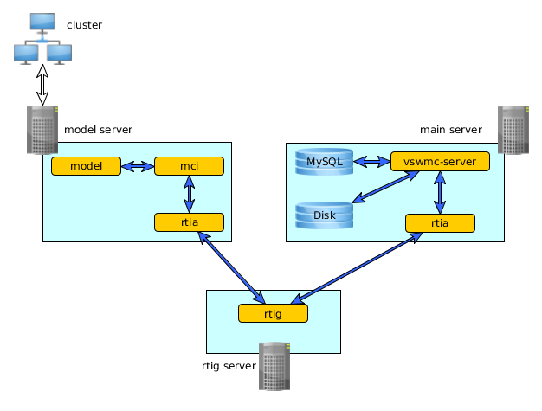
Typical setup of the VSWMC prototype
Remote model
Main server
Local models
(ODI)
HLA gateway

Slide 14
Objects and Interactions
Much of the interactions between federates involve objects and interactions which work in a publish-subscribe model:
  A federate can register an instance of an object and then change its attributes. Other federates that are subscribed to the object receive attribute value updates.
Interactions work in a similar way, except that an interaction is only used once with a specified set of parameter values and then discarded.

Slide 15
Time Management
Coordinates federate time advancement along the federation time axis
Attempts to preserve causality and ordering
Mechanisms supported:
  Conservative synchronization
  Optimistic synchronization (e.g., time warp)
  Hybrid methods
  Time-stepped
  Real-time driven

Slide 16
‘Federations’ (models) included
ODI (Open Data Interface): MySQL database system
XTRAPOL*: NLFF Magnetic Field Reconstruction tool
AMRVAC*: 2.5D solar wind model + superposed CMEs
iPIC-3D*: 3D kinetic (PIC) Earth magnetosphere model
COOLFluiD*: 3D MHD Earth magnetosphere model
GUMICS-4*: 3D MHD Earth magnetosphere/ionosphere model
* Internal consortium models
* Models from SAT

Slide 17
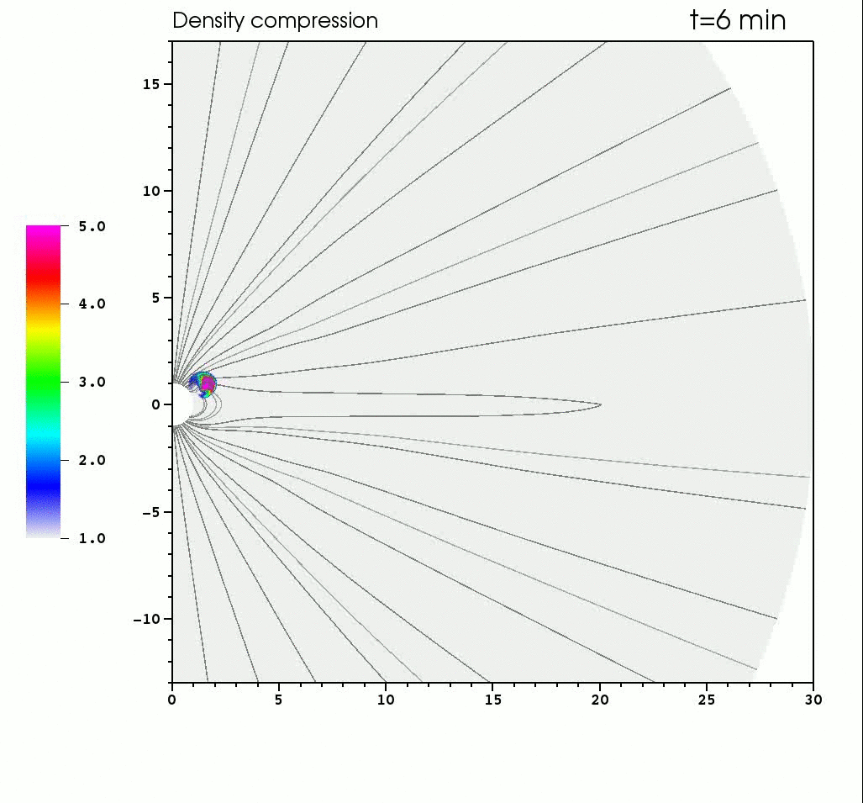
e.g. simple AMRVAC model
Sample AMRVAC 2.5D solar wind model with a superposed simple CME

Slide 18
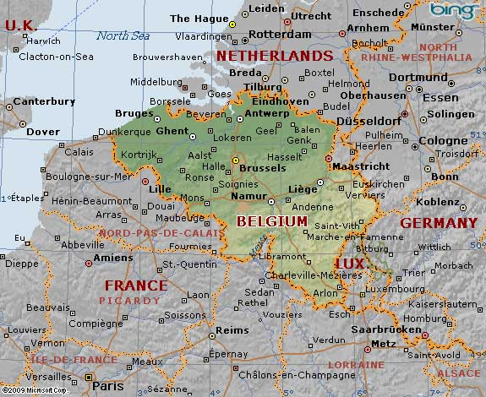
‘Federations’ (models) included
Server
ODI
AMRVAC
GUMICS-4
iPIC3D
COOLFluiD
WE
XTRAPOL

Slide 19
Comparison with CCMC & SWMF
Differences:
  VSWMC only started recently: only prototype version available at the moment
  VSWMC is distributed → models can run remotely, but still be coupled over internet
  VSWMC is interactive: modelers will be able to install/adjust their own model and couple it to another model in the repository (in Phase 2)

Slide 20
Implemented couplings
ACE – COOLFluiD (magnetosphere)
ODI – Gumics4
(AMRVAC (Solar wind + CMEs) – Gumics4)
COOLFluiD – iPIC3D
(continuum magnetosphere – kinetic magnetosphere)
Short DEMO

Slide 21
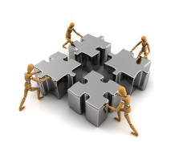
Vision on the future VSWMC
The full-fledged VSWMC should:
Continue to provide a homogeneous environment to run space weather community simulation codes;
Enable new code couplings and interactions between components;
Facilitate more complex multi-physics and multi-scale simulations.

Slide 22
Vision on the VSWMC roadmap
Next phase(s) of the VSWMC should include:
    A tracking/queueing system to schedule the simulation runs;
    A credit management system;
    An extension of the number of models;
    An extension of the number of couplings between models,
    Gradually more complex models, involving coupling of more than two models (→ no problem in VSWMC set-up);
    More coupling tools enabling to build more complex models;
    A more developed GUI;
    Visualization tools;
    More extensive couplings to data sets;
    Tools to enable/facilitate comparison of different couplings & comparison of simulation output with observational data;
    Etcetera
Notes:
VSWMC is flexible and enables such very complex and diverse model couplings!
Ever more partners & become more complex
Will require more management for administrators > bottleneck
How to prioritize the list?

Slide 23
Recommendation
Make the VSWMC as open as possible!
HLA allows for such an open system, in which modellers can couple VSWMC compliant models from anywhere in the world(!) with their own MCI to already existing ‘federations’ (data sources, other models, data analysis tools, visualization tools, etc.) in the system.
This is key to success, guaranteeing a larger and growing VSWMC user community.

Slide 24
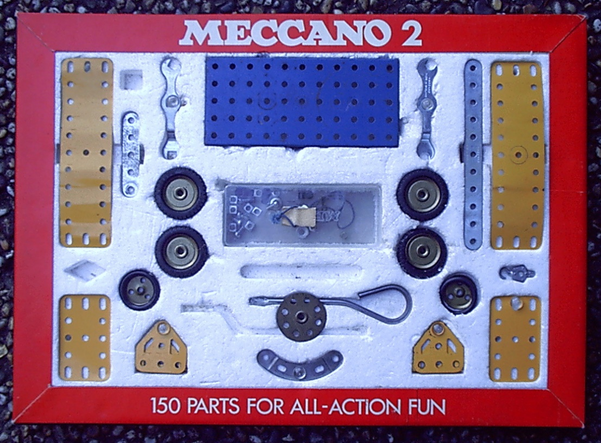
Metaphor
VSWMC should be set up as a ‘meccano set’, or perhaps the more modern version of that, ‘Lego technic’, i.e. it should be providing the standards, the building blocks and some simple tools to use them and provide a clear ‘user guide’.

Slide 25
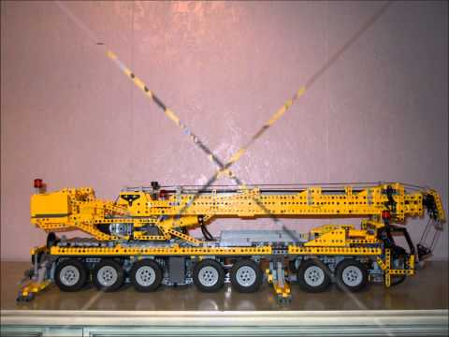
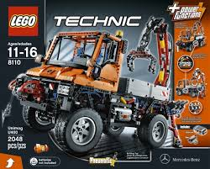
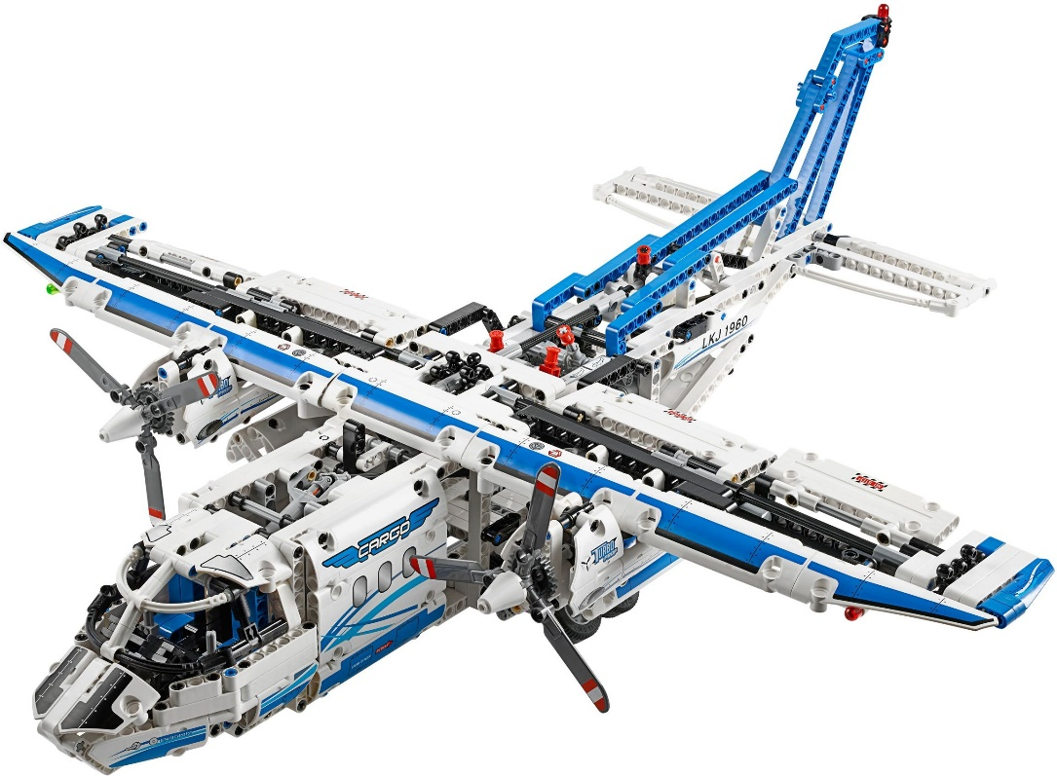
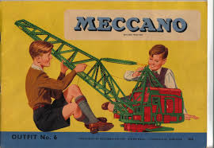
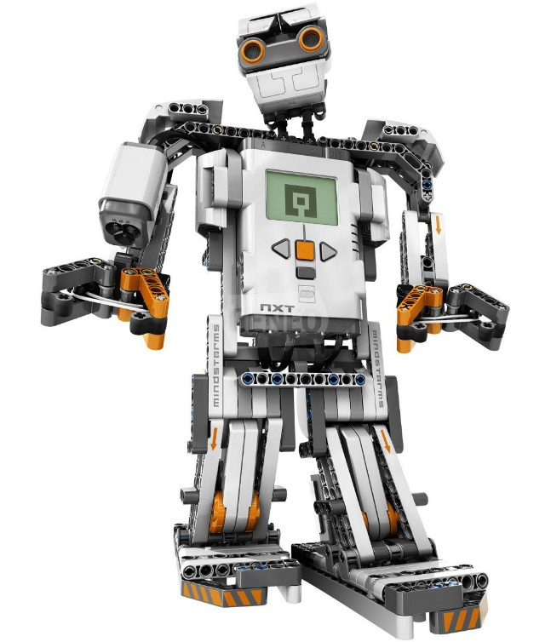
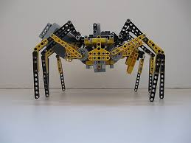
Metaphor
Provided a sufficient amount of building blocks and easy-to-use tools is available, the users of the meccano set (or Lego technic), in this case the modellers, will use their imagination and creativity to build an astonishing diversity of the most remarkable models.

Slide 26
Thank You!
Questions?

