Slide 1

Ionosphere threat model assessment for GBAS at high latitudes
Knut Stanley Jacobsen, Yong Lin
Norwegian Mapping Authority
Threat model
Ionospheric fronts are a threat to GBAS systems
The ionospheric fronts are characterized with velocity(V), slope(g) and width(W) as the main parameters.
Ionospheric front parameters are region-dependent.
Tromsø ~ 70ºN

Slide 2
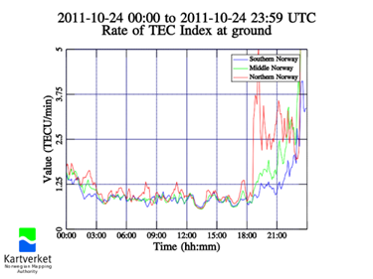
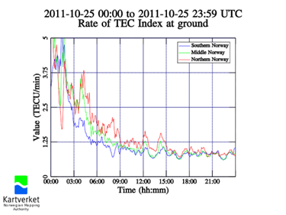
Datasets
Dates | Geomagnetic storm class
2011-08-05 ~ 2011-08-06 | G3
2011-09-26 ~ 2011-09-29 | G2
2011-10-24 ~ 2011-10-25 | G2
Dataset 3: 2011-10-24 ~ 2011-10-25

Slide 3
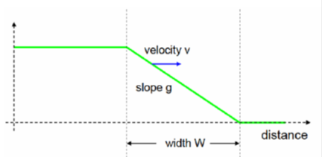
Method: the algorithm described in Mayer et. al, 2009
Velocity (V): Determined using the search in parameter space method
Slope (g): The first derivative of the VTEC time series, corrected for the relative motion of the plasma.
Width (W): The product of a combined velocity of the front velocity and the velocity of IPP and the duration of the front.

Slide 4
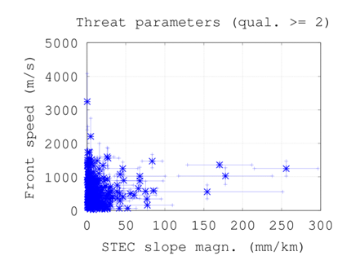
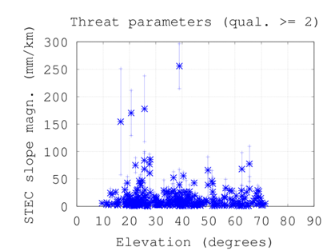
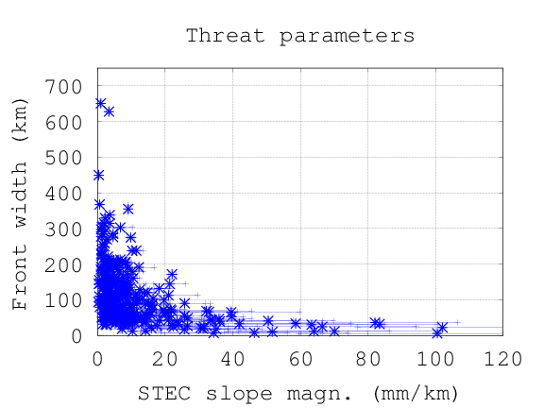
Results
We found that in the Norwegian region:
The front speed often reaches higher values (up to 2000 m/s)
The typical slope of the fronts is less than 60 mm/km
The typical width of the fronts is less than 400 km
Please visit our poster

