Slide 1
Ionospheric Services
The Australian Bureau of Meteorology, Space Weather Services setion (formerly the Ionospheric Prediction Service, IPS) provides a range of ionospheric forecast, mapping, monitoring, warning and alert services.

Slide 2
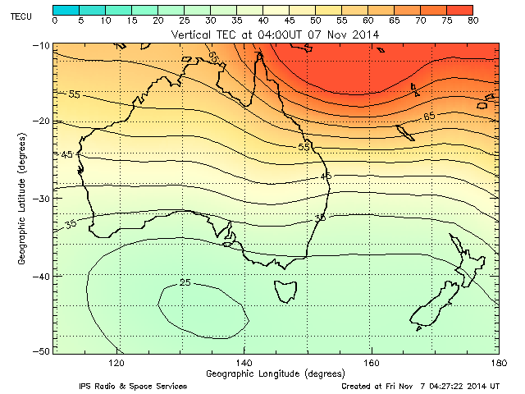
Ionospheric Services
Total Electron Content (TEC) near real time map

Slide 3
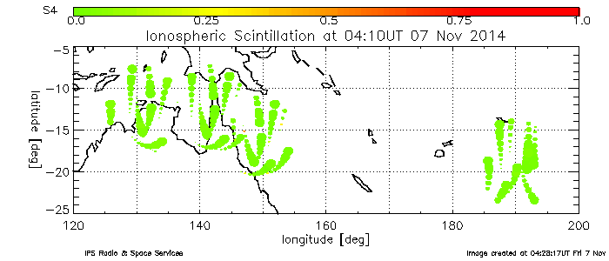
Ionospheric Services
Ionospheric Scintillation Monitoring

Slide 4
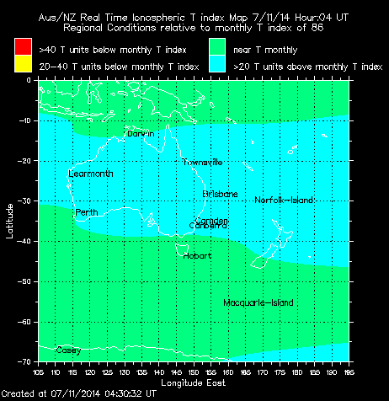
Ionospheric Services
Ionosonde driven foF2 near real time mapping using an ionospheric index, T

Slide 5
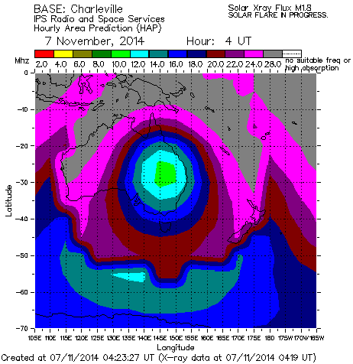
Ionospheric Services
HF circuit frequency prediction

Slide 6
Ionospheric Modelling R&D
We are actively developing new models to improve existing services and provide support to emerging areas, particularly in GNSS.

Slide 7
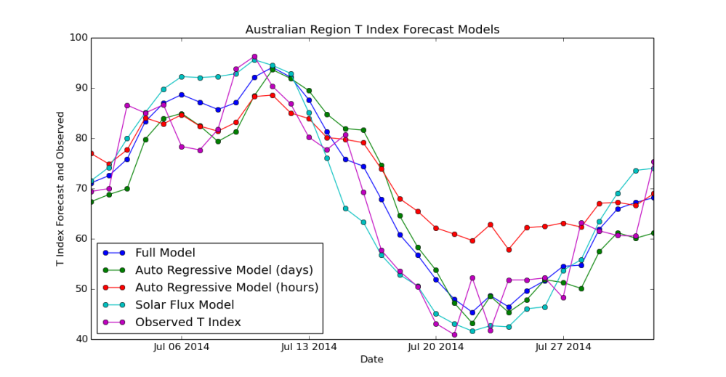
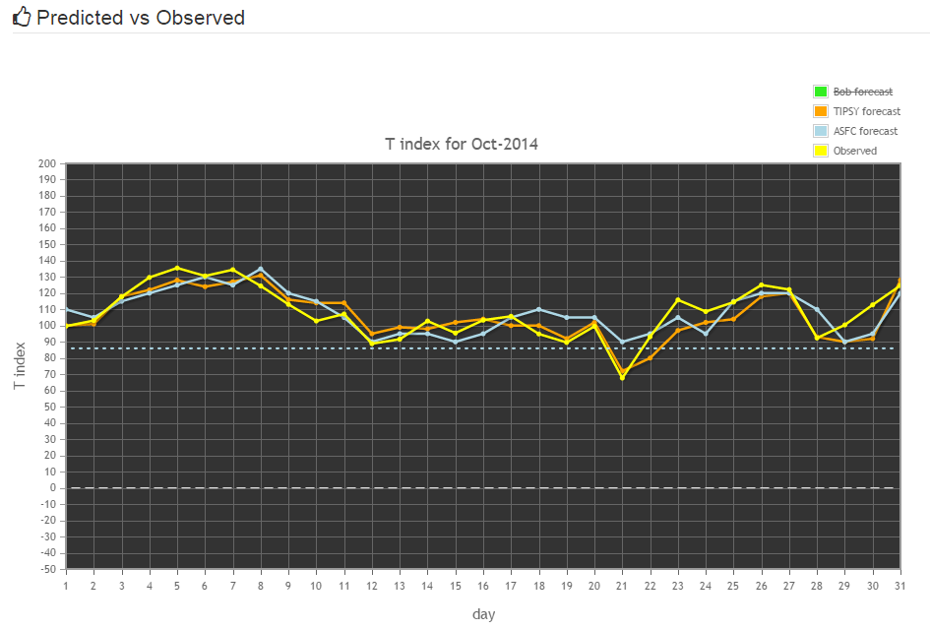
HF Frequency Forecasting
We use an ionospheric index, T, to parameterise the fof2 and hmF2 for HF frequency prediction. The Australian Region T is forecast each day for the next 3 days. A new model to aid the forecaster has been developed incorporating solar flux and geomagnetic data as well as an auto-regressive component. The forecaster can see the predictions of each 'sub-model' as well as the full jointly fit model in order to see the context for why the model has forecast a particular value. This ensure the forecaster can optimally blend their expertise and experience with the model guidance.
Forecasters can view the recent performance of the model and the official forecast against observations using an interactive tool that forms part of a web based suite of software to support the Australian Space Forecast Centre operations.

Slide 8
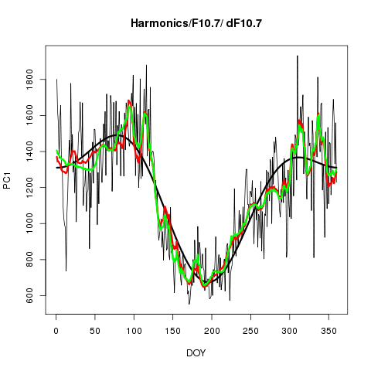
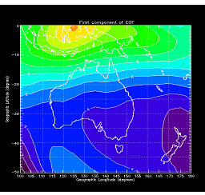
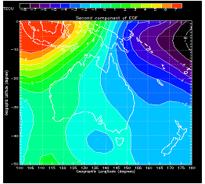
TEC Forecasting
We decomposed several years of TEC maps into Empirical Orthogonal Functions (EOFs). The first two EOFs are shown, along with co-efficients over one year (2010)
A Neural Network model is used to forecast co-efficients of the derived EOFs

Slide 9
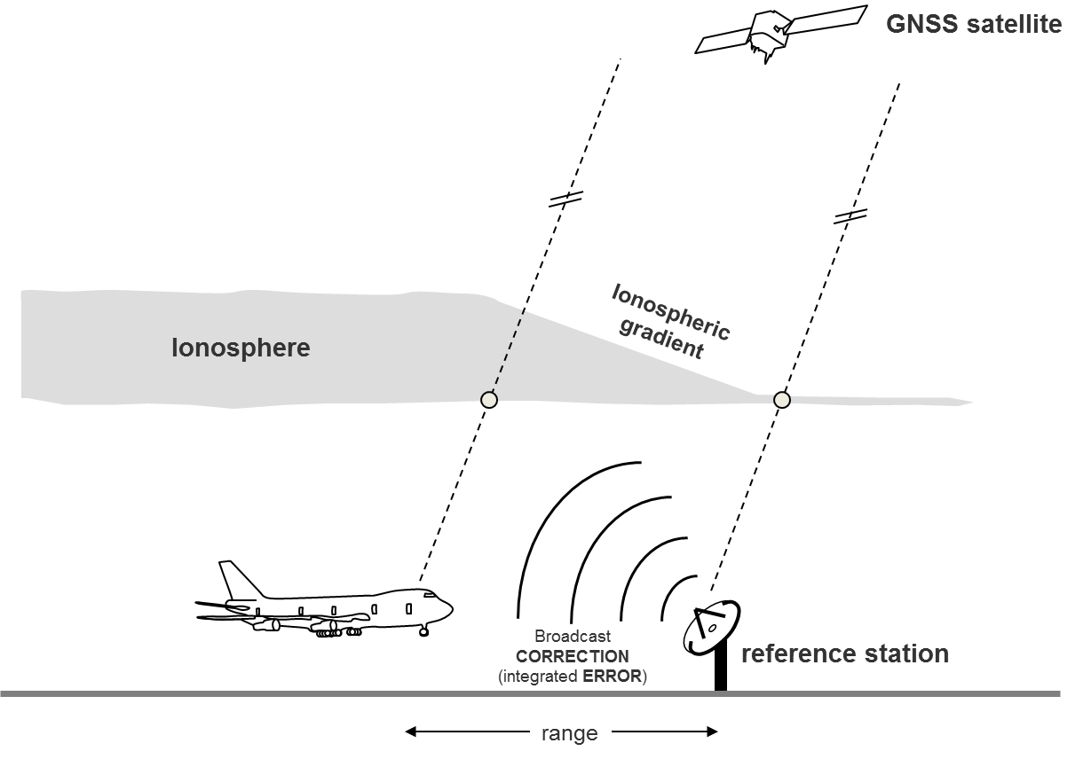
Ionospheric Gradient Monitoring
Product under development at Space Weather Services
"Traffic light" alert service for the presence of ionospheric gradients.
Target users: RTK / nRTK / DGPS type GNSS applications, without explicit ionospheric correction

Slide 10
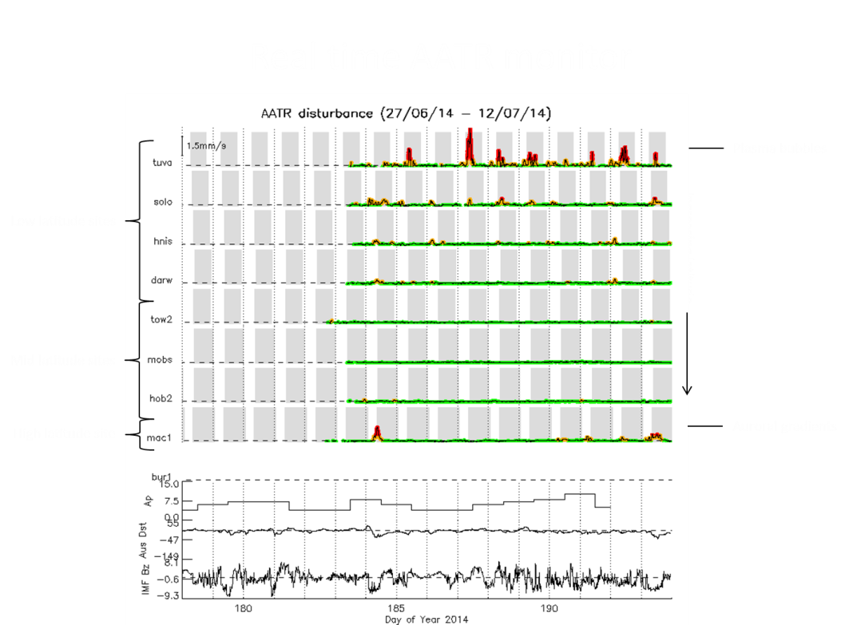
Ionospheric Gradient Monitoring
Along Arc TEC Rate (AATR)
$$\text{A}\text{ATR}=\frac{STEC}{{F\left(e\right)}^{2}.∆T}$$
$F\left(e\right)$ is the obliquity factor, ∆𝑇 is in range 30-60s, AATR is defined only over continuous arcs. The associated indices are calculated as hourly RMS of AATR, with median diurnal variability removed.
Sensitive to both spatial and temporal gradients
Can be estimated at a single site (no network required)
Responsive to:
plasma bubbles in the equatorial and low-latitude zones;
MSTIDs and large ionisation fronts at mid-latitudes;
auroral signatures at high latitudes
Schlüter S., R. Prieto-Cerdeira , R. Orús-Pérez, J.P. Lam, M. Juan, J Sanz and M. Hernández-Pajares. Characterization and Modelling of the Ionosphere for EGNOS Development Qualification. European Navigation Conference (ENC 2013) April 23-25 Vienna

