Slide 1
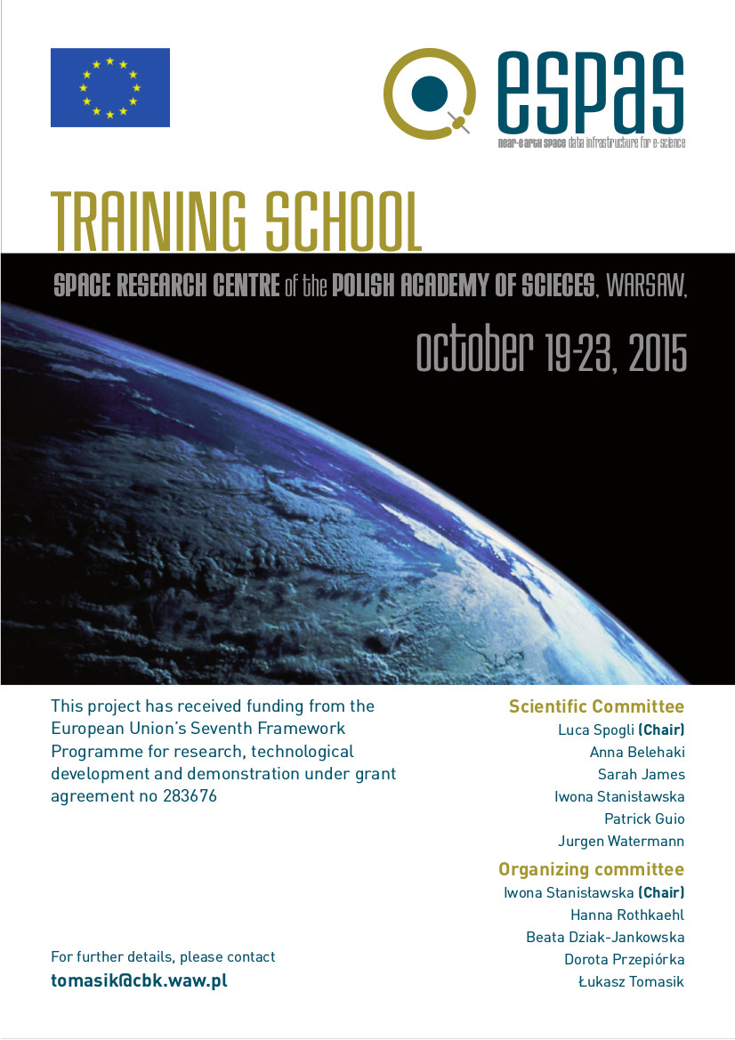

ESPAS: Near Earth Space Data Infrastructure for e-Science
FIRST ANNOUNCEMENT OF THE ESPAS TRAINING SCHOOL
School is addressed to PhD students and young scientists
Training on the use of the ESPAS system
School program includes:
  Scientific overview.
  Introduction about instruments/data/models available in ESPAS.
  Insights on ESPAS architecture, ontology and data model.
  Hands-on sessions on the ESPAS use (search and download, science cases, registration of new datasets, etc.)

