Slide 1
Requirement for transitioning radio heliophysics research into operations
David Jackson
Radio Heliophysics Infrastructure for Space Weather Science and Operations Splinter
ESWW11, Liege, Belgium, 17-21 November 2014
© Crown copyright Met Office

Slide 2
Overview
Current Met Office Monitoring and Modelling
  Observations requirements
  Monitoring
  WSA Enlil
Future Requirements
  New instrument at L5
  IPS – improvement on WSA; Enlil assimilation?
  Solar Radio Bursts

Slide 3
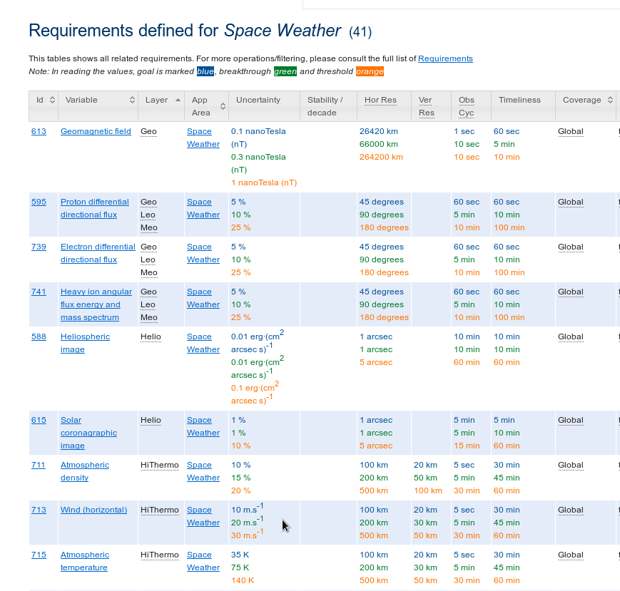
WMO Observing requirements
List of observations required for space weather operations – rolling requirements
Classed by physical variable, not observation
Goal / breakthrough / threshold reqs
http://www.wmo-sat.info/oscar/applicationareas/view/25

Slide 4
Monitoring

Slide 5
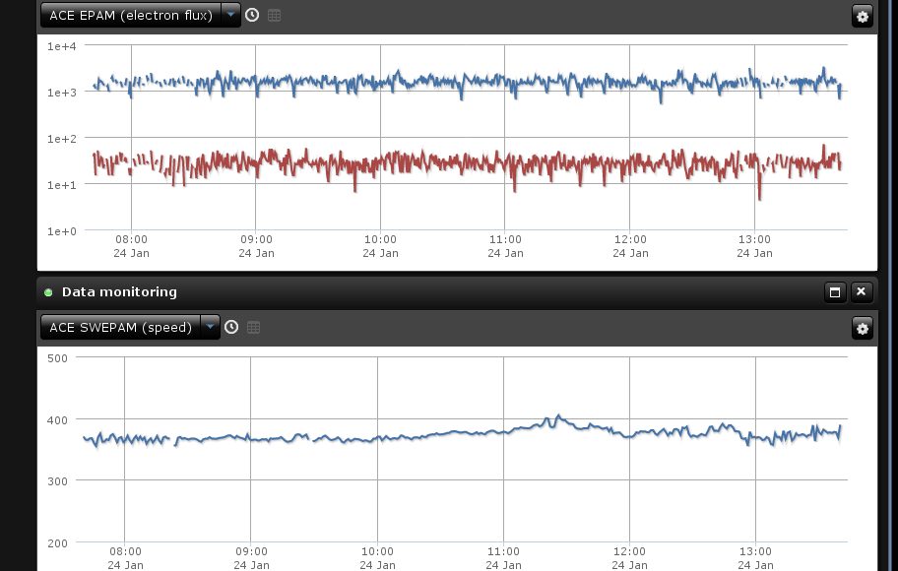
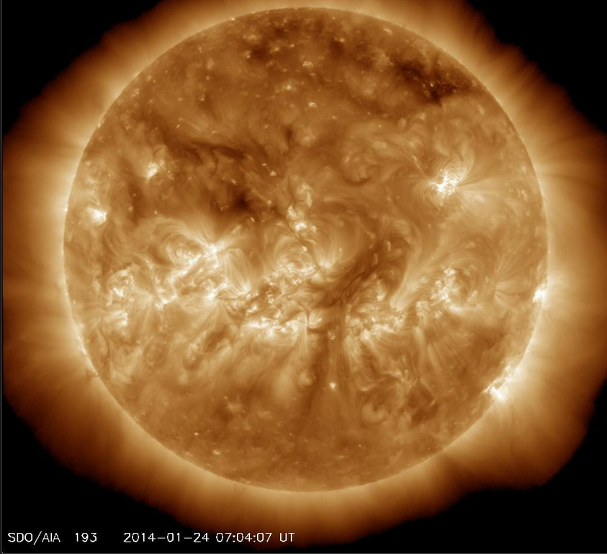
Monitoring
Real time data reception from NASA and NOAA
ACE
  Magnetometer – 1 min cadence, ~3 mins latency
  Also electron & proton flux density, proton temp, speed
  WMO: Typically goal/threshold for cadence; b/thru for latency
1 minute GOES X-ray fluxes
SDO: AIA, HMI magnetogram
GOES X-ray proton & electron flux, magnetometer
WMO: cadence mainly b/thru (mag < threshold), b/thru for latency

Slide 6
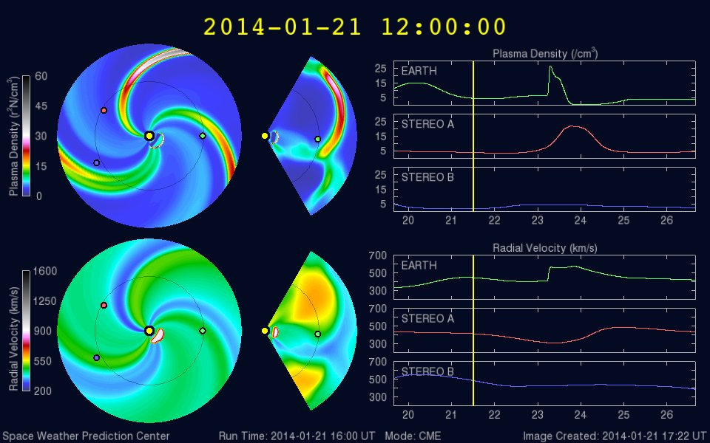
WSA Enlil
Run every 2 hours
Run completed / graphics produced around 4 hrs after model analysis time (ie T=0)
Observations:
  WSA – GONG Latency = 20 mins, cadence=hourly
  CME fitting –
    SOHO LASCO c2 & c3 (cadence=12 min; latency ~1-2 hrs (but gaps –sometimes ~ 5hrs)
    STEREO A&B cor2 (cadence=15 min; latency – 1-3 hrs.
    Occasional delays an issue. No STEREO until 2016
  Enlil – no data currently (may use STEREO or IPS in future?)

Slide 7
Future Requirements
© Crown copyright Met Office

Slide 8
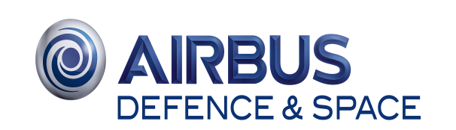




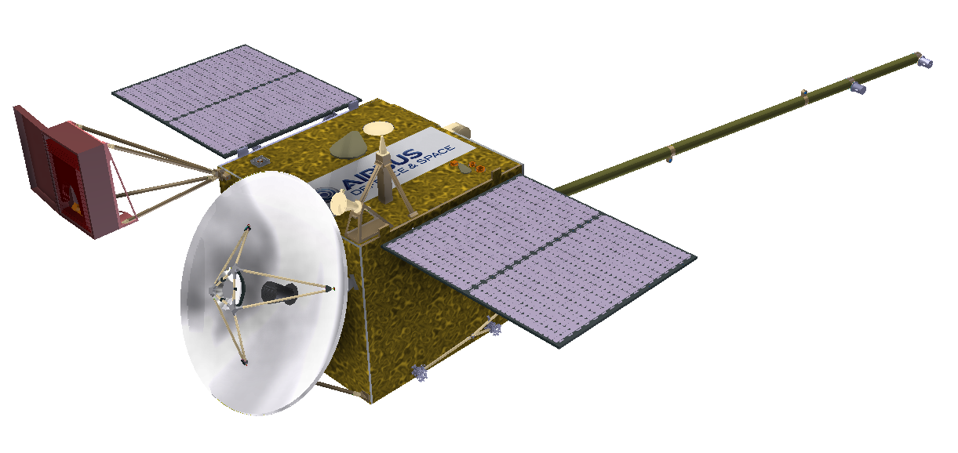
Proposal for “Carrington” – a UK Space Weather Mission
A Sun-Earth Sentinel at L5
First Operational Space Weather mission
Addresses MOSWOC requirements
High technology readiness, low risk, low cost
Fast transfer (<2 years) to L5 for a 10-year mission
24/7 operations, 100% coverage, continuous data
Excellent research output
Protects infrastructure hence growth
Excellent opportunity for UK/US bilateral
Instrument | Usage
Coronagraph | Identify Earth-directed CME
Heliospheric Imager | Identify Earth-directed CME, and image arrival at Earth
Particles/fields | Measurement of CIR approaching Earth.
Magnetograph | Image the magnetic structure of the photosphere and assess the potential for eruptions/flare.
For any queries:
markos.trichas@astrium.eads.net

Slide 9
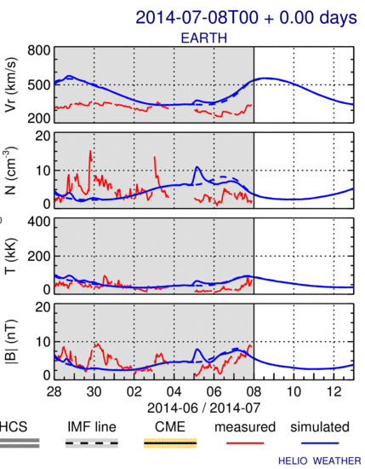
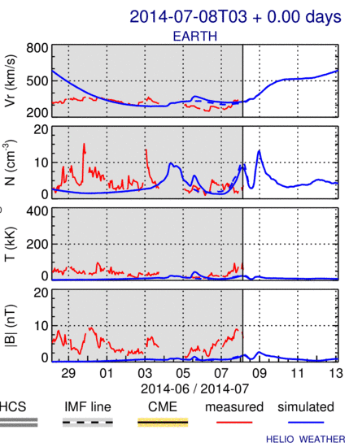
More Observations: IPS
Absence of STEREO highlights (over)reliance on STEREO & LASCO
Need to extend WSA Enlil to include other obs types – desirable as this increases system robustness
IPS - Ground based system:
WSA
Better solar wind forecasts:
  WSA replacement – (UCSD/KWSC (+ MetO/RAL?) work) – need to show skill scores consistently improve
  DA in Enlil domain?
Bz inference from Faraday rotation
  Bz warning times 10 x L1: ~3 ½ - 7 ½ hrs
  Harder science challenges but benefits in terms of cost, more rapid availability
IPS
Dusan Odstrcil

Slide 10
Solar Radio Burst Data
Useful to indicate presence of CMEs
Observation and detailed theoretical modelling of type II bursts can in principle provide warnings with lead-times of over a day for large and fast CMEs (Cairns and Schmidt)
Needs Space-based data (STEREO, Wind/WAVE) but the former currently N/A and the latter non-NRT
Ground based obs plentiful and NRT – but ionospheric cutoff makes CME tracking difficult
  Improved solar wind density and other models may lead to better interpretation / use of such observations in future?

Slide 11
Summary
Currently high reliance on finite-lifetime, science-focused, space missions
Need to develop operational space missions geared at NRT delivery, redundancy (2x instruments in place at one time with follow-on plan)
Need to diversify range of observations used in solar wind forecasts
  IPS offers good possibilities for improved initialisation of corona (WSA), assimilation in heliosphere (Enlil)
  Also Bz via Faraday rotation
  NRT type II radio burst data useful for CME warnings? Make case for future missions?
  Less clear about benefits of ground-based radio obs.

Slide 12
Questions?
© Crown copyright Met Office

