Slide 1
Lessons learned from
CCMC-led community-wide Model Validation Challenges.
Outlook on international coordination of M&V activities.
M. Kuznetsova, M. L. Mays, C. Wiegand, A. Pulkkinen, L. Rastaetter, J-S. Shim, M. Maddox
MODELS • DATA • TOOLS • SYSTEMS • SERVICES • DATABASES

Slide 2
Metrics & Validation
Forecasting
Methods ScoreBoards
Event-Based Metrics to Trace Model Improvement
Real-Time Validation
Model-data comparison with data available in real-time
2003/10/27 - 10/30
2006/12/13 - 12/16
2010/04/04 - 04/07
2011/08/05 - 08/07
………………………
Testing predictive capability before the event onset.
Sanity check
A list of events.
High quality data.
A library of metrics.
Simulate the same set of events over and over…
Examples:
CME Arrival
Flare
SEP
Examples:
TEC, Neutral density, Ground magnetic perturbations
Examples:
Magnetopause position
Mag. perturbations at geosynch. orbit

Slide 3
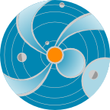
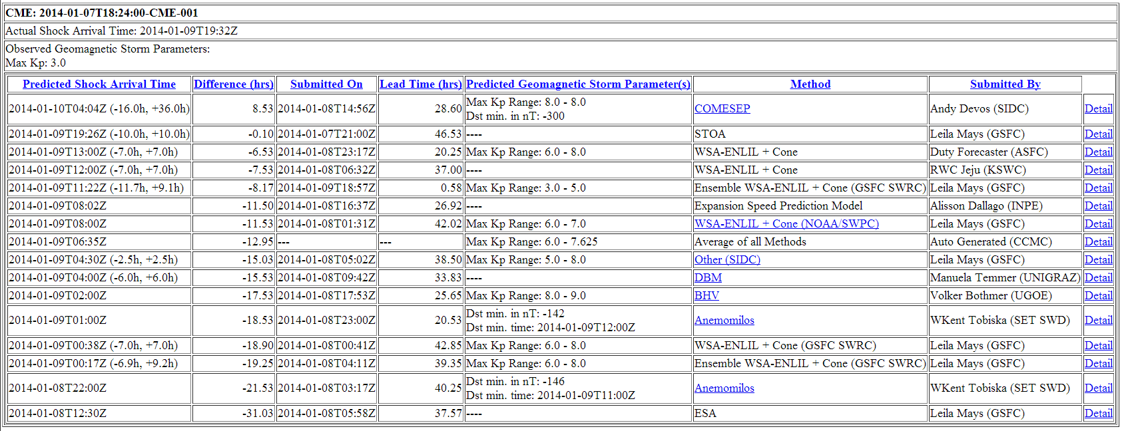
CME Arrival Prediction ScoreBoard
http://kauai.ccmc.gsfc.nasa.gov/SWScoreBoard/
The ScoreBoard is a research-based forecasting methods validation activity for CME arrival time predictions which provides a central location for the community to:
submit their forecast in real-time,
quickly view all forecasts at once in real-time,
generate experimental community-wide ensemble forecasts,
compare forecasting methods when the event has arrived
All types of prediction models and methods are welcome from the world-wide community. There are currently 17 registered CME arrival time prediction methods, including entries from the CCMC/SWRC, SWPC, UK MetOffice, KSFC, COMESEP
Average of all predictions is calculated for the user
Columns are sortable!(click column headings)

Slide 4
Flare Forecasts ScoreBoard Planning
Contacts: CCMC (Masha Kuznetsova, Leila Mays), MetOffice (Sophie Murray) + …
Web site:
First steps:
define file format for predictions,
automate file generation, uploading and archiving procedures,
move towards calibration of probability forecasts.
http://ccmc.gsfc.nasa.gov/challenges/flare.php
Sample file for full disk forecast:
#File name format: Flare_Forecast_modelname_yyyymmdd_hhmm.txt
Forecasting method: MAG4
Time: 2013-10-23T12:00Z
Input data: SDO/HMI LOS_Magnetogram
Prediction window (hours): 24
#Full Disk Forecast
#X_prob X_uncert X_Level M_prob M_uncert M_Level C_prob C_uncert C_Level
0.4000 0.0800 3 0.6800 0.0500 3 0.7500 0.0500 3
#X-prob, M-prob, C-prob: Probability of X, M or C class flare in decimal format (4 places)
#X_uncert, M_uncert, C_uncert: Uncertainty in X, M or C class flare probability in decimal format (4 places) (optional)
#X_Level, M_Level, C_Level: Calibration of probability for the model for X, M or C class flares (1=low, 2=medium, 3=high)
#Use ---- when leaving optional fields empty

Slide 5
Model Validation:
Elements of Metrics
Physical parameter most useful for specific applications.
Good quality observational data.
Algorithm for model-data comparison to produce skill score.

Slide 6
Community-Wide
Model Validation Efforts
Community-wide metrics studies (Modeling Challenges):
GEM (2008) – Magnetosphere,
CEDAR (2009) - Ionosphere
SHINE (2011) – Solar
Bring together modelers, data providers and users of space weather products to
define physical parameters and metrics formats relevant to specific space weather applications, prepare observational data.
address uncertainties and challenges in model-data comparisons.
trace model improvement over time.
CCMC supports Challenges:
Develop web interfaces and analysis tools.
Maintain interactive metrics archives.
Organize discussion meetings, sessions, workshops.

Slide 7
Examples of physical Parameters from GEM-CEDAR Challenges
Magnetic perturbations at geosynch orbits.
Magnetopause position.
Joule Heating/Poynting Flux along DMSP.
Auroral boundaries.
Neutral densities at CHAMP (~400 km) (point-by-point & orbit averaged).
Electron density parameters at CHAMP, ISRs, COSMIC.
TEC from ground-based GPS in eight 5° geographic longitude sectors.
Dst Index.
Magnetic perturbations (dB/dt) at ground stations and regional K.

Slide 8
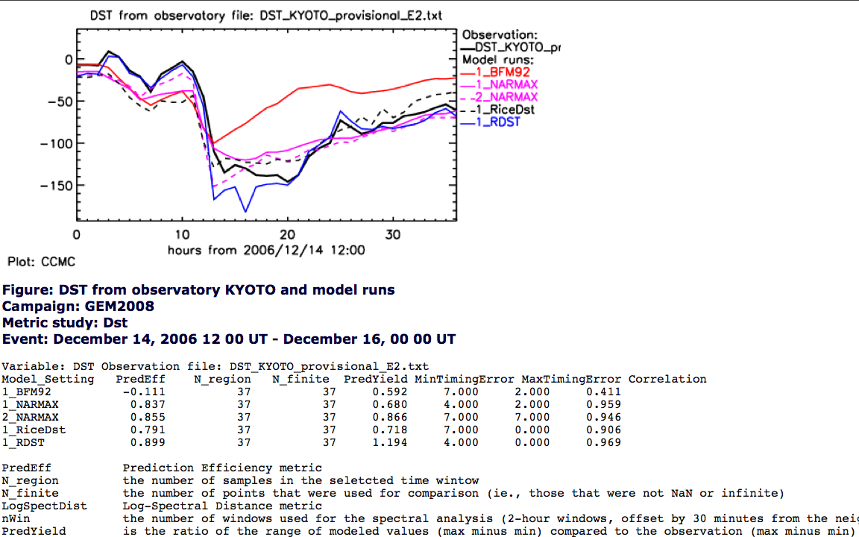
Automated Web-Based Validation System and Interactive Archive
Observed Dst (black) and models (colors)
Time series data from a wide variety of models and quantities.
Skill scores computed with plots.

Slide 9
Operational Geospace Model Validation
in support of SWPC geospace model selection
Community-wide efforts (2008 -2012) led by the CCMC established a foundation for operational geospace model selection based on model ability to reproduce dB/dt and regional K index.
6 events

Slide 10
Ongoing Event-Based Validation activities
Neutral densities at high altitudes (> 700 km).
TEC in large geographical areas (America, Europe, Australia). Collaboration with MetOffice (Suzy Bingham).
Auroral boundaries.

Slide 11
Event List
2001/088-093
2001/08/31 - 09/01
2002/142-145
2003/10/27 - 10/30
2003/323-326
2003/329-333
2005/05/14 - 05/16
2005/07/09 - 07/12
2005/08/31 - 09/01
2006/12/13 - 12/16
2010/04/04 - 04/07
2011/08/05 - 08/07
2011/09/24 - 09/29
2011/10/24 - 10/26
2012/01/20 - 01/23
2012/03/08 - 03/11
2012/07/14 - 07/17
2013/03/16 - 03/19
2013/05/31 - 06/04
2013/06/26 - 06/30
2013/07/05 - 07/09
2013/11/08 - 11/13
2014/02/18 - 02/23
GEM-CEDAR + MetOffice (Edmund Henley)

Slide 12
Metrics & Validation
Forecasting
Methods ScoreBoards
Event-Based M&V to Trace Model Improvement
Impacts vs Space Environment Events Forecasts
2003/10/27 - 10/30
2006/12/13 - 12/16
2010/04/04 - 04/07
2011/08/05 - 08/07
………………………
Surface Charging
Testing predictive capability before the event onset.
A list of events.
High quality data.
A library of metrics.
Simulate the same set of events over and over…
A need for database of space environment impacts.
Examples:
CME Arrival Prediction
Flare Forecasts
SEP Forecasts
Examples:
TEC, Neutral density, Ground magnetic perturbations
A need for database of
events & alerts.

Slide 13
Supplementary Material

Slide 14
List of Events in Solar Cycle 23
Events | Data currently/to be available/Providers | Previous/on-going/planned Studies | Notes
E.2006.347: 2006/12/13 - 12/16 | GPS TEC for eight longitude sectors/A. Coster and L. Goncharenko (MIT) and X. Pi (JPL) and IGS TEC provided by S. McDonald (NRL) COSMIC NmF2 and hmF2 for eight longitude sectors/ L. Lomidze and L. Scherliess (USU) Regional GPS TEC (North and South America)/A. Coster and L. Goncharenko (MIT) TIMED/GUVI and DMSP/SSUSI auroral data/Y. Zhang (APL) | TEC_lon (TEC for eight longitude sectors) NmF2, hmF2 (eight longitude sectors) Role of drivers TEC_regional (TEC for North and South America, and Europe) Auroral region | GEM/GEM-CEDAR event
E.2006.348: 2006/12/14 - 12/16 | GOES B fields Ground based magnetometers data DST index (Kyoto WDC, USGS) DMSP Poynting flux/D. Knipp CHAMP electron density CHAMP neutral density/E. Sutton (AFRL) NmF2 and hmF2 from COSMIC, CHAMP NmF2 and hmF2 from ISRs/J. Sojka (USU) and B. Rideout (MIT) Fabry-Perot Spectrometer neutral temperature and wind/Q. Wu (NCAR) Electron density and temperature from ISRs/J. Holt (MIT) Jicamarca vertical drift/J. L. Chau(IAP Rostock) and D. Anderson (UCB) | Magnetic field at geosynchronous orbit Ground magnetic perturbations DST index Poynting Flux Auroral region Electron density at CHAMP orbit Neutral density at CHAMP orbit (point by point comparison and orbit averaged value comparison) NmF2 and hmF2 (ISRs, CHAMP and COSMIC locations) Vertical drifts at Jicamarca Tn, neutral winds, and Te | GEM/GEM-CEDAR event
E.2001.243: 2001/08/31 - 09/01 | B fields at GOES Ground based magnetometers data DST index (Kyoto WDC, USGS) DMSP Poynting flux/D. Knipp CHAMP electron density CHAMP neutral density/E. Sutton (AFRL) Jicamarca vertical drift/J. L. Chau(IAP Rostock) and D. Anderson (UCB) | Magnetic field at geosynchronous orbit Ground magnetic perturbations DST index Poynting Flux Electron density at CHAMP orbit Neutral density at CHAMP orbit (point by point comparison) Vertical drifts at Jicamarca | GEM/GEM-CEDAR event

Slide 15
List of Events in Solar Cycle 23
Events | Data currently/to be available/Providers | Previous/on-going/planned Studies | Notes
E.2003.302: 2003/10/29 - 10/30 | B fields at GOES Ground based magnetometers data DST index (Kyoto WDC, USGS) DMSP Poynting flux/D. Knipp | Magnetic field at geosynchronous orbit Ground magnetic perturbations Dst Index Poynting Flux | GEM event
E.2005.135: 2005/05/15 - 05/16 E.2005.190: 2005/07/09 - 07/12 | DMSP Poynting flux/D. Knipp CHAMP electron density CHAMP neutral density/E. Sutton (AFRL) CHAMP RO NmF2 and hmF2 TIMED/GUVI and DMSP/SSUSI auroral data/Y. Zhang (APL) | Poynting Flux Auroral region Orbit averaged neutral density at CHAMP orbit | GEM/GEM-CEDAR event
E.2005.243: 2005/08/31 - 09/01 | B fields at GOES Ground based magnetometers data DST index (Kyoto WDC, USGS) DMSP Poynting flux/D. Knipp CHAMP electron density CHAMP neutral density/E. Sutton (AFRL) NmF2 and hmF2 from CHAMP NmF2 and hmF2 from ISRs/J. Sojka (USU) and B. Rideout (MIT) Jicamarca vertical drift/J. L. Chau(IAP Rostock) and D. Anderson (UCB) World Day Observations (WDO) (for 2005/09/01 from JRO, MLH, and SON ISR stations) TIMED/GUVI and DMSP/SSUSI auroral data/Y. Zhang (APL) | Magnetic field at geosynchronous orbit Ground magnetic perturbations DST index Poynting Flux Auroral region Electron density at CHAMP orbit Neutral density at CHAMP orbit (point by point comparison and orbit averaged value comparison) NmF2 and hmF2 Vertical drifts at Jicamarca Ne, Te, and etc. using WDO | GEM/GEM-CEDAR event
2003/01/01 - 12/31 2004/01/01 - 12/31 | HASDM density data at 600km altitude (3-hour averages over ~60deg x 60deg geographic blocks)/B. Bowman | Neutral density at 600 km altitude | GEM event
2003/07/19 - 12/31 2004/07/18 - 12/31 | HASDM orbit averaged data along the orbit of a Calsphere (at 800km altitude)/B. Bowman | Orbit averaged neutral density along the Calsphere at 800 km altitude | GEM event
2003/10/27 – 11/24 2004/07/18 – 07/31 2004/11/05 – 11/14 | HADSM orbit averaged data along CHAMP and GRACE orbits/B. Bowman CHAMP and GRACE orbit averaged neutral density/B. Bowman | Orbit averaged neutral density at CHAMP and GRACE orbits | GEM event

Slide 16
List of Events in Solar Cycle 24
Events | Data currently/to be available/Providers | Previous/on-going/planned Studies | Notes
E.2010.095: 2010/ 04/05 - 04/07 | CHAMP neutral density/E. Sutton (AFRL) ISS/FPMU electron density and Te/J. Minow (NASA) Ground based magnetometers data DMSP/SSUSI auroral data/Y. Zhang (APL) | Electron density and temperature Neutral density at CHAMP orbit (orbit averaged) Ground magnetic perturbations Auroral region | Single CME Dst_min= -81 nT ISS auroral charging observed GEM/GEM-CEDAR event
E.2011.217: 2011/08/05 - 08/07 | CHAMP neutral density/E. Sutton (AFRL) DMSP Poynting flux/C. Huang (AFRL) ISS/FPMU electron density and Te/J. Minow (NASA) Ground based magnetometers data DMSP/SSUSI auroral data/Y. Zhang (APL) World Day Observations (WDO) (from ARO and MLH ISR stations) | Electron density and temperature Neutral density at CHAMP orbit (orbit averaged) Ne, Te, and etc. using WDO Ground magnetic perturbations Auroral region Poynting flux | Multiple CMEs Dst_min= -107 nT Cheryl Huang’s choice GEM/GEM-CEDAR event
2011/09/24 – 09/29 | DMSP Poynting flux/C. Huang (AFRL) DMSP/SSUSI auroral data/Y. Zhang (APL) GRACE, GOCE, HASDM data/C. Huang (AFRL) | Poynting flux Auroral region Neutral density | Dst_min= -101 nT C. Huang’s choice
2011/10/24 – 10/26 | DMSP Poynting flux/C. Huang (AFRL) DMSP/SSUSI auroral data/Y. Zhang (APL) GRACE, GOCE data/C. Huang (AFRL) | Poynting flux Auroral region | Multiple CMEs Dst_min= -132 nT C. Huang’s choice
2012/01/20 – 01/23 | DMSP Poynting flux/C. Huang (AFRL) DMSP/SSUSI auroral data/Y. Zhang (APL) GRACE, GOCE, HASDM data/C. Huang (AFRL) | Poynting flux Auroral region Neutral density | Dst_min= -69 nT C. Huang’s choice
2012/03/08 - 03/11 | DMSP Poynting flux/C. Huang (AFRL) ISS/FPMU electron density and Te/J. Minow (NASA) DMSP/SSUSI auroral data/Y. Zhang (APL) GRACE, GOCE data/C. Huang (AFRL) | Electron density and temperature Auroral region Poynting flux Neutral density | Multiple CMEs Dst_min= -131 nT ISS auroral charging observed C. Huang’s choice
2012/07/14 - 07/17 | ISS/FPMU electron density and Te/J. Minow (NASA) | Electron density and temperature Auroral region | Single CME Dst_min= -127 nT ISS auroral charging observed Y. Zheng’s choice

Slide 17
List of Events in Solar Cycle 24
Events | Data currently/to be available/Providers | Previous/on-going/planned Studies | Notes
2013/03/16 - 03/19 | Regional GPS TEC (North and South America)/A. Coster and L. Goncharenko (MIT) ISS/FPMU electron density and Te/J. Minow (NASA) DMSP/SSUSI auroral data/Y. Zhang (APL) | TEC_regional Electron density and temperature Auroral region Poynting flux | Single CME Dst_min= -132 nT ISS auroral charging observed A. Coster’s choice
2013/05/31 – 06/04 | DMSP/SSUSI auroral data/Y. Zhang (APL) | Auroral region | Single CME + HSS Dst_min= -119 nT L. Mays and Y. Zheng’s choice
2013/06/26 – 06/30 | ISS/FPMU electron density and Te/J. Minow (NASA) DMSP/SSUSI auroral data/Y. Zhang (APL) | Electron density and temperature Auroral region | Single CME + HSS Dst_min= -98 nT ISS auroral charging observed L. Mays and Y. Zheng’s choice
2013/07/ 05– 07/09 | DMSP/SSUSI auroral data/Y. Zhang (APL) | Auroral region | Multiple CMEs Dst_min= -79 nT L. Mays and Y. Zheng’s choice
2013/11/ 08– 11/13 | DMSP/SSUSI auroral data/Y. Zhang (APL) | Auroral region | Multiple CMEs + HSS Two storm period; Dst_min= -81 nT, -70 nT L. Mays and Y. Zheng’s choice
2014/02/ 18– 02/23 | DMSP/SSUSI auroral data/Y. Zhang (APL) | Auroral region | Multiple CMEs Three storm period; Dst_min= -112 nT, -86 nT, -66 nT L. Mays and Y. Zheng’s choice

Slide 18
ISR WDO
Operating days |  | Kp_max | F10.7/F107ave | Stations
2001 | 04/17-19 | 7.3 | 133/169 | JRO, MLH, SON
 | 09/25-27 | 7.3 | 277/210 | ESR
 | 10/10-12 | 5.3 | 174/217 | MLH, SON
2002 | 04/17-24 | 7.3 | 195/184 | JRO, ARO, MLH, IST, SON, ESR
 | 10/05-31 | 6.3 | 159/167 | JRO, MLH, SON
2003 | 03/19-23 | 5.0 | 90/128 | JRO, SON
 | 05/27-29 | 5.7 | 134/127 | SON
 | 09/22-26 | 5.7 | 134/131 | JRO, SON
 | 10/21-23 | 6.0 | 150/135 | MLH, SON
 | 11/11-16 | 6.0 | 100/133 | JRO, SON
2004 | 11/09-13 | 8.7 | 138/102 | JRO, MLH, SON
2005 | 06/13-18 | 6.0 | 101/99 | JRO, MLH, SON
 | 09/01-30 | 7.7 | 120/89 | JRO, MLH, SON
2006 | 03/17-31 | 6.3 | 86/81 | JRO, MLH, SON
2011 | 08/01-10 | 7.7 | 113/105 | ARO, MLH
2012 | 06/12-14 | 5.0 | 147/129 | ARO, MLH
JRO: Jicamarca, ARO: Arecibo, MLH: Millstone Hill, IST: Irkutsk, SON: Sondrestrom, ESR: EISCAT Svalbard Radar

