Slide 1
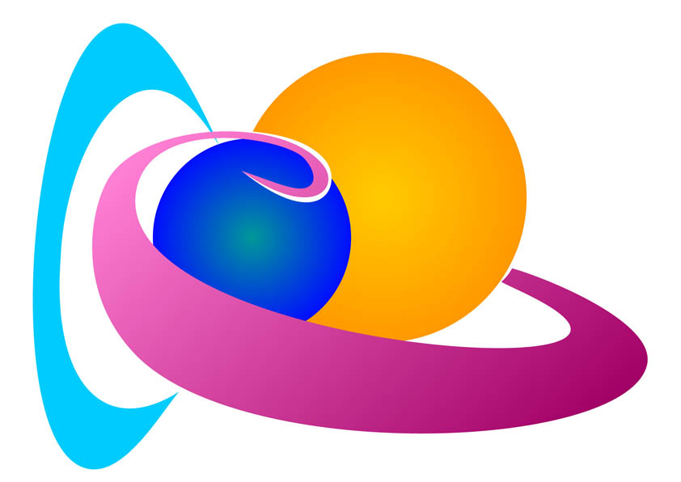
Space Weather Prediction
Become a forecaster in less than 3 hours
Petra Vanlommel
Solar-Terrestrial Centre of Excellence

Slide 2
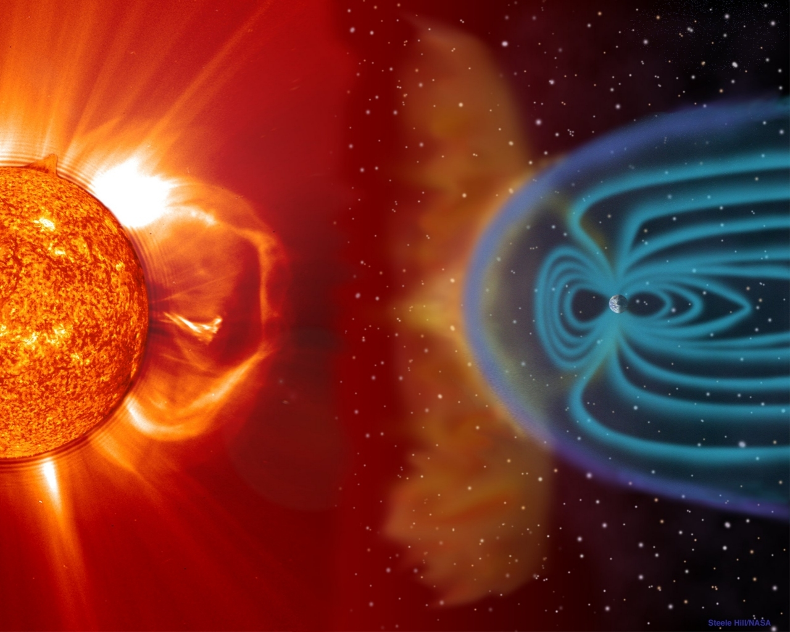
From Sun to Earth
Daily forecast
Fast alerts
Bulletins
Radiation-flares
10cm flux
Protons
Mass-Solar wind
CME
Coronal holes
IMF
Geomagnetism

Slide 3
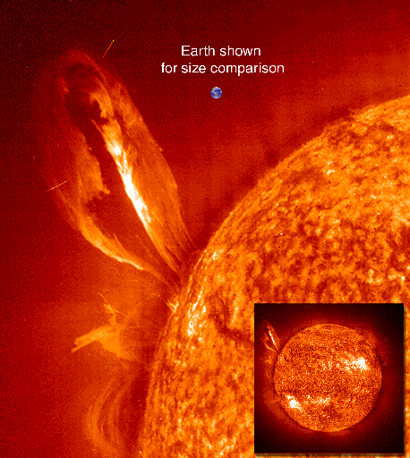
The daily forecast
Email
Internet

Slide 4
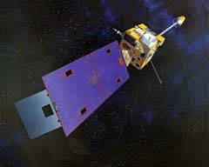
Solar Flares
Light Flashes
Klasse
Maximum Flux
log₁₀(P) in Wm⁻²
A
-8
B
-7
C
-6
M
-5
X
-4
Space Weather predictions - Flares
Notes:
Dagkant

Slide 5
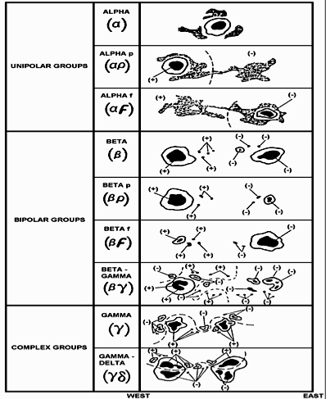
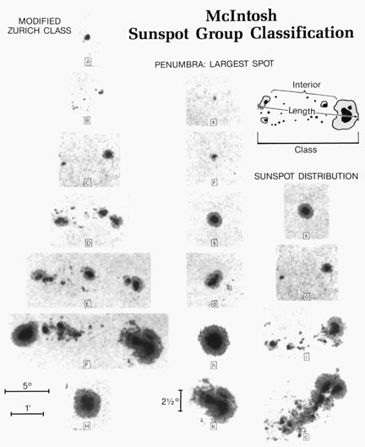
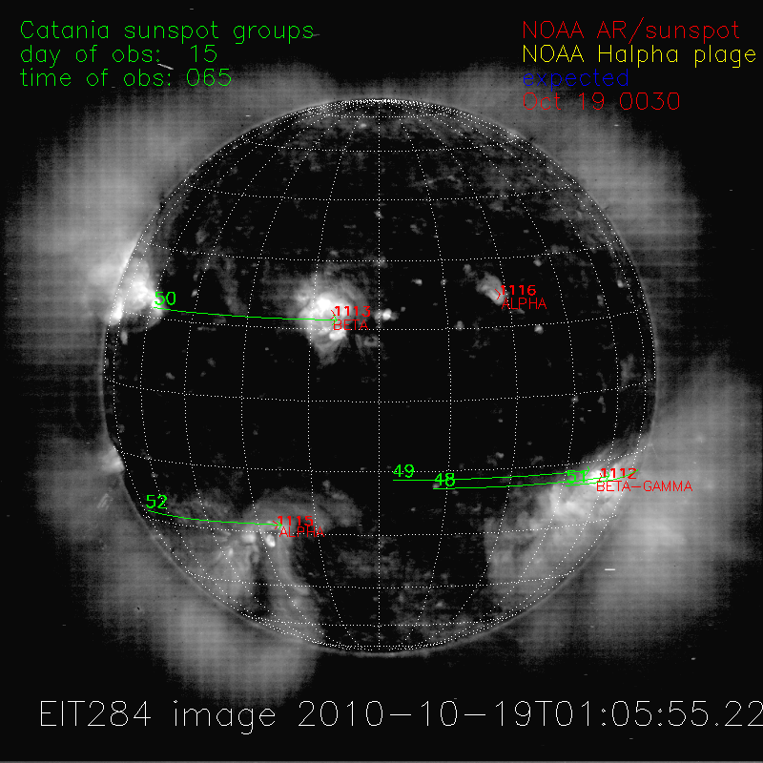
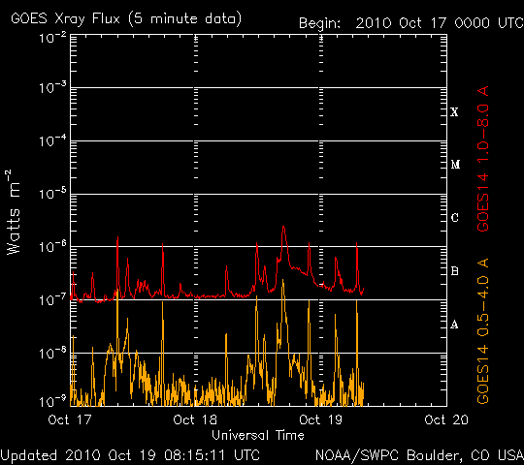
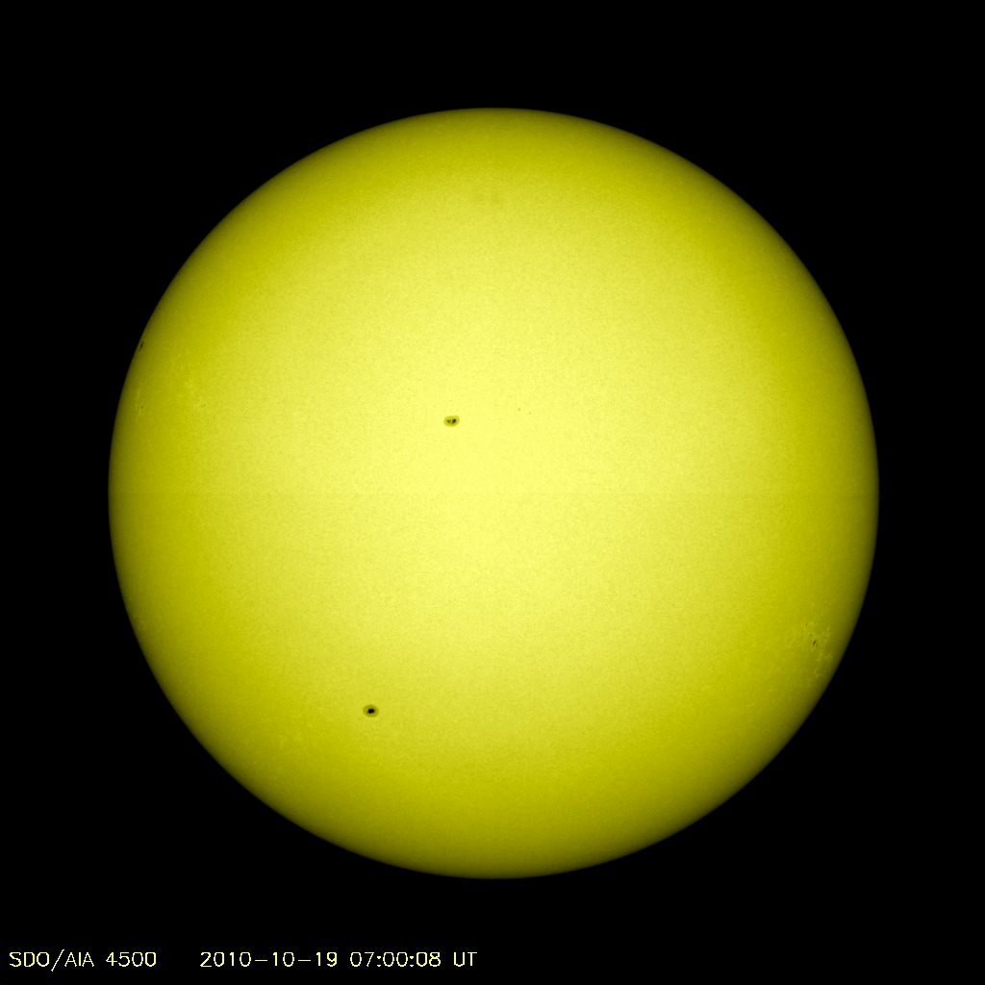
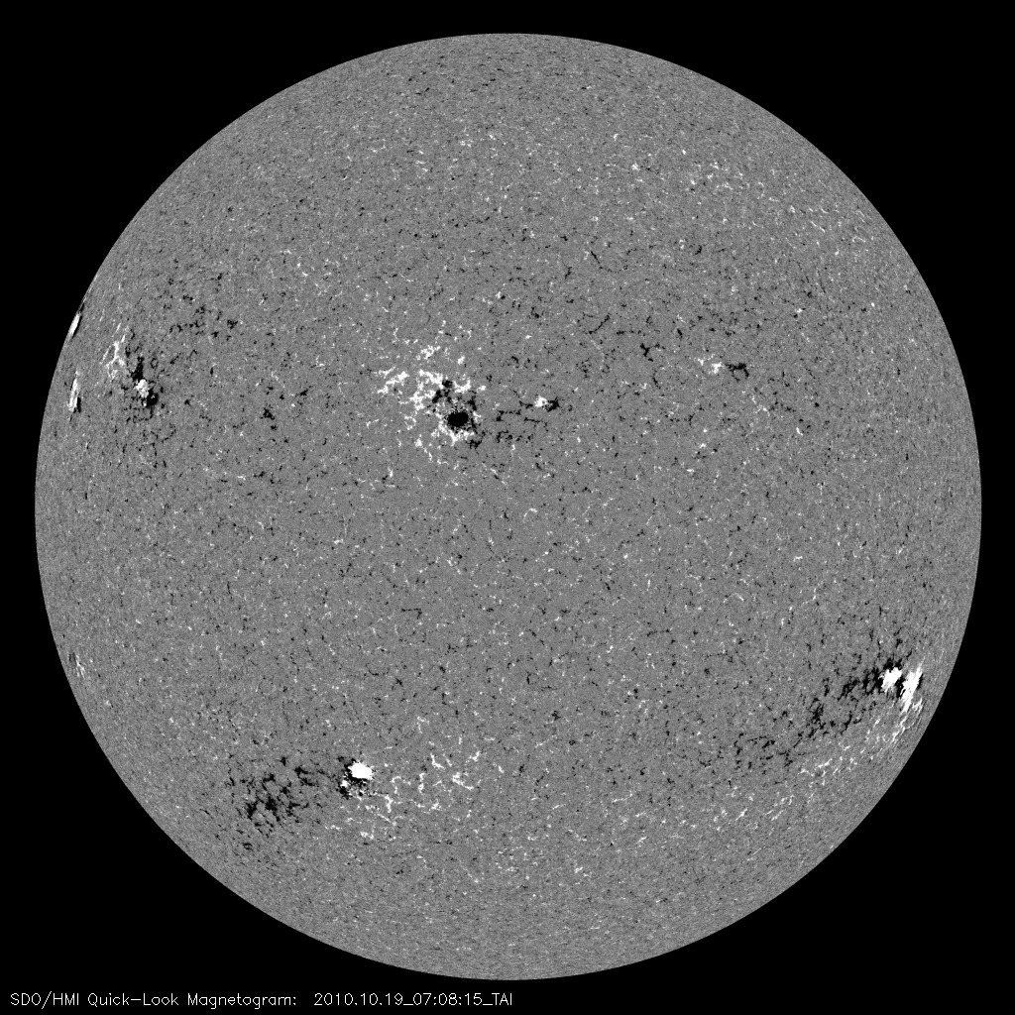
Flare prediction
Space Weather predictions - Flares
Notes:
MDI: in (black,-, south) or out (white,+, north) , line of sight
Flares situated between the central meridian and the western limb are therefore more likely to have a prompt impact on the radiation environment near the earth. (parker spiral)

Slide 6
STEREO Behind as appetizer

Slide 7
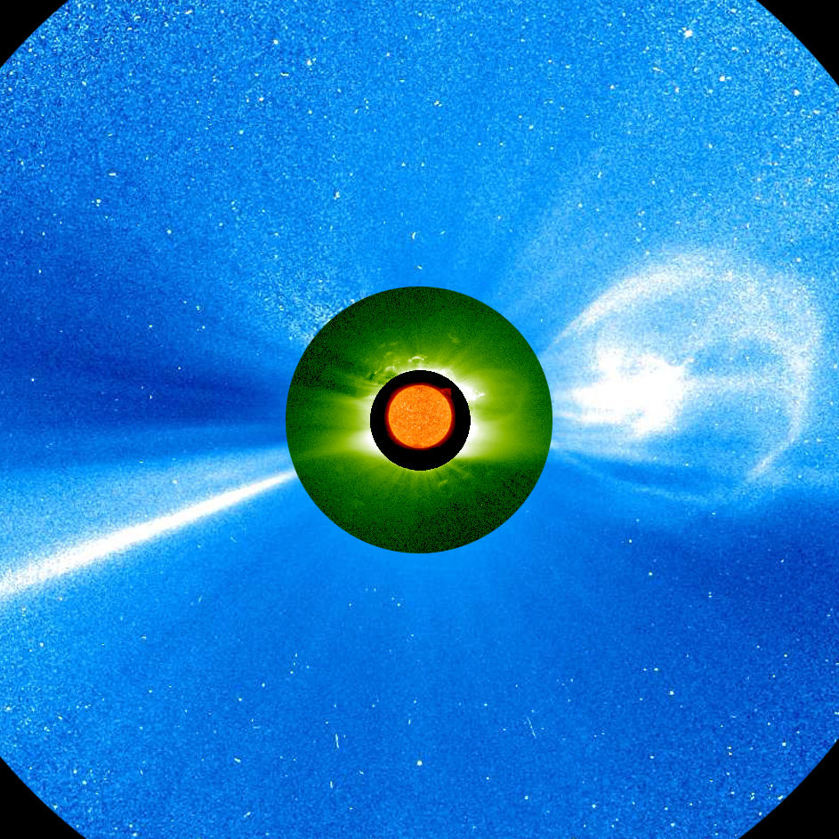
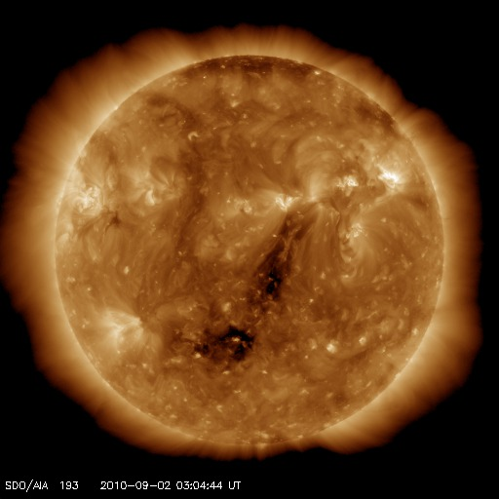
Geomagnetic Conditions
Solar Wind data - ACE
CME
Coronal hole
Boundary sector crossing
Notes:
To determine the geomagnetic conditions, check the solar wind data. This data can be forecasted based on CME and Coronal hole occurrence. It takes the plasma around 3-5 days to arrive at Earth.

Slide 8
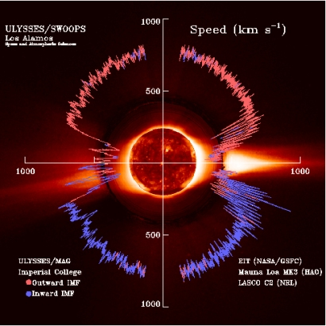
SLOW versus FAST
250-400 km/s
High density: ~ 10 cm⁻³
Low temperature: ~ 10⁴ K ~ 1 eV
Very variable
1998
400 - 800 km/s
Low density: ~ 3 cm⁻³
High temperature: ~ 10⁵ K ~ 10 eV
Stationary for long times

Slide 9
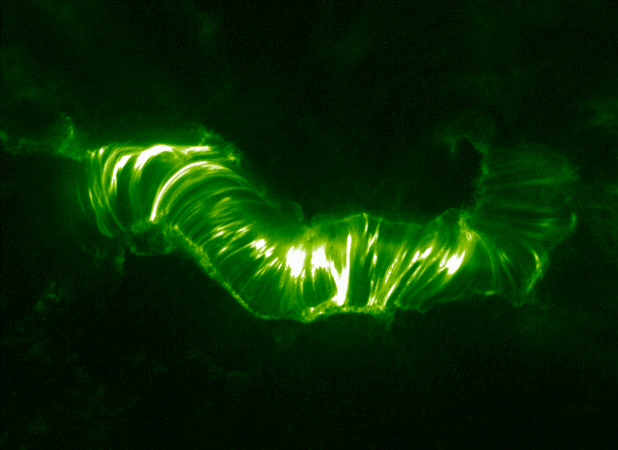
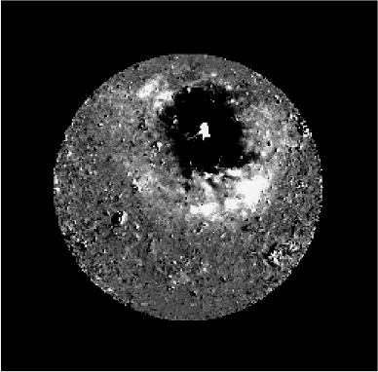
Signatures of a CME in EUV
Post-eruption loops
EUV waves
Prominence eruptions
Dimming
Geomagnetic conditions -CME
Notes:
EIT wave: isotropic diffuse wave front in the low corona was found to propagate outward from the flaring active region with a velocity of 250 km/s. They become anisotropic when the magnetic field on the Sun becomes more complicated and they tend to not pass strong magnetic features or neutral lines. It is unlikely that pressure pulses from flares generate EIT waves. Near solar minimum, they are more easy to detect.
In modern coronal physics, solar image processing (SIP) appears more and more as a needed and timely tool.
SIP is necessary because of:
the large sizes of the current and future missions/observatories archives,
the wish to process solar data automatically in order to evidence hidden trends (e.g. solar cycle or instrumental effects),
the need for systematic detection of rare or faint events such as EIT waves.
This quest is even more acute in the context of Space Weather forecasting where quasi-real time is required. As additional benefits, the algorithmic techniques provide reproducibility and some level of objectivity. They also alleviate the effort of expert forecasters. They are sometimes able to reveal information that would remain otherwise buried in the noise or in the dynamics. Finally, they improve data representation and visualization.
The necessity comes furthermore at a propitious time when the available CPU power and the underlying mathematics have developed considerably.
Space weather applications need real-time alerts
Science applications want objective catalogues
Human detection is expensive & slow.
Coronal mass ejections are associated to a whole list of interesting phenomena:
Flares, dimmings, eit waves, prominence eruptions, etc. Their mutual relation (casual?) is not fully understood and their observation/analysis is ussually incomplete or late.
SDO will bring a lot of new disc images. STEREO will bring a lot of new coronagraphic images.
We prepare for these missions by using mathematical techniques from the field of image processing and do automated feature recognition. Our ultimate ambition is to set up software that monitors all available data and that warns the space weather community of any significant space weather event.
Some subproblems have been solved completely (eg flare detection) or are very close (CME detection).
Others are more experimental (EIT wave detection, flare precursor detection).
Automatically detect CMEs in coronagraphic images
Make objective interpretation possible
Detect CMEs 24h per day + send halo alerts
Determine first estimates of CME parameters

Slide 10
CACTus
SOHO/LASCO – near real time
STEREO A/B COR2 – 3 days delay
Geomagnetic conditions -CME

Slide 11
Structure of a CME
Shock, if the ICME is fast enough
Followed by shocked sheath plasma
Compressed – heated - oscillating magnetic field
Followed by the driver gas, ie ICME
Strong B/low variance/large-scale smooth field rotation
T depression
Geomagnetic conditions -CME
Notes:
A CME-driven shock has larger angular extent than the CME itself!
To be geoeffective, the CME-associated disturbance should:
1) arrive to the Earth;
2) have a suitable magnetic field configuration: IMF Bz component should be negative (southward), strong enough and long-lasting.
Even CMEs originating at the limb can arrive to the Earth (provided they are wide enough). In Most of such cases however, only the inerplanetary shock is observed as the angular extend of the shock is larger than that of a corresponding CME. The CME thus misses the Earth and only the shock arrives. (magnetically connected)
An example: October 21, 2003: EIT wave observed above the eastlimb, as it was propagating from the active region behind the limb as indicated by the rising post-eruption loops. However, the eruption was so powerful and wide that the corresponding CME was a full halo.
Shock (if the ICME is fast enough)
…followed by shocked sheath plasma (compressed and heated, with oscillating magnetic field)
…followed often by the driver gas (ICME itself):
Strong magnetic field
Temperature depression: typically < ~ 105 K ~ 10 eV
Low variance of the magnetic field
Large-scale smooth field rotation (magnetic cloud): in about 30% of cases
Composition signatures (increased a/p and O/O ratios etc.)
Bi-directional electrons

Slide 12
Types of flux ropes
Left-handed flux ropes
Right-handed flux ropes
ENW
WNE
SEN
NWS
NES
SWN
WSE
ESW
Geomagnetic conditions -CME
Notes:
6 out of 8 flux rope types contain southward Bz!
Additionally, one should not forget the sheath plasma!

Slide 13
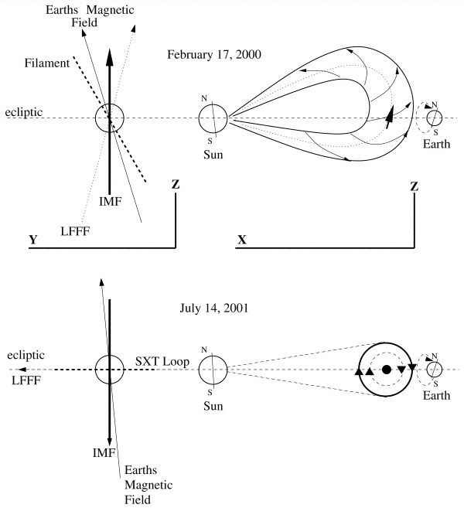
Flux rope orientatie
SOHO/EIT
Fe XII bandpass
(195 Å)
SOHO/MDI
(Yurchyshyn et al. 2000)
Geomagnetic conditions -CME

Slide 14
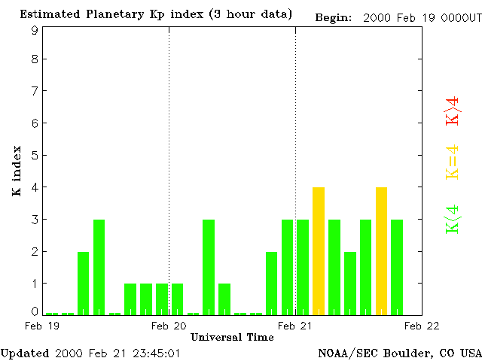
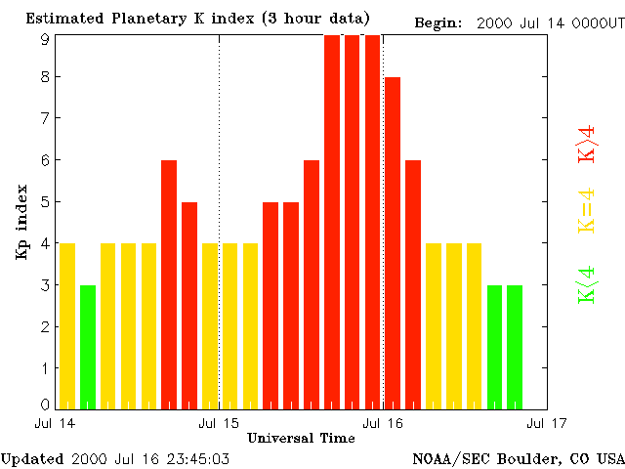
Geomagnetic result
(Yurchyshyn et al. 2000)
Geomagnetic conditions -CME
Notes:
Yurchyshyn et al. (2001) showed that for the full halo CME on February 17, 2000 the
source region neutral line was oriented along the north – south direction, similarly to
the resulting interplanetary flux rope orientation. As the axial field in the flux rope was
northward, the magnetic cloud produced only a very weak geomagnetic disturbance. On
the contrary, the halo CME on July 14, 2000 (“Bastille day”) originated from an active
region with the neutral line oriented along the east – west direction. This orientation will
produce a negative Bz either in the leading or in the trailing part of the flux rope.
The inclinations of the flux rope axes close to the Sun and in the heliosphere do not
always correspond to each other. The neutral line in the event of May 12, 1997 had the
north – south orientation (Webb et al. 2000b), and, if its inclination is conserved, the
flux rope had to have the ENW orientation, i.e. to be not geoeffective. However, the
interplanetary flux rope was of the SEN type and produced a major geomagnetic storm.
The reason for such a change of orientation seems to be that during the low activity years
the CMEs are deflected by the fast flows from polar coronal holes (Cremades & Bothmer
2004) and thus have the tendency to have a small inclination with respect to the ecliptic
plane. The CME on February 17, 2000 propagated without such an influence because of
the absence of polar coronal holes during the activity maximum. Another explanation
(Webb 2002) suggests that the interplanetary flux rope results rather from the large-scale
dipole field than from the local bipolar field of the source region.

Slide 15
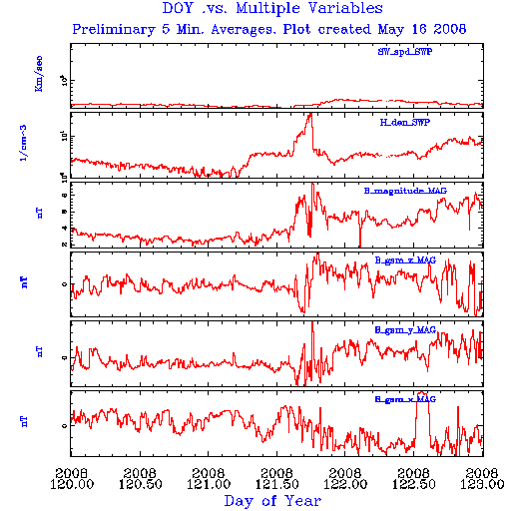
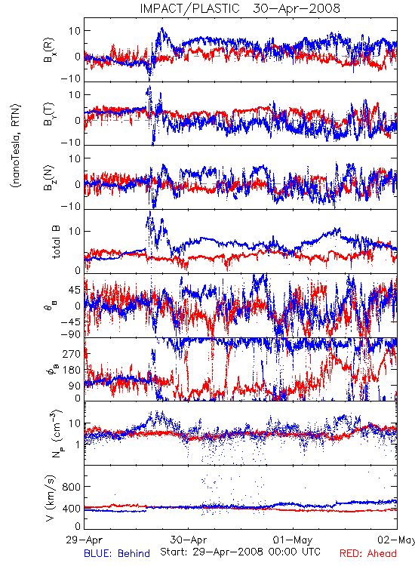
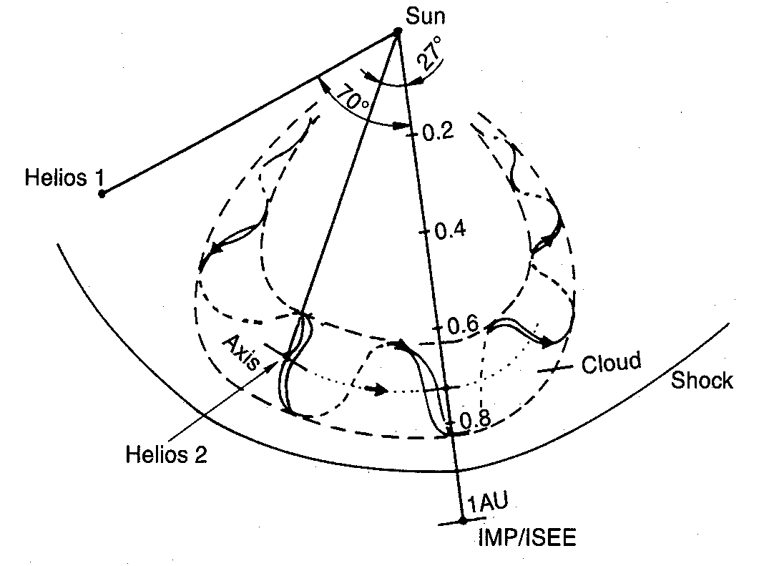
STEREO in situ data
(Bothmer & Schwenn 1998)

Slide 16
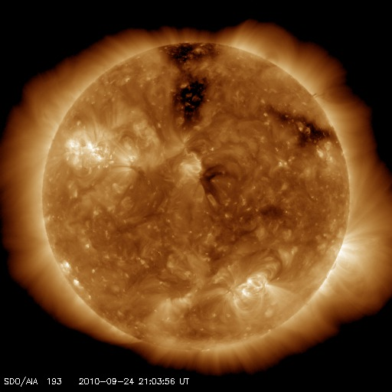
Coronal Holes
Geomagnetic conditions –Coronal Holes
Notes:
The heliospheric current sheet persists into the outer heliosphere and is responsible for both local and global phenomena in the solar wind. Moreover, for a uniform plasma density at the base of the corona, easier escape of the plasma particles will cause the plasma density on open field lines to be smaller (and the outflow speed larger) than on closed field lines at the same distance from the Sun. This concentration of plasma in the solar equatorial band is expected to produce higher levels of thermal X-rays and other emission (Figure 11.2), as indeed observed.

Slide 17
The IMF according to a Coronal Hole
Geomagnetic conditions –Coronal Holes

Slide 18
Scheme of a CIR
Geomagnetic conditions –Coronal Holes

Slide 19
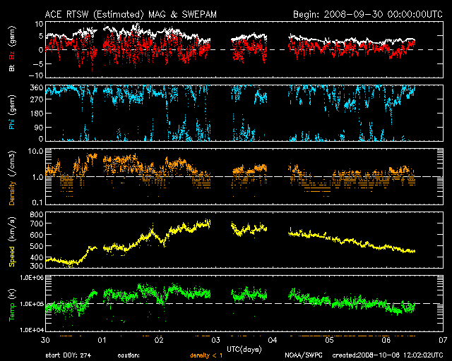
In Situ
Geomagnetic conditions –Solar wind parameters

Slide 20
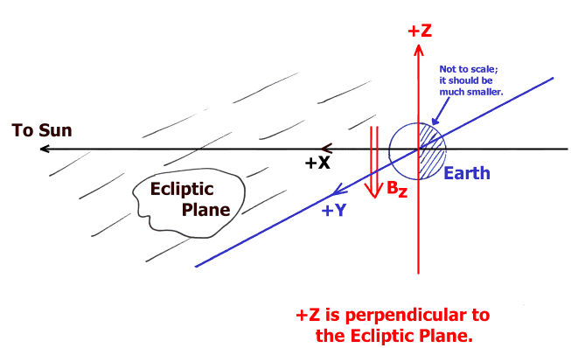
Coordinate system
Geomagnetic conditions –Solar wind parameters
Notes:
Geocentric Solar Magnetospheric
Geocentric Solar Ecliptic
Magnetische veldlijnen gaan van magnetisch noorden(+) naar magnetisch zuiden(-). Tijdens maximum is er een flip van magnetisch veld. Nu: magnetisch zuiden in noordelijke hemisfeer, magnetisch noorden in zuidelijke hemisfeer (figuur is dus fout).
Flip tijdens februari 2001 (maximum).

Slide 21
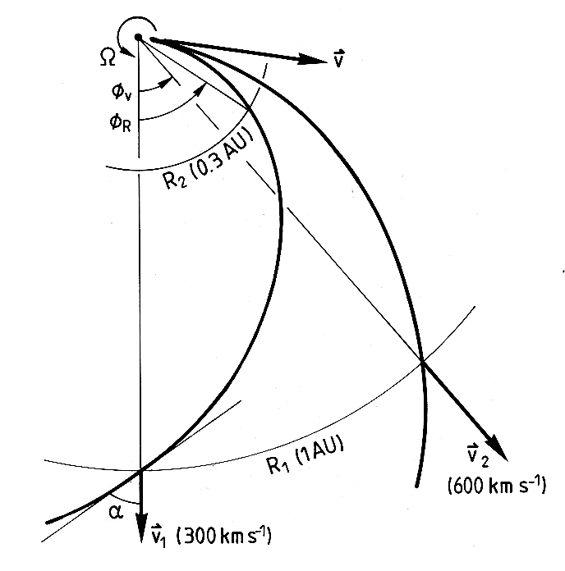
IMF polarity
for 400 km/s
ϕ ~ 135°
for 400 km/s
ϕ ~ 315°
Geomagnetic conditions –Solar wind parameters

Slide 22
When did the plasma leave the Sun
Distance
150 10⁶ km
Speed
700 km/s
Time needed
214 285 s
=2.48 days
=> 30 Sept
Geomagnetic conditions –Solar wind parameters

Slide 23
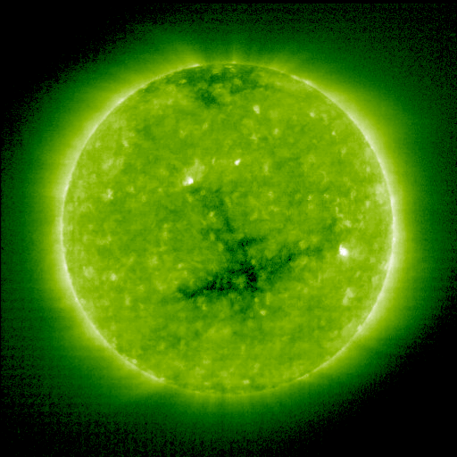
At time of leaving

Slide 24
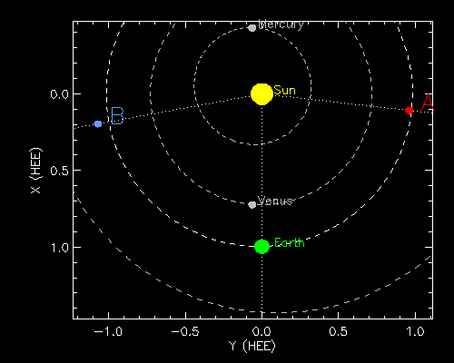
STEREO B as an appetizer

