Slide 1
Exercises
Become a forecaster in less then 3 hours
Petra Vanlommel
Solar-Terrestrial Centre of Excellence

Slide 2
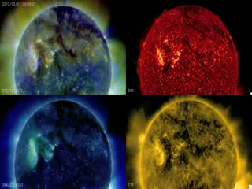
A solar event: Aug 1
August 1 event

Slide 3
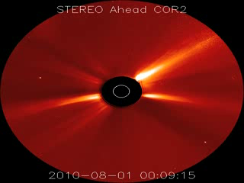
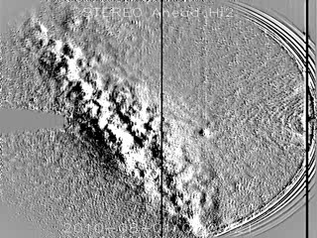
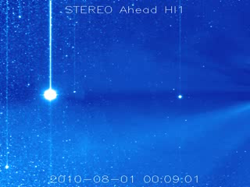
An energetic trip from the Sun to the Earth
Lasco was not available, STEREO A/B were
Real time calculation based on coronographic images
Post-check: Cactus
August 1 event

Slide 4
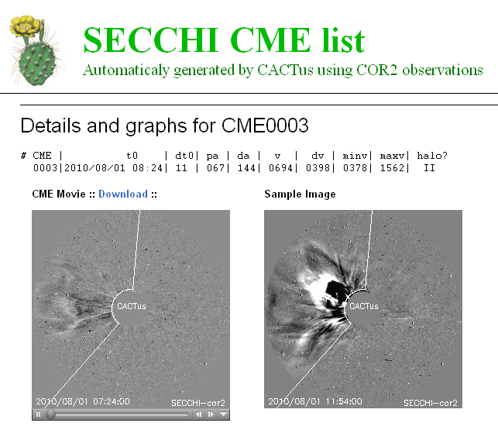
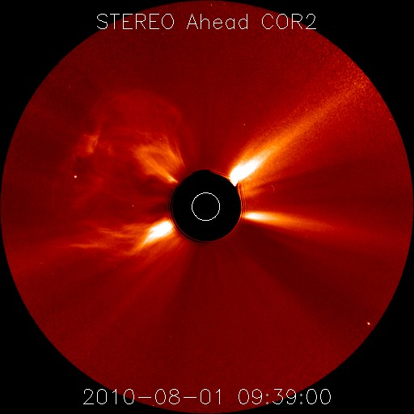
Real time calculation – STEREO A
Solar diameter = x’ pix
08:24:00 UT → y’ pix
09:39:00 UT → z’ pix
75 min = 4500 sec → z’-y’ pix
(z’-y’) * 1392000 / (4500*x’) km/sec

Slide 5
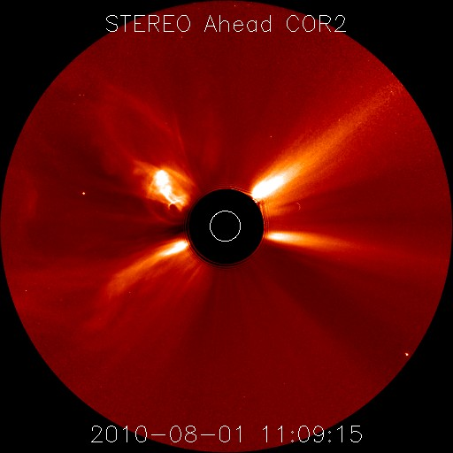
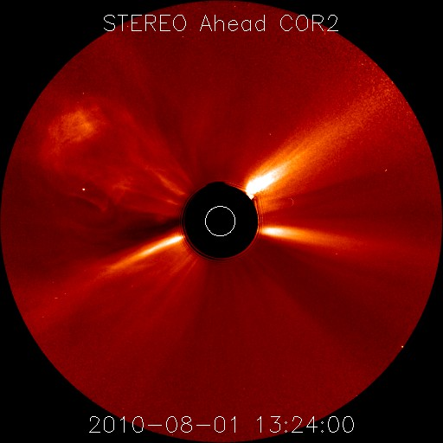
Real time calculation – STEREO A
Solar diameter = x’ pix
11:09:15 UT → y’ pix
13:24:00 UT → z’ pix
.... sec → z’-y’ pix
(z’-y’) * 1392000 / (.....*x’) km/sec

Slide 6
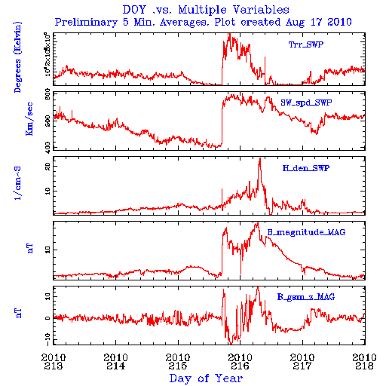
ACE: at arrival
The August 01 event

Slide 7
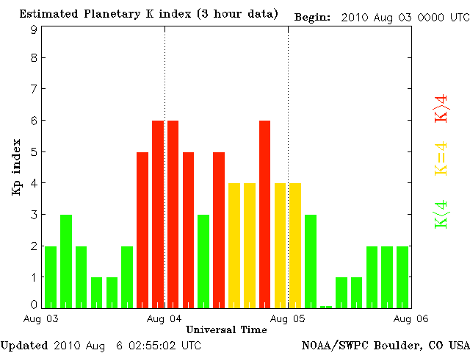
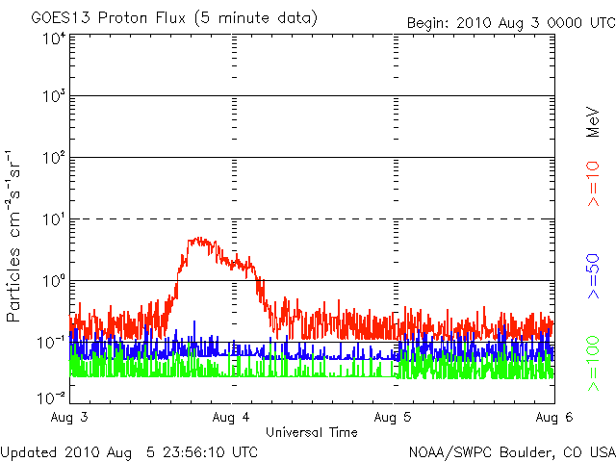
At Earth - Geomagnetic response
The August 01 event

Slide 8
October 10, 2010
What happened on the Sun?
Could it be expected/predicted?
EUV movies - (In)stable filament
Would there be an effect on Earth and when?
Find images from SOHO/LASCO – STEREO COR2/calculate the speed of the CME/direction
Check with CACTus
Arrival at L1 can be checked in ACE-data: http://www.srl.caltech.edu/ACE/ASC/browse/view_browse_data.html use ‘day of the year’ (google)
How big was the effect on Earth? - Kp

Slide 9
Speed calculation based on STEREO A/B
Solar diameter = x pix
02:40:23 UT → y pix
06:55:23 UT → z pix
4h 15 min = 15300 sec → z-y pix
(z-y) * 1392000 / (15300*x) km/sec
Solar diameter = x’ pix
01:24:24 UT → y’ pix
05:54:24 UT → z’ pix
4h 30 min = 16200 sec → z’-y’ pix
(z’-y’) * 1392000 / (15300*x’) km/sec

Slide 10
Report
A filament located in the south east of the solar disk erupted late on Oct 10. In SOHO/LASCO images, the CME was seen as a partial CME. In STEREO Ahead/Behind COR2 it is seen from aside. The speed calculated from STEREO Ahead images by the CACTus software, is 297 km/s; from STEREO Behind images, 337 km/s.
ACE data showed a rather sudden enhancement of the magnetic field carried in the solar wind on Oct 15. The speed jumped at 03UT from 280 km/s to 290 km/s. The density increased slightly. This was possibly the passage through the shock in front of the CME associated with the filament eruption of late Oct 10. The IMF stayed turbulent until Oct 17. Probably, ACE passed side away along the shock. This glancing blow lead to one period with active conditions on Oct 17.

Slide 11
October 06, 2010
What happened on the Sun?
X-ray flux
SDO AIA 304/193 – SWAP
Could it be expected/predicted?
Would there be an effect on Earth and when? –Earth directed – arrival time
STEREO - LASCO
CACTus
ACE-data: http://www.srl.caltech.edu/ACE/ASC/browse/view_browse_data.html use ‘day of the year’ (google)
How big was the effect? - Kp

Slide 12
Report on this event
Oct 06, a filament erupted. The shock and the CME arrived on Oct 11. The total interplanetary magnetic field (IMF) rose to values between 10 and 15 nT. ACE passed the shock heading the actual CME. We suspect that ACE passed along a leg of the plasma cloud measuring a negative Bz for a long period. The Bz was shifting slowly to zero. This negative Bz of the IMF is optical for reconnection and lead to a short minor geomagnetic storm on Oct 11.

Slide 13
Oct 16, 2010
What happened on the Sun?
EUV movies – SWAP – STEREO – SDO
X-ray data
Could it be expected/predicted?
SDO – magnetogram
EUV movies – SDO - SWAP
Was there an associated CME?
Coronal dimming – EUV wave
X-ray flux: Long duration event

Slide 14
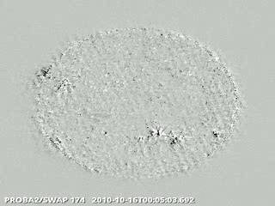
Report
Oct 16, AR 1112 was responsible for an M2.9 flare peaking at 19:12UT. The event lasted only for 8 minutes. In SWAP images, a small coronal dimming is visible. Although the large filament in the vicinity of this active region did not erupt. SOHO/LASCO and STEREO/SECCHI didn't show any evidence of an associated, strong CME.

Slide 15
Forecast
http://sidc.be/previweb_demo

